Slide 1
American Regionalism and Thomas Hart Benton
Names

Slide 2
Notes:
What is American Regionalism and when did it happen? Include an image

Slide 3
Notes:
Name three artists who are considered American Regionalists and include artworks by them.

Slide 4
Notes:
1. What did Thomas Hart Benton paint? Include an image and a description OR- how does this tie into American Regionalism?

Slide 5
Notes:
2. What different subject/topic did Thomas Hart Benton paint? Include an image and a description OR- how does this tie into American Regionalism?

Slide 6
Notes:
3. What different subject/topic did Thomas Hart Benton paint? Include an image and a description OR- how does this tie into American Regionalism?

Slide 7
Notes:
4. What different subject/topic did Thomas Hart Benton paint? Include an image and a description OR- how does this tie into American Regionalism?

Slide 8
Notes:
5. What different subject/topic did Thomas Hart Benton paint? Include an image and a description OR- how does this tie into American Regionalism?

Slide 9
Notes:
Provide the image and description of either the painting or lithograph of the 1951 Midwest flood

Slide 10
Notes:
Name a famous artist that Thomas Hart Benton taught. Please show images of his work.

Slide 11
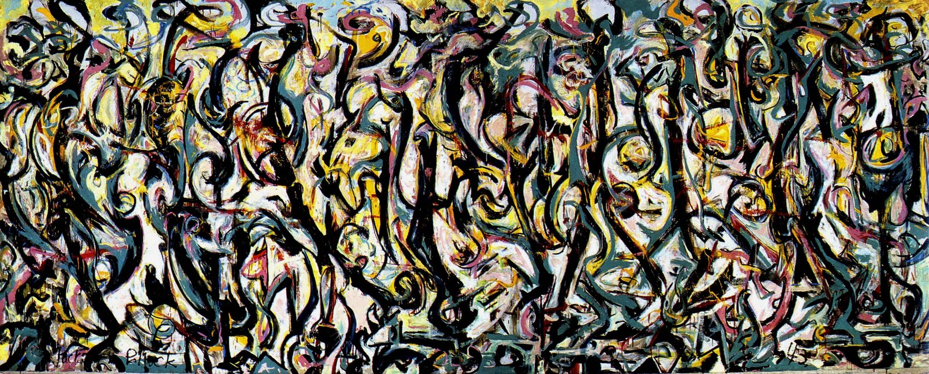
Jackson Pollock
Mural 1943
Thomas Hart Benton
Achelous and Hercules, a 1947 mural made for a Kansas City department store, now in the Smithsonian American Art Museum
Notes:
Compare and Contrast the two works of art

Slide 12
Jackson Pollock
Mural , 1943
Thomas Hart Benton
Achelous and Hercules, 1947
How is this painting different?
?
?
?
How is this painting different?
?
?
?
What do these paintings have in common?
?
?
?
Notes:
Compare and Contrast the two works of art

Slide 13
Answer goes here…
Notes:
This painting is a great example of Benton’s “bump and hollow” technique. Looking at the painting, what do you think “bump and hollow” is referring to?

Slide 14
Notes:
What was the last painting Benton made? Give some details about his death or about his final painting

Slide 15
Notes:
Look back at slides 4-8 where you researched different topics that Thomas Hart Benton portrayed. Select one of these topics for your own painting. What will you paint? YOU ARE NOT ALLOWED TO COPY ANY OF THE THB PAINTINGS. Please provide reference photos for you to paint from. You can use as many slides as needed for your photos. YOU ARE NOT TO COPY ONE ENTIRE PHOTOGRAPH, but you may copy pieces from several images to compile together to create your own composition. Please provide a description of what you will paint and why you chose to paint this along with your photographs.

Slide 16
When done
Email your finished PP to heather.sulzen@nkcschools.org

