Slide 1
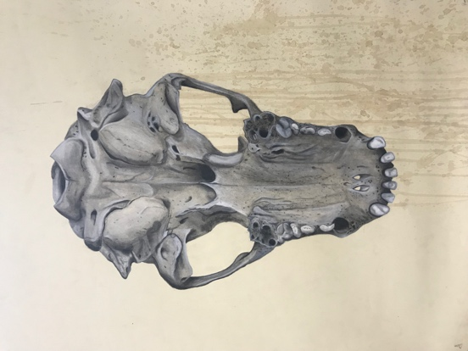
Rendering of form
Asymmetrical composition
Surface manipulation
Notes:
What do you notice about this artwork?
-rendering of form
-asymmetrical composition
-surface manipulation

Slide 2
Experiment with at least 4 different materials in your sketchbook to create different colors or marks
Coffee
Tea
Tissue paper
Berries
India ink (watered down) splatters
Notes:
Experiment with at least 4 different materials in your sketchbook to create different colors or marks
I usually start by filling a coffee cup halfway with water, and microwaving it for a minute. That heats the water enough to dissolve the coffee quickly. I use about three tablespoons of instant coffee, which makes a thick, dark brown liquid. I can always thin it later with a little water if I find I need a lighter color.
-http://gomakesomething.com/ht/age/coffee-paper/
Coffee
Tea
Tissue paper
Berries
India ink (watered down) splatters

Slide 3
Wangechi Mutu

Slide 4
After you’ve experimented with staining…
What object are you going to draw?
It should be a 3Dimensional object (NOT A PHOTO), drawn large on the paper
Notes:
Look through ideas
Shoes
Bottles
Tools (Jim Dine)

Slide 5
After you’ve experimented with staining…
What object are you going to draw?
It should be a 3Dimensional object (NOT A PHOTO), drawn large on the paper
Sketch out 3 thumbnail compositions (big enough so we can see what is going on)
Where will the object be placed on the paper (not always in the center)
Try having some of the object going off the edge of the paper
Where will the background staining be in relation to the drawn object?

Slide 6
Rendering of Form
Graphite, ebony
Blending stump OR tortillion
Charcoal pencils
Pen
Eraser- carve out a white highlight
I can render my object to appear 3Dimensional.

