Slide 1
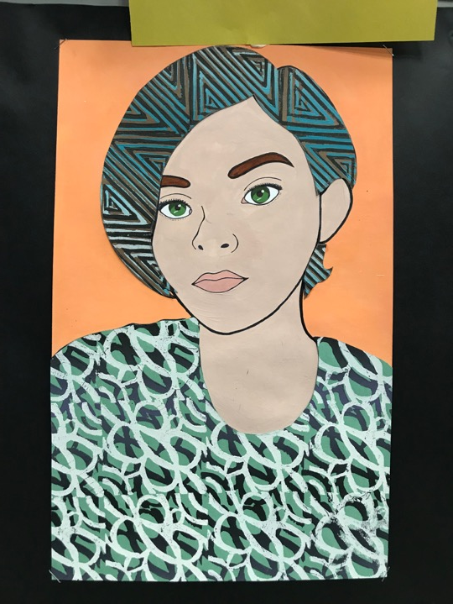
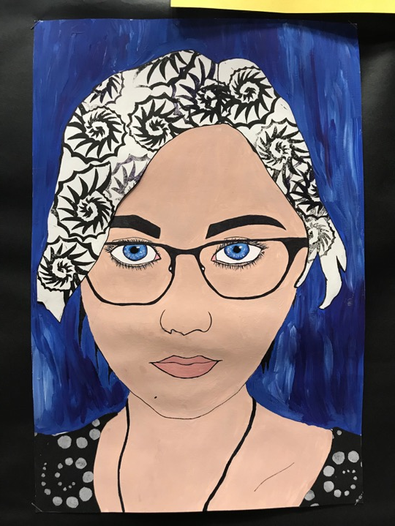
Notes:
How to start-
STEP 1: Draw the portrait
Make a 1” grid on your photo and a 2” grid on your drawing paper
OR
Free hand draw your portrait
Erase the grid lines inside the skin
Trace over facial features with a Sharpie
Make a skin tone and paint it a flat and solid color- NO BRUSHSTROKES
When dry, trace back over facial features with Sharpie
EYES, LIPS & EYEBROWS-
paint your eye color OR use the printed paper
Eyebrowns and lips- printed paper
STEP 2: Make your print block
You will use two images, one on each side of the bock
One side will say something about you- a logo, shape (NOT A HEART, MUSIC NOTE, PEACE SIGN, CLICHÉ SYMBOLS)
Other side will be Art Nouveau inspired
We will create several sketches before choosing one
Look at fabric textile designs and Art Nouveau

Slide 2
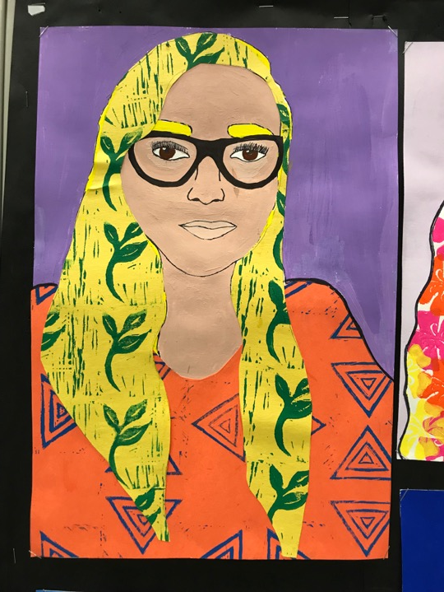
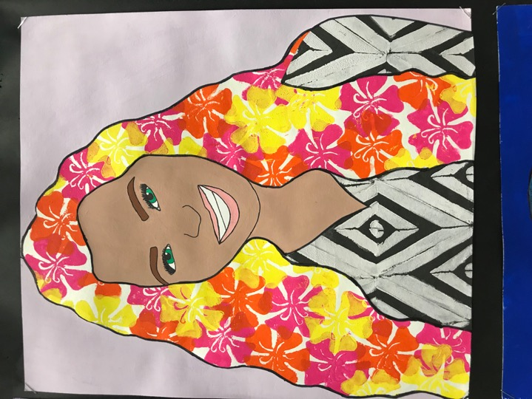
Notes:
Look at the prints in the hair- how is the printing different?
Organized vrs layered
Look at textile designs as a career connection

Slide 3
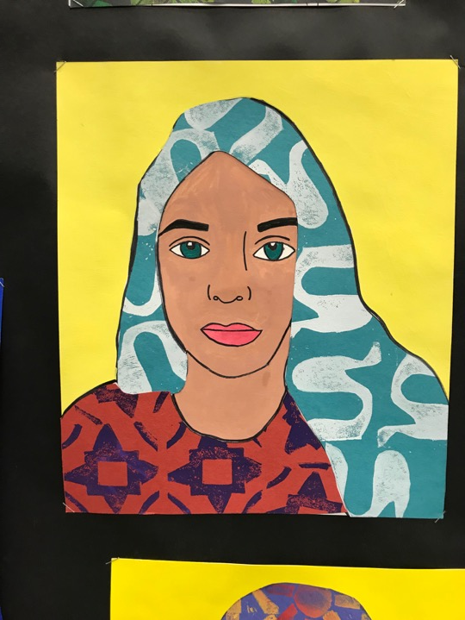
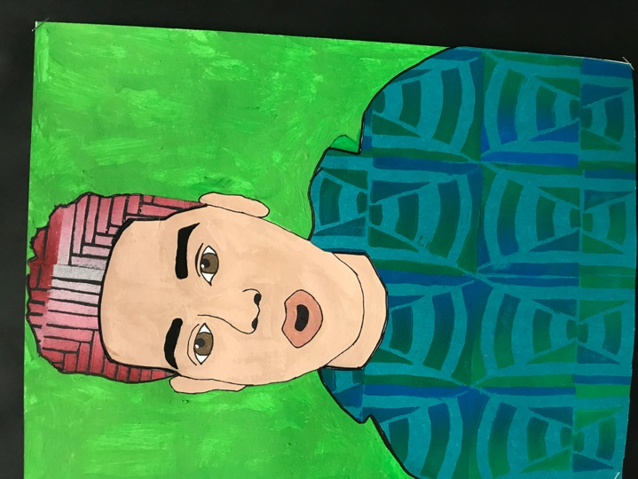
Notes:
Painting characteristics
Flat, solid color
Background color should contrast with the hair

Slide 4
Notes:
PRINTMAKING
DAY 1: Rainbow roll

Slide 5
Notes:
PRINTMAKING
DAY 2: Offset

Slide 6
Notes:
PRINTMAKING
Day 3: Reductive print
Go over editioning, title & sign prints

Slide 7
Notes:
Assemble work into a reflective piece/NOTES
Include
Examples of three different types of prints (rainbow, offset & reduction)
Reflection on process
Labeled tools

Slide 8
Notes:
instructions

Slide 9
Notes:
Printmaking in your hair
Organic or geometric?
What printmaking technique do you want to use?
Offset
Rainbow
Layered 3 different colors
Reduction print

Slide 10
EQ: How are Organic Shapes used in art??
LT: I can describe how organic shapes are used in the art movement Art Nouveau
https://www.youtube.com/watch?v=P4luPnObQYo
Start at 30 seconds-1:24
Notes:
EQ: How are Organic Shapes used in art??
LT: I can describe how organic shapes are used in the art movement Art Nouveau
What do you notice about this work of art? Have you seen this before?
Combines natural/realistic elements with abstracted or stylized
An art movement characterized by intricate linear designs and flowing curves based on natural forms.
1890-1910
Means new art in French
Moved away from the imitation of real subjects and moved towards flowing and twisting lines/shapes in nature
Organic in ornamentation decorating in every surface
Nature illustrations and deep sea illustrations were used as references
Famed Austrian painter
His work is decorative, colorful and contained gold leaf

Slide 12
Notes:
Mucha
Elongated depictions of women

Slide 14
Notes:
Select a sample from these art nouvou art works or the art nouvou coloring sheets for one side of the block

Slide 15
Notes:
Textile design is a college major
Jobs directly related to your degree include:
Clothing/textile technologist
Colour technologist
Interior and spatial designer
Fashion designer
Textile designer
Employers of textile design graduates include:
design studios and consultancies
large fashion and design companies
small specialist design companies
manufacturing and processing companies that produce clothing, soft furnishings and other textile-based products
interior design and decoration services
private clients.
The average annual pay for a Textile Designer Across the U.S. is $57,299 a year. A Textile Designer annual salary ranges from $37,500 to $81,500 nationally. This moderate spread of $44,000 indicates Textile Designer salaries are seeing general stability across the country.

Slide 16
Notes:
Examples of textile designs

Slide 17
EQ: How has Pop Culture been used in art?
LT: I can describe the Pop Art art movement and who the artists were.
https://www.youtube.com/watch?v=DhEyoDCTSDQ
Notes:
Watch video till 2:50 and take notes on what was Pop Art AND who were the Pop Artists?
EQ: How has Pop Culture been used in art?
LT: I can describe the Pop Art art movement and who the artists were.

Slide 18
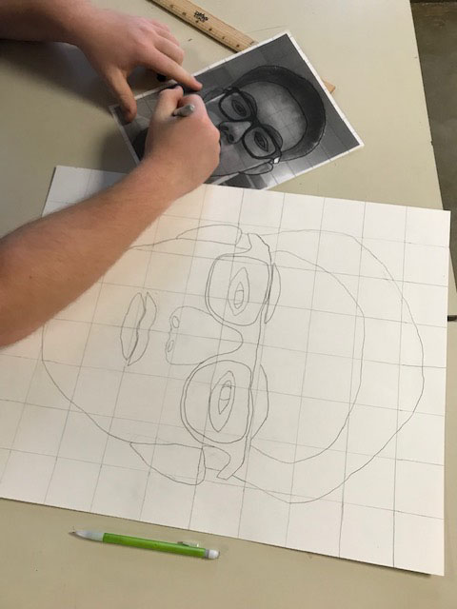
Notes:
To get the portrait, do a 1” grid on the photo and a 2” grid on the 16” x 20” Bristol paper
Trace all the facial features on the photo with a Sharpie and then draw the Sharpie lines with a pencil on the Bristol paper

Slide 19
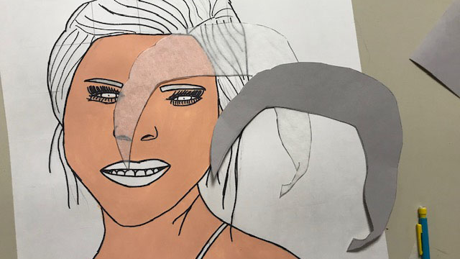
Notes:
Once your portrait is drawn…
Trace over your pencil lines with a Sharpie
Erase the grid/pencil lines everywhere except in the hair and in the clothes
Paint in the skin tone using 2-3 coats to be solid---NO BRUSHSTROKES
Mix a lip color by adding a small amount of red to the skin tone- 2 coats to be solid

Slide 20
Notes:
Hair and Eyebrows
With tracing paper, trace your hair shape and transfer that shape onto a piece of construction paper of your choice.
Do the same process for the eyebrows

Slide 21
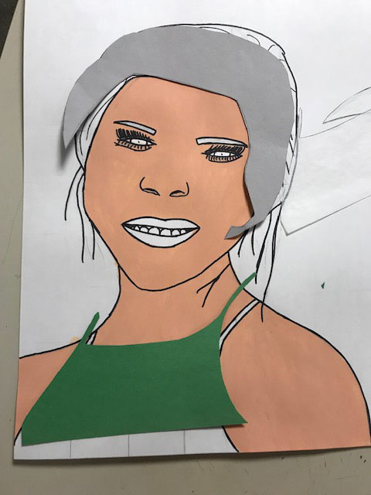

Slide 22
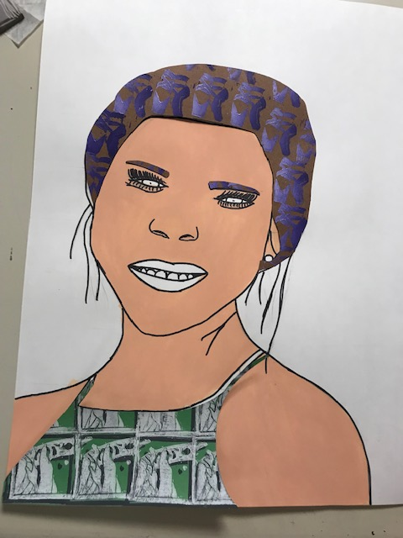

Slide 23
