Slide 1
Scratchboard Still Life

Slide 2
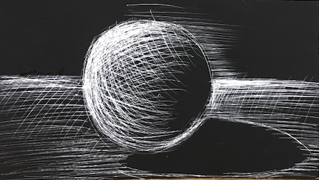
I can draw a still life on scratch board depicting the different forms with values using line

Slide 3
Tape scratchboard into SB
2. write a reflection on using the scratch board in SB

Slide 4
What tools will we be using?
https://www.youtube.com/watch?v=XWiPTfqFcNk
Take notes in SB during video
Only watch first minute

Slide 5
What is wrong with this drawing?

Slide 6
Setting up for your drawing
Select 3-4 objects from the storage closet as a group (doesn’t have to be white)
Arrange them on desk
3 thumbnail sketches of different compositions

Slide 7
I can draw 3 Thumbnail sketches of different compositions

Slide 8
I can draw 3 Thumbnail sketches of different compositions

Slide 10
1. Lightly sketch your favorite composition on the scratchboard with a pencil
Your eraser may leave a mark!!!

Slide 11
2. Check out an exacto knife and start scratching
Think about…
Cross-contour lines
Hatching cross hatching
Contrast
Pressure

Slide 12
Art 1/ Varied Line Composition Name Block Final Grade
Mark-Making
4- All five techniques (Stippling, Hatching, Cross Hatching, Implied Line, Line design) have been successfully incorporated, twice each, into the work of art creating a sense of texture and value.
3- All five techniques were used but may not be used twice throughout the piece or not used successfully.
2- Only three of the five techniques were used.
1- Only two of the five techniques were used.
Composition
4- The triangle method was successfully used in creating a balanced work of art. Techniques were repeated throughout composition to create movement. Objects chosen are depicted life like and there is not too much empty space in composition.
3-The Triangle method was successfully used in creating a balanced work of art but there was no repetition of the techniques.
2-The art work is not balanced successfully.
1- No thought is evident in the composition of this piece, too much empty space.
Value
4-The Highlights, midtone, core shadow, cast shadow, and reflective light are used successfully to depict 3-D objects in 2D form.
3- Only three values, created by the build up of the techniques, can be seen used throughout.
2- Only two values can be seen used throughout.
1-Cast shadows are forgotten about in the final work of art.
Craftsmanship
4- Mark-making is clean and precise. Transitions between line techniques are smooth.
3- Transitions are not smooth.
2- There are eraser marks and smudges left from sketching out the collage on final piece.
1- There are pencil marks that can be seen from sketching.

