Slide 1
Radial Symmetry in Art
EQ: Where can we find radial symmetry in Nature??
LT: I can create a radial design
http://weavesilk.com
Notes:
Where can we find radial symmetry in Nature??
Have students think about this question while they create
Use Weavesilk to create a radial design http://weavesilk.com

Slide 2
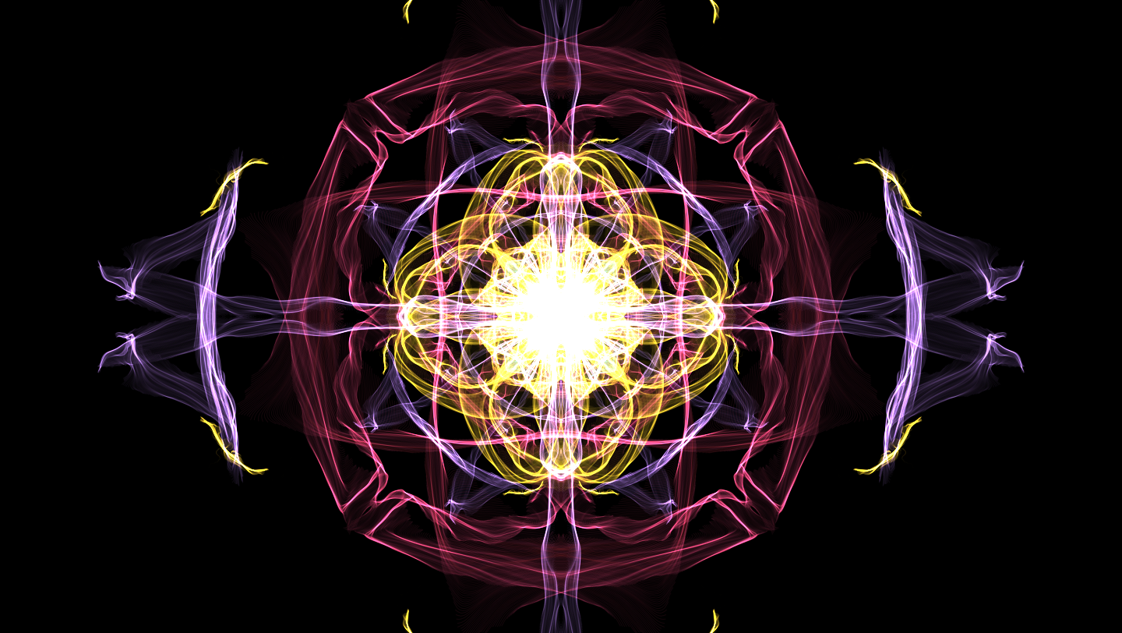
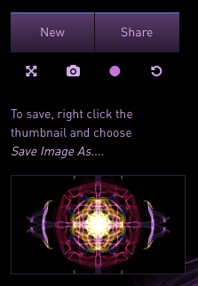
Save as Radial Last Name

Slide 3
Funky Funky Cha-Cha of Rose Windows
Notes:
FFCC of Rose windows
Notre Dame Cathedral. Paris, France
-Chartres Cathedral. Chartres, France for APAH

Slide 4
FFCC
Form
Function
Content
Context

Slide 5
Notes:
What do you know about the Notre Dame Cathedral?/CONTEXT
Gothic Cathedral
In Paris France
Means: Our Lady of Paris
Construction began in 12th century, Medieval period
Large fire leaving destruction on Monday, April 15th 2019

Slide 6
Notes:
What was before Gothic?
Romanesque= dark and heavy
Thick walls and little light, no windows
Gothic has thinner walls which allowed for more windows
Gothic architecture was about bringing light into the church, bringing sunshine into peoples lives

Slide 7
Notes:
Form four columns of students
Inner two columns face one another
Outer two columns face away from the inner columns
Outer two columns touch backs with the inner columns to form a buttress

Slide 8
Notes:
Inner columns inner lock hands to form a rounded arch
Have another student try to hang on the arch while the buttresses reinforce the students

Slide 9
Notes:
Have another student try to hang on the arch while the buttresses reinforce the students

Slide 10
Notes:
Gothic architecture was about bringing light into the church, bringing sunshine and the light of god into peoples lives

Slide 12
Notes:
Tracery
Stone outlines with openings around the stone
Inside the openings is the stained glass

Slide 15
Notes:
Strasbourg Cathedral

Slide 16
Notes:
Chartres Cathedral

Slide 17
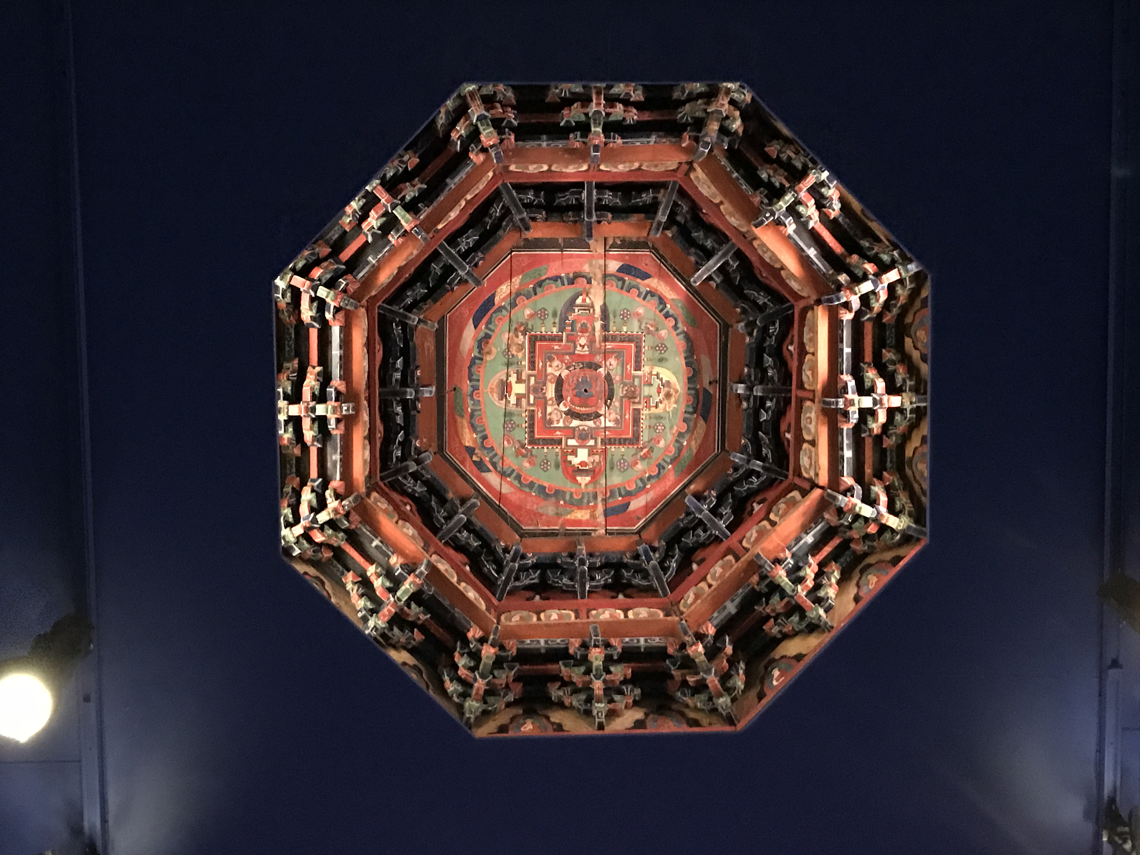
Notes:
EQ: What is the spiritual significance of the Mandala?
This mandala was once on the ceiling of a Tibetan temple
FUNCTION- during prayer, Buddhists would look up and visualize this as a 3D place with a major deity/god at the center
This would help guide along the path to enlightenment

Slide 18
Notes:
EQ: What is the spiritual significance of the Mandala?
A mandala is a spiritual and ritual symbol in the Indian religions of Hinduism and Buddhism, representing the universe
Used for meditation
Borobudor is the largest Buddhist monument, is in Indonesia

Slide 26
Green
Yellow
Blue
Orange
Violet
Red
Notes:
What colors would go next to yellow?
Next to orange?
Next to red?
In between green and violet?

Slide 27
I can create a radial-symmetrical design by adding the same shape in each section
Intermediate Color
Green
Yellow
Intermediate Color
TINT
TINT
Intermediate Color
Orange
Darken by adding complimentary color (changing the intensity)
TINT
TINT
Blue
TINT
TINT
Intermediate Color
(red-orange)
Intermediate Color
Violet
Red
Intermediate Color
Notes:
Add two concentric circles

Slide 28
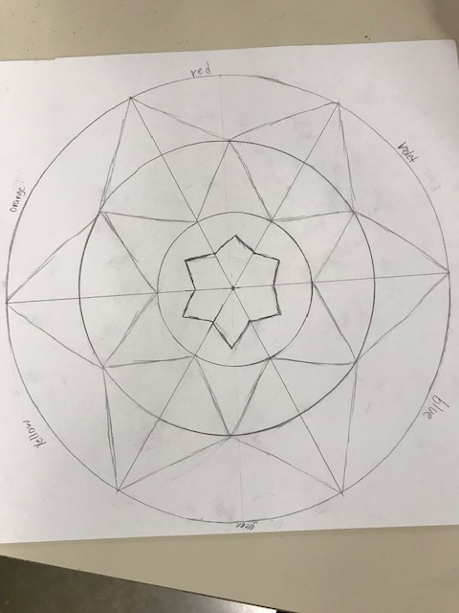

Slide 29
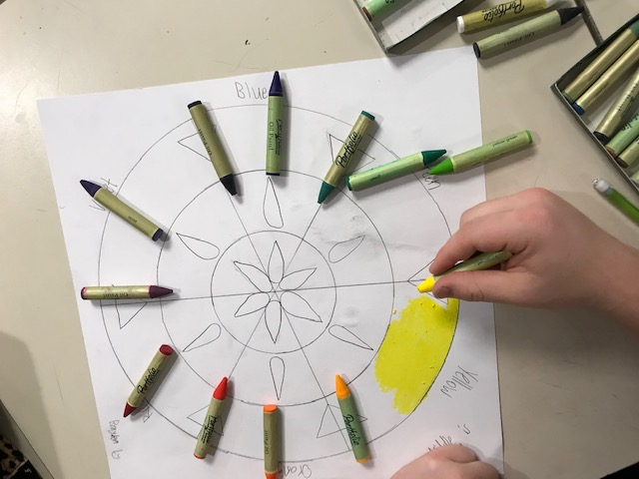

Slide 30
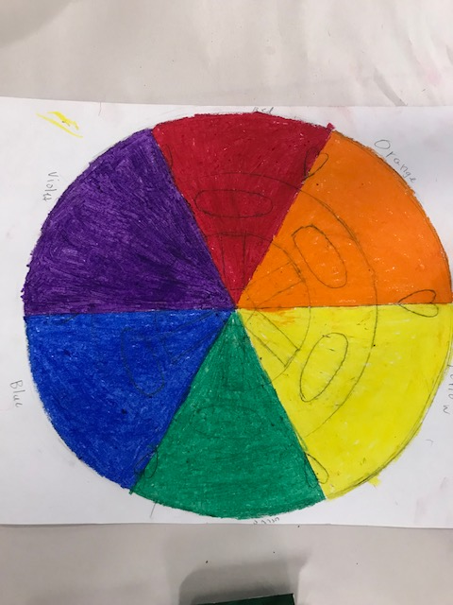
Notes:
Color the whole triangle slice first with one color

Slide 31
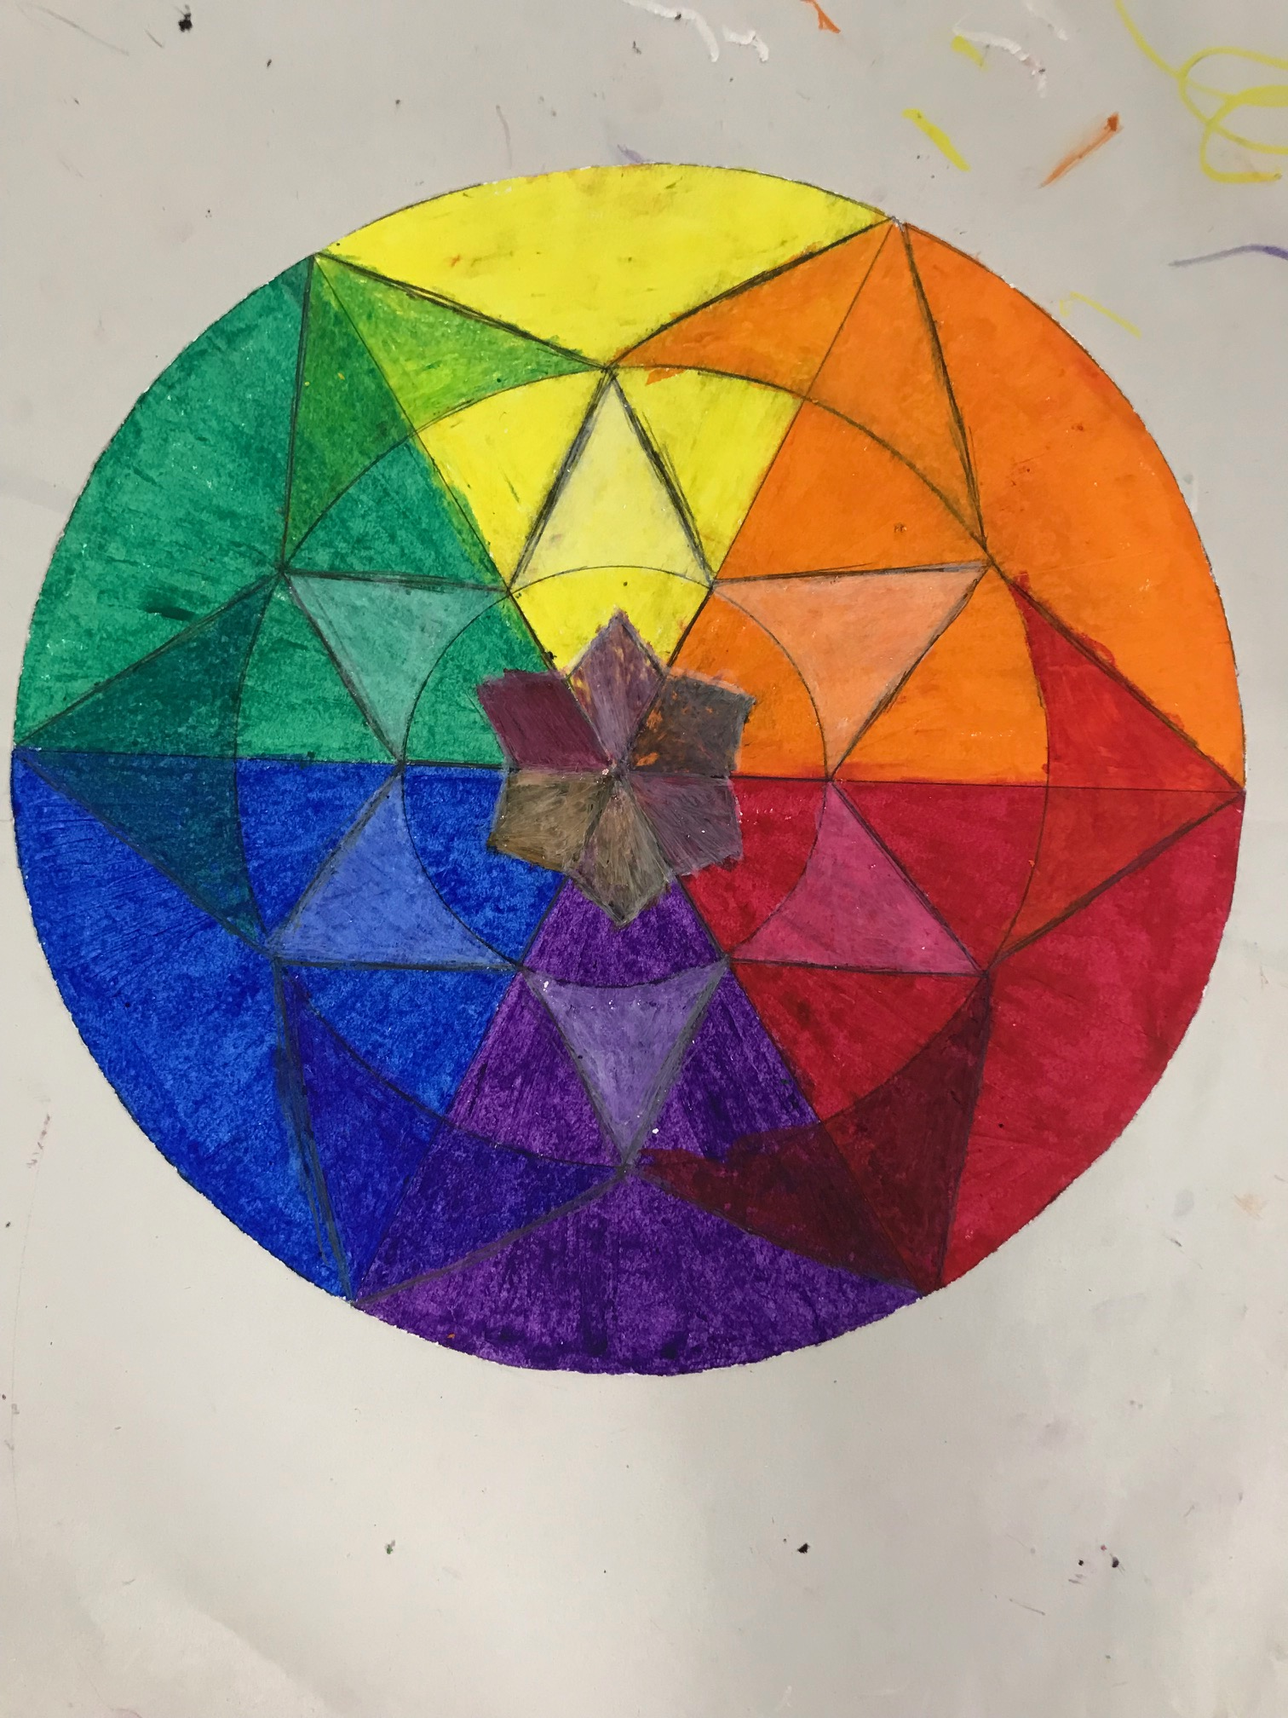

Slide 32
Notes:
it needs to have at least 3 concentric layers/levels

