Slide 1
EQ: What is printmaking?
Notes:
take notes of what process we are doing for that day
Rainbow Roll
Offset
Reduction Print
edition

Slide 2
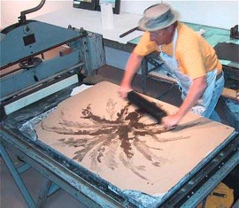
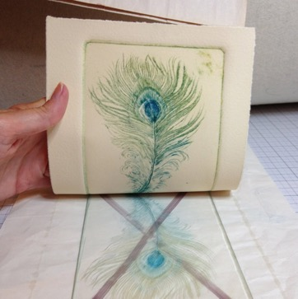
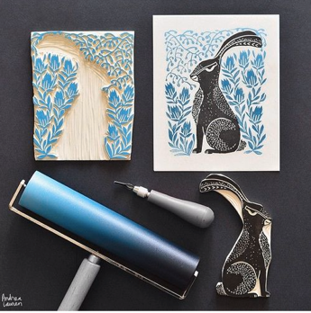
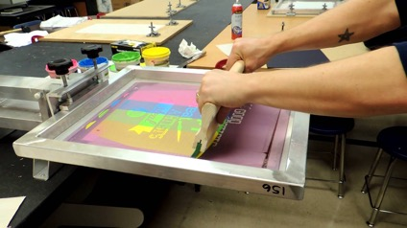
What is printmaking?
A way of making art by transferring an image to paper with a block, plate, stone or screen
Plate
Block
Stone
Screen

Slide 3
Print Vocabulary
What is an Edition?

Slide 4
Print Vocabulary
What is an Edition?
-A total number of copies made at one time

Slide 5
How to finish your print…
I can edition, title and sign my prints in pencil.
The bottom of each print should look like this…
This needs to be done IN PENCIL!

