Slide 1
EQ: What is printmaking?
Learning Target
I can create prints using different relief printmaking techniques
Notes:
take notes of what process we are doing for that day
Rainbow Roll
Offset
Reduction Print
edition

Slide 2
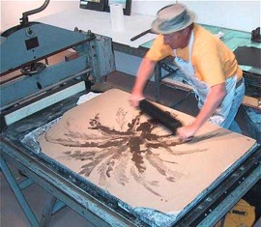
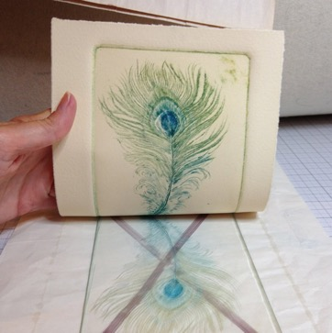
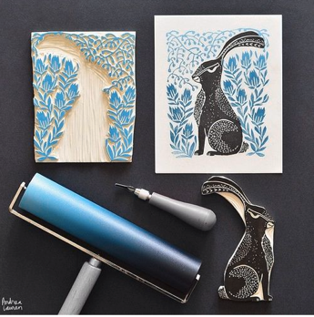
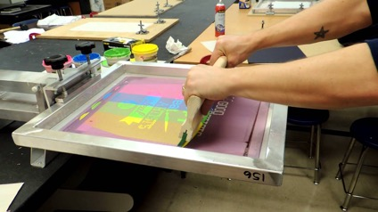
What is printmaking?
A way of making art by transferring an image to paper with a block, plate, stone or screen
Plate
Block
Stone
Screen

Slide 3
What do I carve?
The positive or the negative?

Slide 4
What do I carve?
the negative space!

Slide 5
Print Vocabulary
What is an offset print?

Slide 6
Print Vocabulary
What is an offset print?
Printing once in a light color then printing on top in a darker color but slightly off registration

Slide 7
Step 1
Draw a design using my initials onto the tracing paper using pencil
fill the space with your design!
Try not to use just lines
OR Use the same block that you had for Rainbow Roll

Slide 8
Step 2
Transfer the tracing paper onto the rubber block
The pencil lead needs to be touching the block
Hold it VERY still during this process
OR Use the same block that you had for Rainbow Roll

Slide 9
Step 3
Carve away the negative space
Carve what you DON’T want to print
OR Use the same block that you had for Rainbow Roll

Slide 10
Step 4
Print using a light color repeatedly on a piece of construction paper
What color ink(s)?
What color paper?
Print a second layer using a darker color slightly off registration

