Slide 1
EQ: What is printmaking?
Learning Target
I can create prints using different relief printmaking techniques
Notes:
take notes of what process we are doing for that day
Rainbow Roll
Offset
Reduction Print
edition

Slide 2
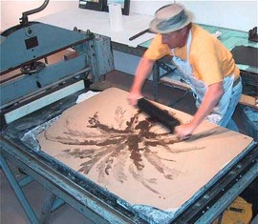
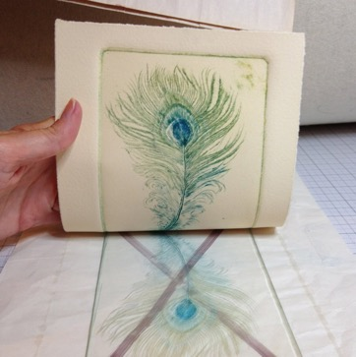
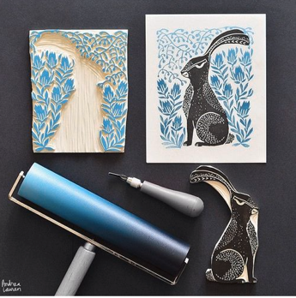
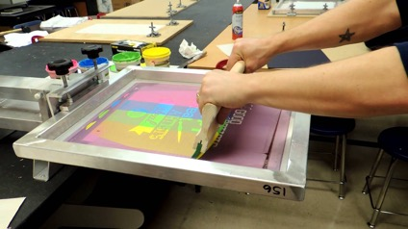
What is printmaking?
A way of making art by transferring an image to paper with a block, plate, stone or screen
Plate
Block
Stone
Screen

Slide 3
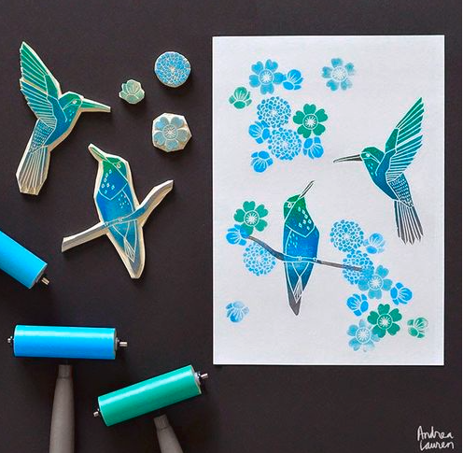
Relief
PRINTING

Slide 4
Relief
PRINTING
What ever you carve on the block will be backwards!

Slide 5
Name that Tool

Slide 6
V Gauge

Slide 7
Name that Tool

Slide 8
Carving Tool

Slide 9
Name that Tool

Slide 10
Brayer

Slide 11
Name that Tool

Slide 12
Printing block

Slide 13
Step 1
Draw a design using my initials onto the tracing paper using pencil
fill the space with your design!
Try not to use just lines

Slide 14
Step 2
Transfer the tracing paper onto the rubber block
The pencil lead needs to be touching the block
Hold it VERY still during this process

Slide 15
Step 3
Carve away the negative space
Carve what you DON’T want to print

Slide 16
Step 4
Print using each process repeatedly creating a pattern
What color ink(s)?
What color paper?

Slide 17
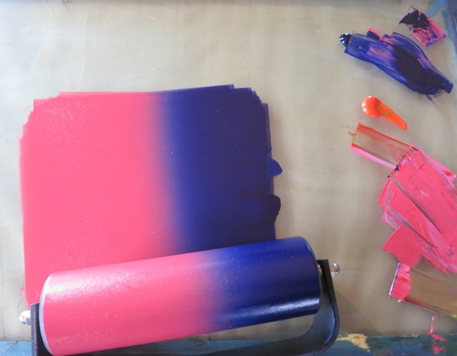
Print Vocabulary
What is a rainbow roll?

Slide 18
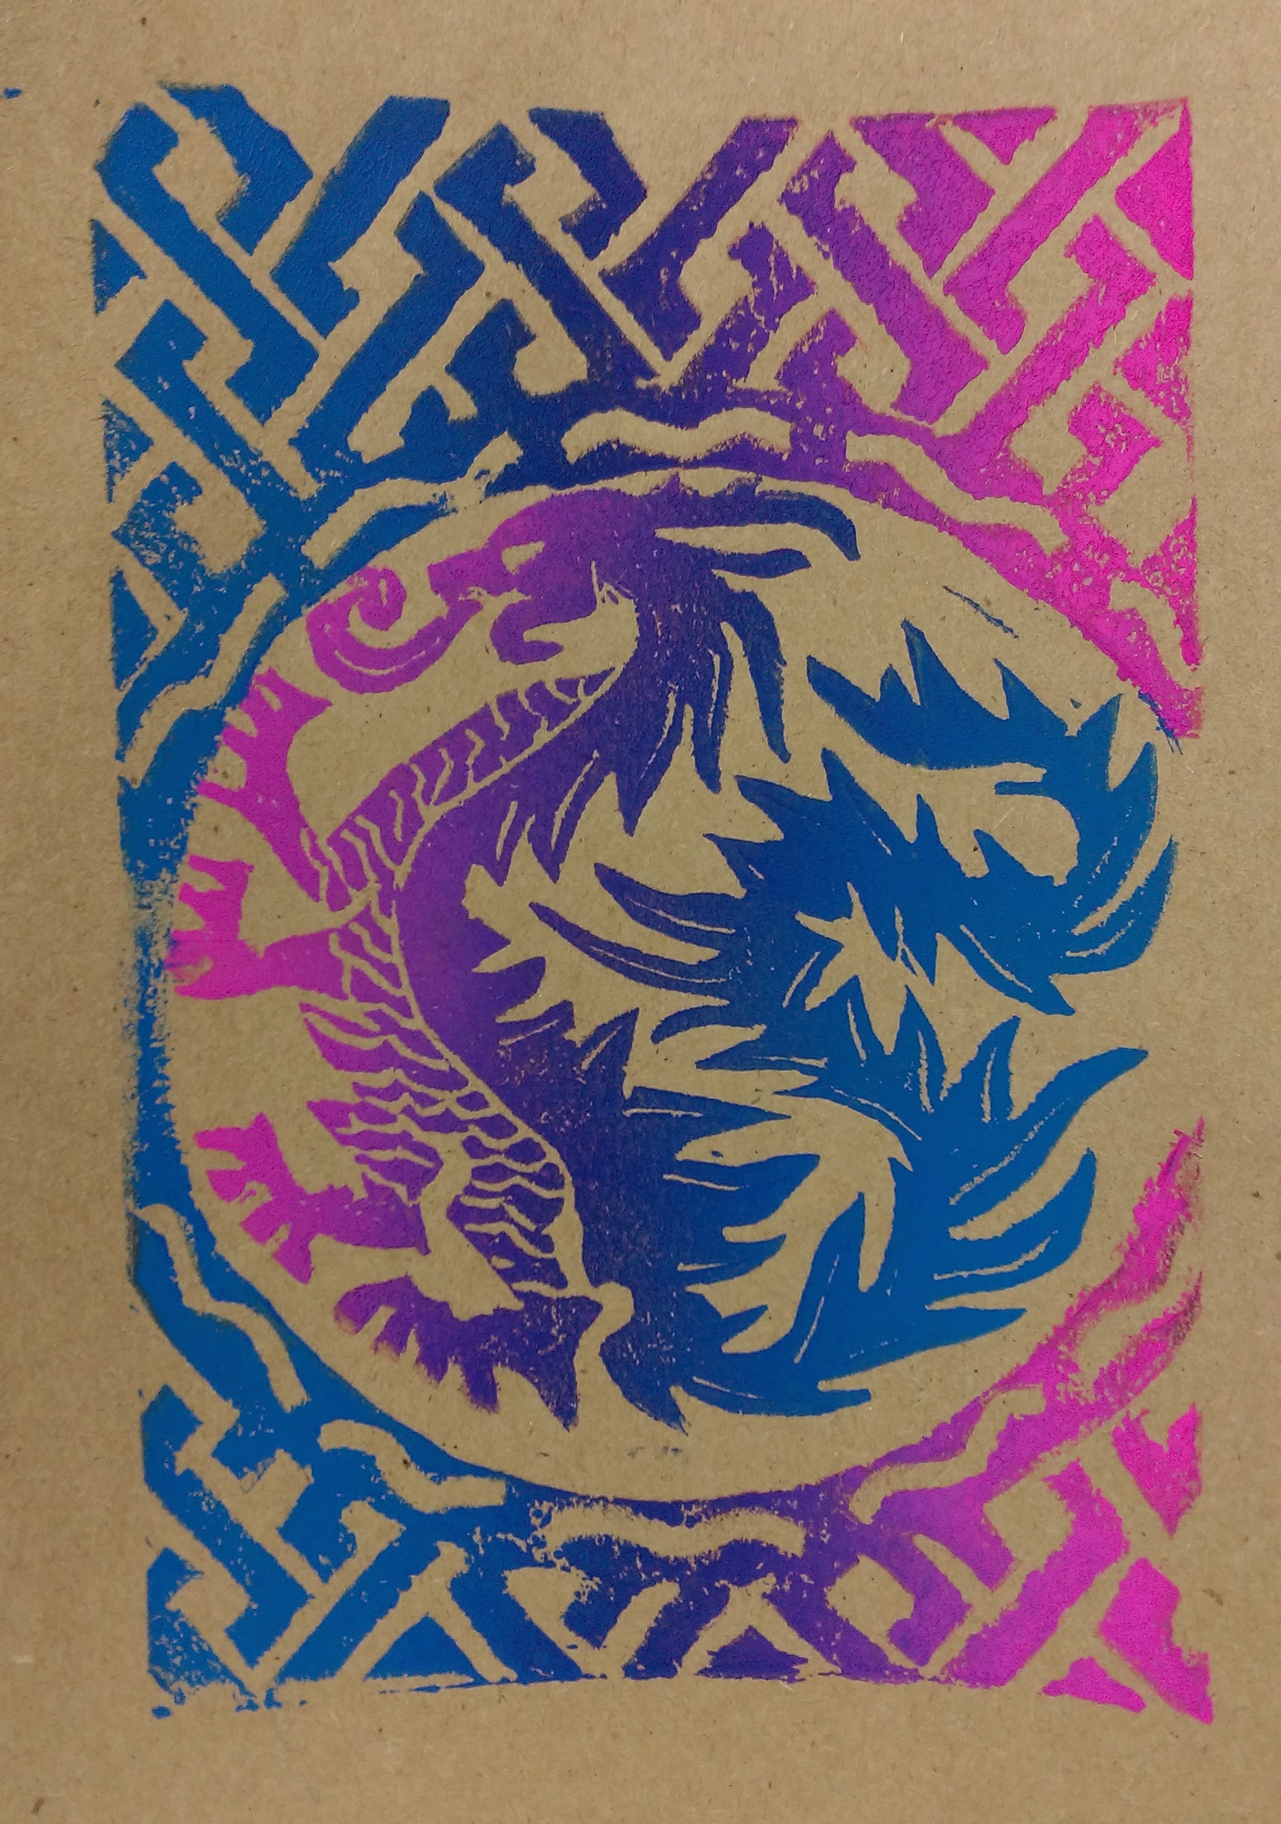
Print Vocabulary
Rainbow roll- two or more colors printed at the same time!

