Slide 1
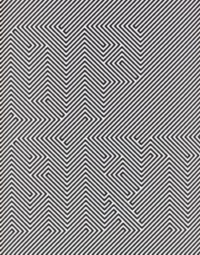
Using Contrasts
Notes:
Day 1-Intro, take notes (definition and artists names). Demo - students work, clean up, quickwrite as an exit ticket. Day 2-Students read paragraphs on pg 3 of scholastic magazine. Add to Cornell Notes- one question based off each paragraph. Discuss with person next to you- be ready to share out! Formulate questions on left of notes.
Day 3-Continue working, end with a summary on Cornell Notes- turn in.
3 days on Notes

Slide 2
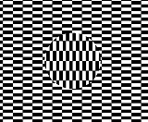
What is “Op” Art?

Slide 3
What is “Op” Art?
“Op” is short for optical. Optical means having to do with the eye.
What’s the fancy word for an eye doctor?
https://www.youtube.com/watch?v=YkEhDyhCTPk
Notes:
optometrist

Slide 4
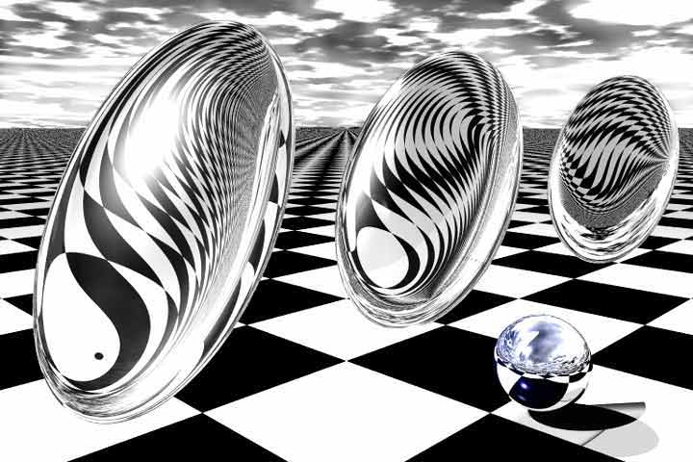
What is “Op Art?”
Notes:
Review for another day

Slide 5
What is “Op Art?”
When something plays tricks on your eyes
it is called an Optical Illusion…
Op Art is artwork that plays tricks on our eyes.

Slide 6
Op is short for Optical Illusion
Is the ball moving?

Slide 7
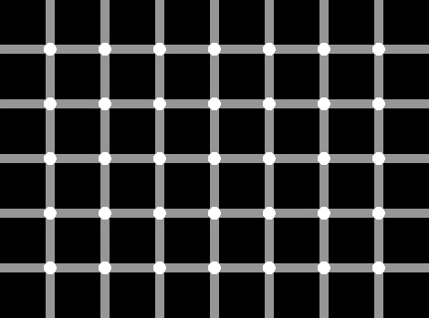
Are the dots white or gray?

Slide 8
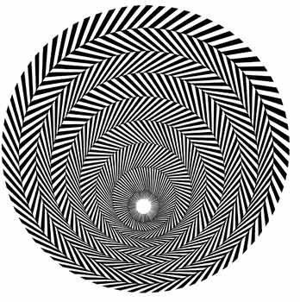
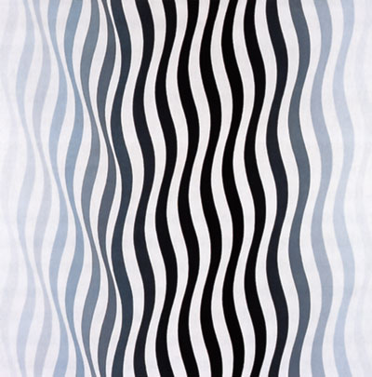
Op Art
There is an artist named Bridget Riley who is famous for creating Op Art that looks like it is moving.

Slide 9
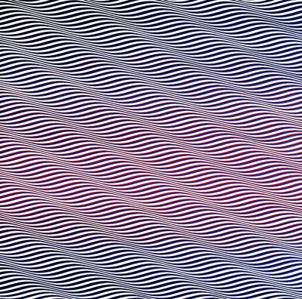
Notes:
Bridget Riley

Slide 10
Op Art Artist
Bridget Riley
Richard Anuszkiewicz
Victor Vasarley

Slide 11
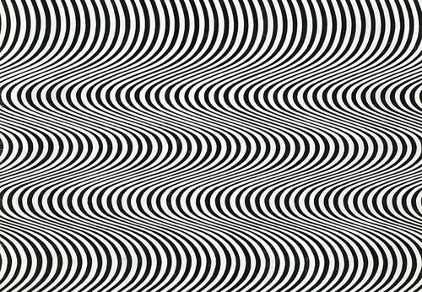

Slide 12
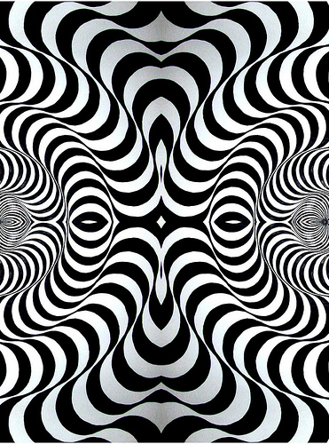
Bridget Riley

Slide 13
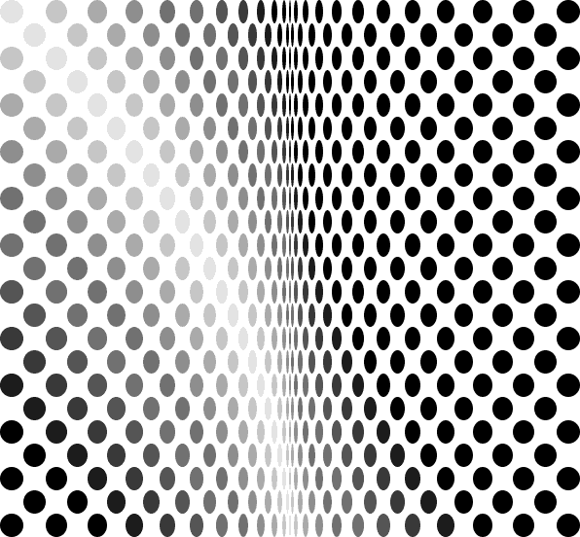

Slide 14
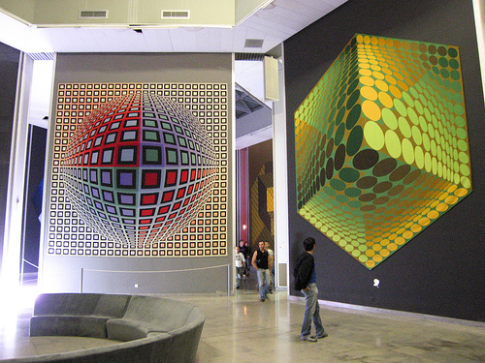
Victory Vasarely

Slide 15
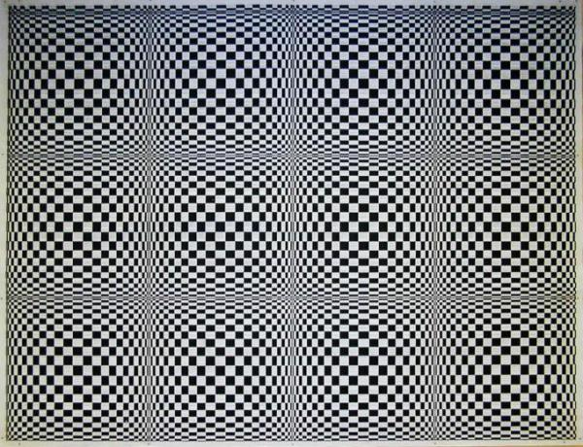

Slide 16


Slide 17
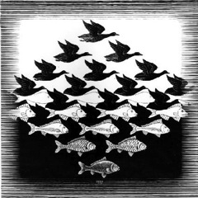
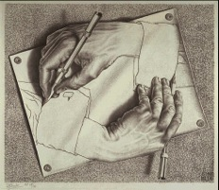
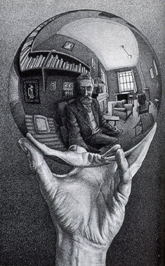
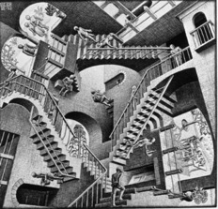
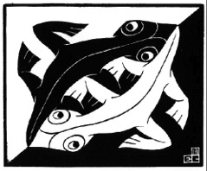
Op Art
There is an artist named M.C. Escher who is famous for his use of tessellations.

Slide 18
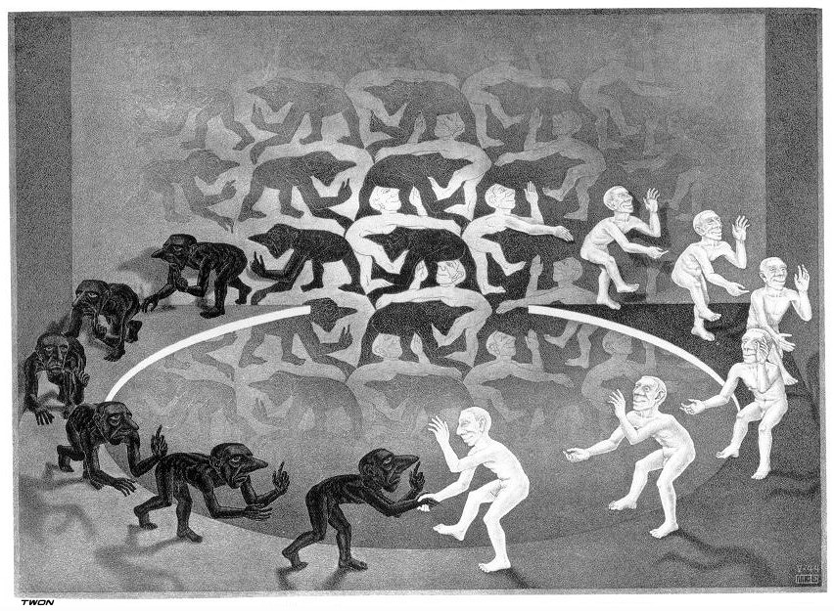
M.C. Escher is famous for his use of tessellations

Slide 19
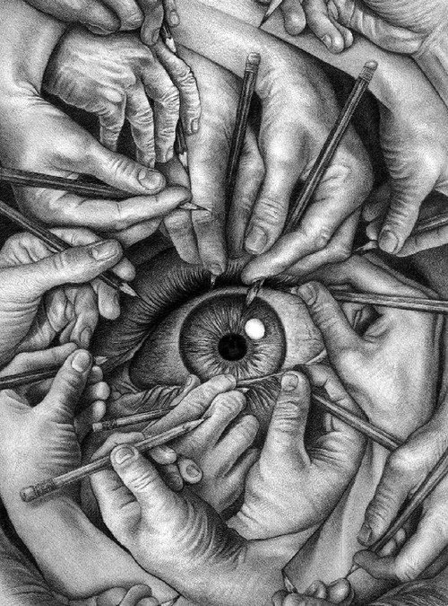
M.C Escher is a mathematically inclined artist who worked between the Surrealist art movement and Op Art

Slide 20
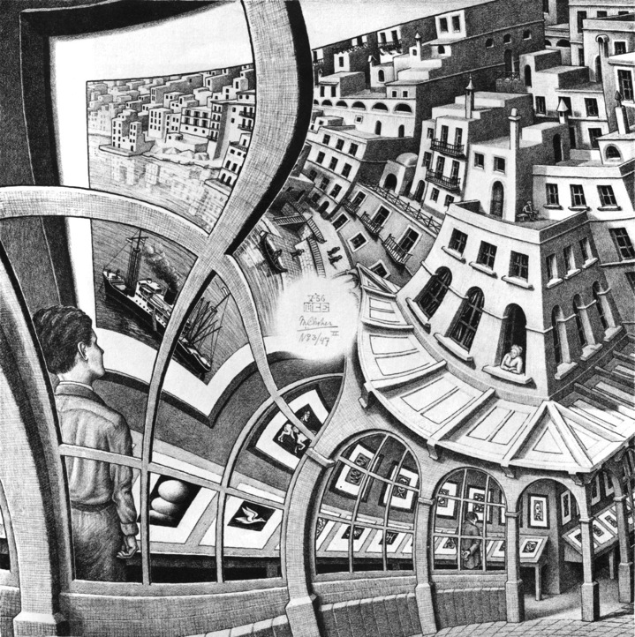

Slide 21
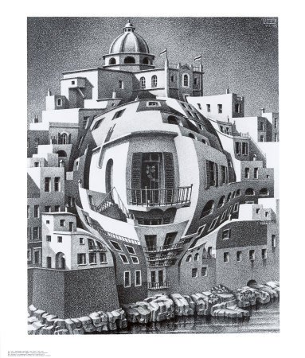

Slide 22
What is “Op Art?”
Notes:
Review for another day

Slide 23
What is “Op Art?”
When something plays tricks on your eyes
it is called an Optical Illusion…
Op Art is artwork that plays tricks on our eyes.

Slide 24
Who is famous for making Op Art that looks like it is moving?

Slide 25
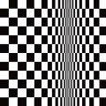
Op Art is ??? Which one???.
Optical Art is a mathematically-themed form of
  Representational?
  Symbolic?
  Abstract art?

Slide 26
Op Art is a form of Abstract Art.
Optical Art is a mathematically-themed form of
  Representational?
  Symbolic?
  Abstract art

Slide 27
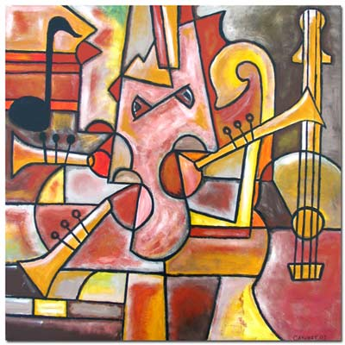
Op Art is which kind of Abstract Art?
Optical Art is a mathematically-themed form of Abstract art.
There are 2 kinds of abstract art.
  Objective (representational)
  Non-Objective (non-representational)

Slide 28
Op Art is which kind of Abstract Art?
Optical Art is a mathematically-themed form of Abstract art.
There are 2 kinds of abstract art.
  Objective (representational)
  Non-Objective (non-representational)

Slide 29
Op Art is Abstract Art.
Optical Art is a mathematically-themed form of Abstract art.
There are 2 kinds of abstract art.
  Objective (representational)
  Non-Objective (non-representational)
What kind of abstract art is Bridget Riley known for?

Slide 30
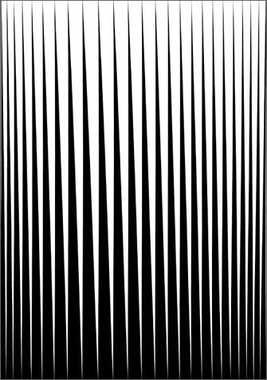
1960’s beginnings
What’s going on in the 1960’s?
Breathe, 1962
Notes:
Accompany this slide with OP Art Scholastic Magazine, pg. 3. Read paragraph 2. Then read last paragraph and illustrate it on the back.

Slide 31
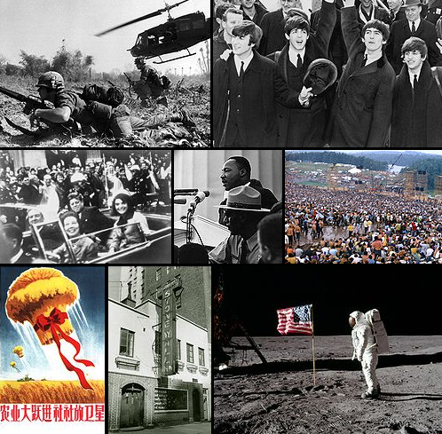
1960’s beginnings
  Revolution dealing with “social norms” clothing, music, etc.
  Vietnam War
  Antiwar protests, civil rights and women’s rights
  Teen begin to influence the culture.
  Created an “anything goes” mentality.
  This time of overturning traditional values called for an art form that questioned perception as well.

Slide 32
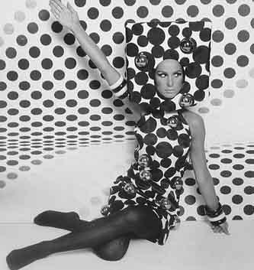
1960’s Fashion
Op art became popular with the public in a way that few art movements have been. The craze extended into fashion and design, and Op patterns appeared on everything from dresses to wallpaper.

Slide 33
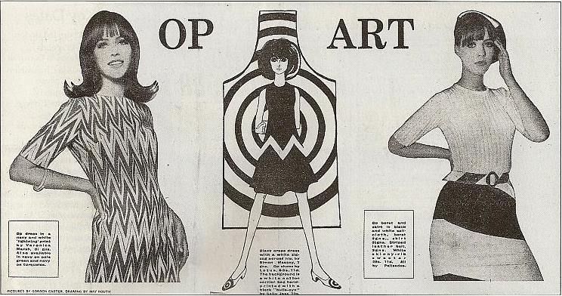

Slide 34
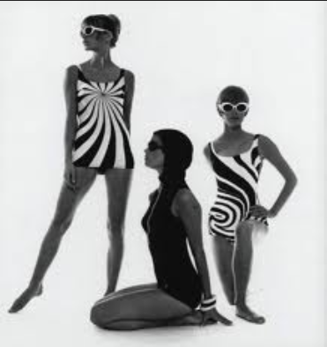

Slide 35
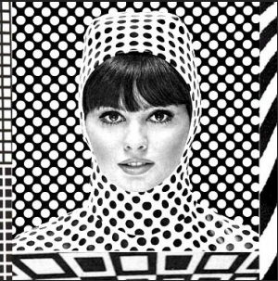

Slide 36
WHO is famous for his use of tessellations?

Slide 37
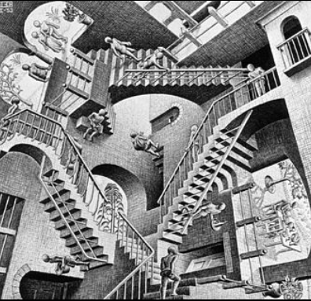
1953

Slide 38
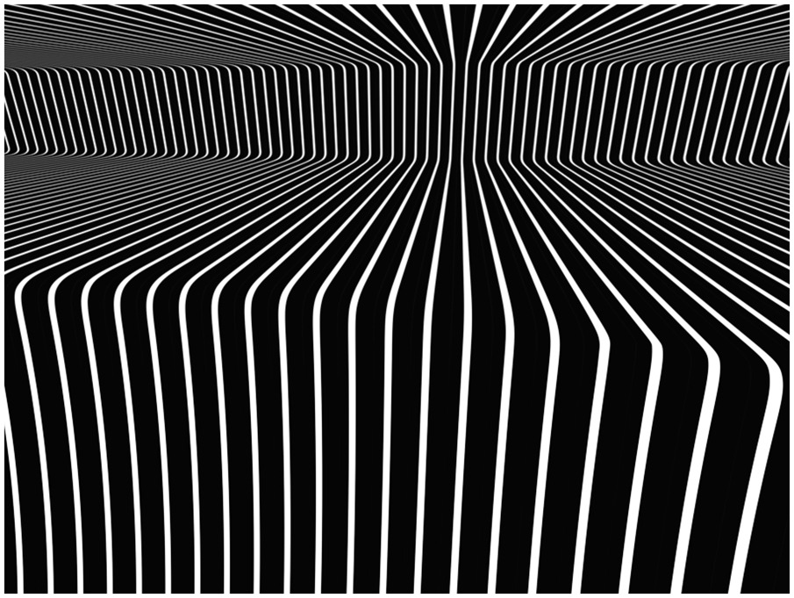
L I N E S
Notes:
Have students do a cross-contour line drawing on their notes.

Slide 39
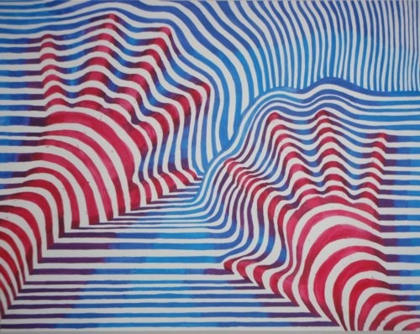
What are cross-contour lines?

Slide 40
What are cross-contour lines?
Lines that define the form!
Think about a piece of string draping over an object, then drawing that string

Slide 41
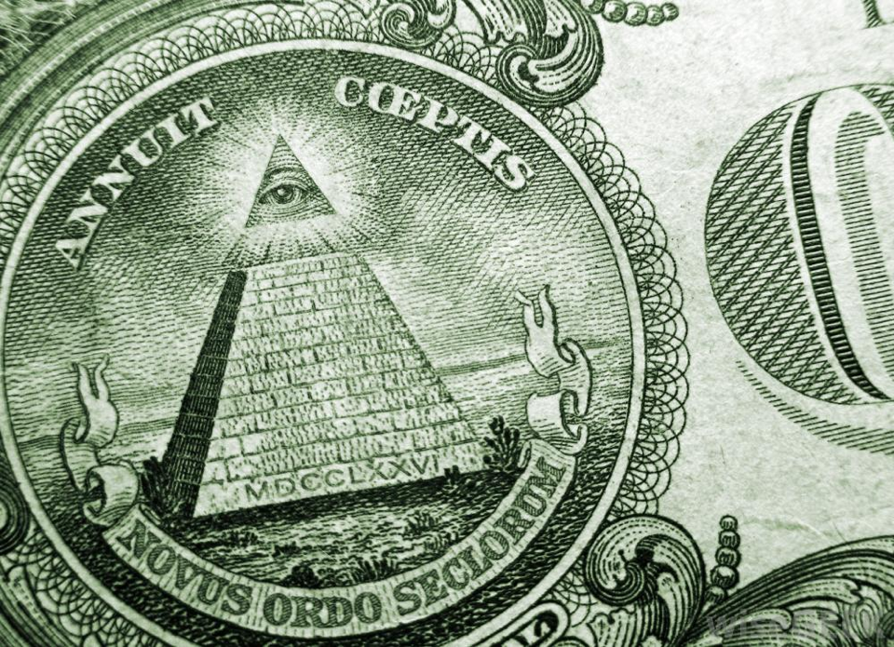
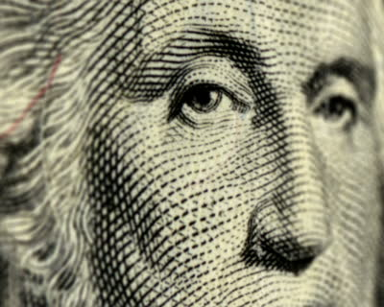
Notes:
http://footage.shutterstock.com/clip-2894515-stock-footage-ntsc-close-up-on-president-benjamin-franklin-on-a-one-hundred-dollar-bill-loop.html

Slide 42
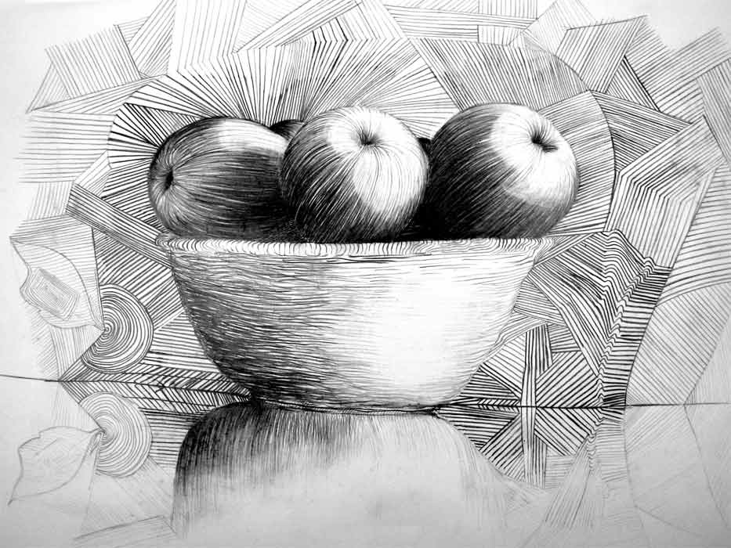

Slide 43
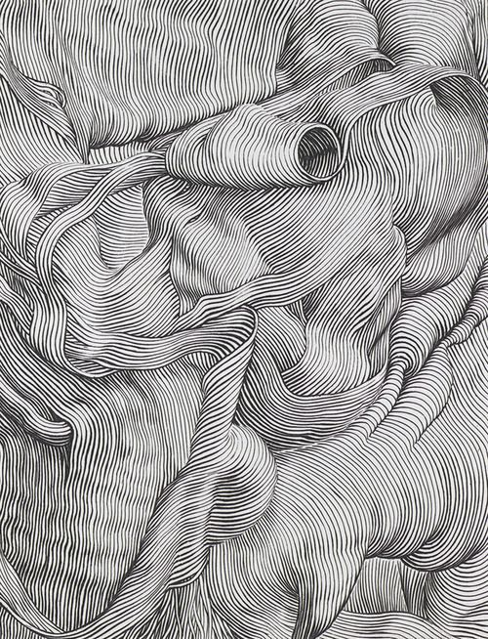

Slide 44
What are WEIGHTED Contour lines?

Slide 45
What are WEIGHTED Contour lines?
Lines that are thicker or heavier to show value

Slide 46
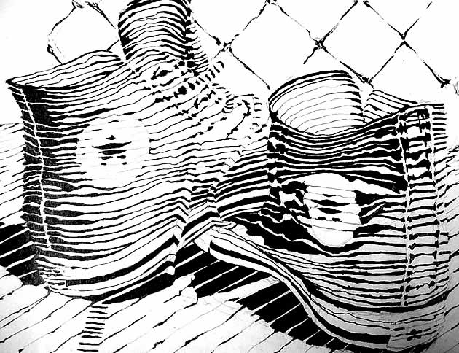
What are WEIGHTED Contour lines?

Slide 47
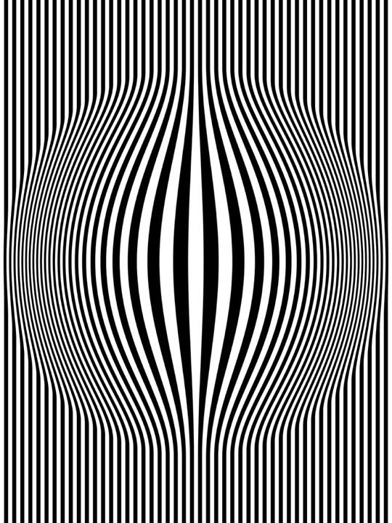
Write this learning target on the top left white square…
I CAN create an Optical Illusion using Cross- Contour Lines AND Weighted Contour lines
Notes:
http://www.op-art.co.uk/op-art-gallery/your-op-art/Op-Art-Bulging-Vertical-Stripes-Black-and-White-One

Slide 48
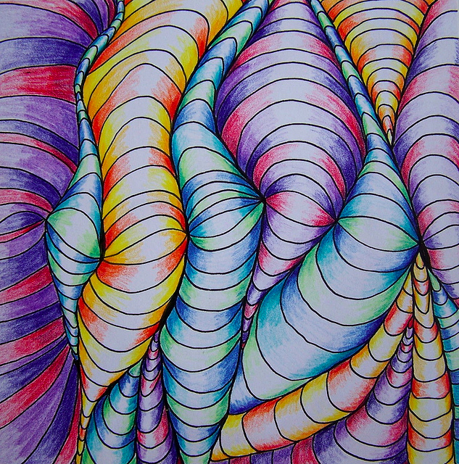

Slide 49
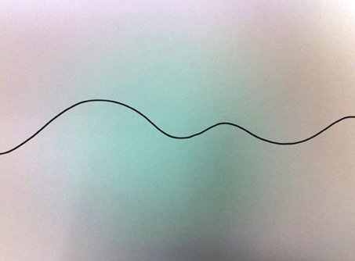
Op Art Shading Blobs
Start by drawing a curved line across the paper. Think rolling hill... not roller coaster!

Slide 50
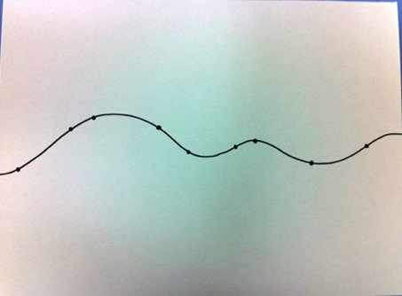
Op Art Shading Blobs
Add 6 dots across the line.
They should be at different lengths apart.
You need a dot close to the edges of your paper.

Slide 51
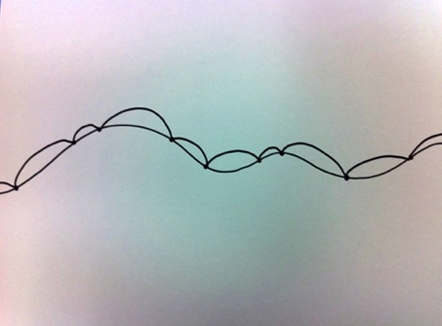
Op Art Shading Blobs
Start connecting the dots with bumps.
The dots close to the edge will go off the edge of the paper to an imaginary dot.
The lines will eventually go off the top and bottom of the paper . Fill the whole paper.

Slide 52
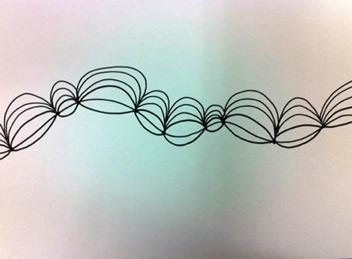
Op Art Shading Blobs
Start connecting the dots with bumps.
The dots close to the edge will go off the edge of the paper to an imaginary dot.
The lines will eventually go off the top and bottom of the paper . Fill the whole paper.

Slide 53
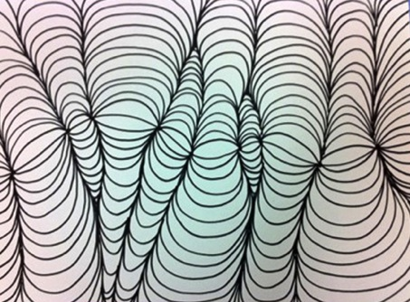
Op Art Shading Blobs
Start connecting the dots with bumps.
The dots close to the edge will go off the edge of the paper to an imaginary dot.
The lines will eventually go off the top and bottom of the paper . Fill the whole paper.

Slide 54
Op Art Shading Blobs
Start connecting the dots with bumps.
The dots close to the edge will go off the edge of the paper to an imaginary dot.
The lines will eventually go off the top and bottom of the paper . Fill the whole paper.
Weighted contour lines- Add thickness to the outer edge of every line!

Slide 55
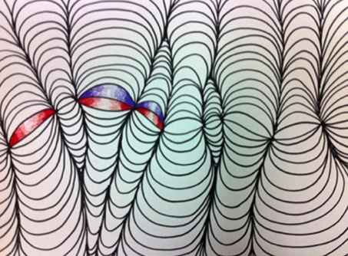
Op Art Shading Blobs
Pick a group of colors you feel work well together.
Press harder in the corners... and as you get near the top of each bump get lighter and lighter.

Slide 56
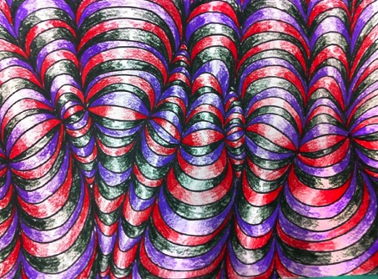
Op Art Shading Blobs
Pick a group of colors you feel work well together.
Press harder in the corners... and as you get near the top of each bump get lighter and lighter.

Slide 57
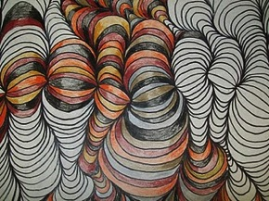
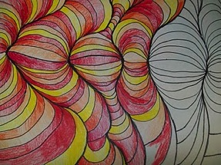

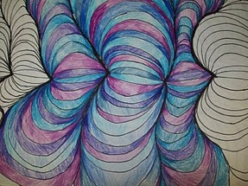
Op Art
Shading Blobs
- Start by drawing a curved line across the paper. Think rolling hill... not roller coaster!
- Add 8 dots across the line.
- They should be at different lengths apart.
- You need a dot close to the edges of your paper.
- Start connecting the dots with bumps.
- The dots close to the edge will go off the edge of the paper to an imaginary dot.
- The lines will eventually go off the top and bottom of the paper. Fill the whole paper.
-Pick a group of colors you think work well together.
-Press harder in the corners... and as you get near the top of each bump get lighter and lighter.
When something plays tricks on your eyes
it is called an Optical Illusion…
Op Art is artwork that plays tricks on our eyes.

Slide 58
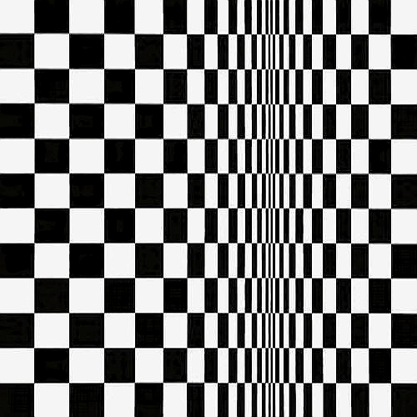
Bridget Riley
Movement in Squares
1961
Write this learning target on the bottom of the bottom left square…
I CAN create an Optical Illusion by varying the spacing of a pattern.
SPACE
Notes:
Have students try to draw this using a ruler. Talk about the spacing of the black and white rectangles varying to create the illusion

Slide 59

Bridget Riley –
Hesitate
1964
Notes:
http://www.op-art.co.uk/op-art-gallery/bridget-riley/hesitate

Slide 60


Slide 61

Write this learning target on the the top right square…
DEMO!
I CAN Create an optical illusion with a complex shape

Slide 62


Slide 63


Slide 64
Summary
How would YOU summarize Op Art? How do you feel about it- WHY

Slide 65


