Slide 1
My example of 2-Point Perspective
Mrs. Sulzen

Slide 2
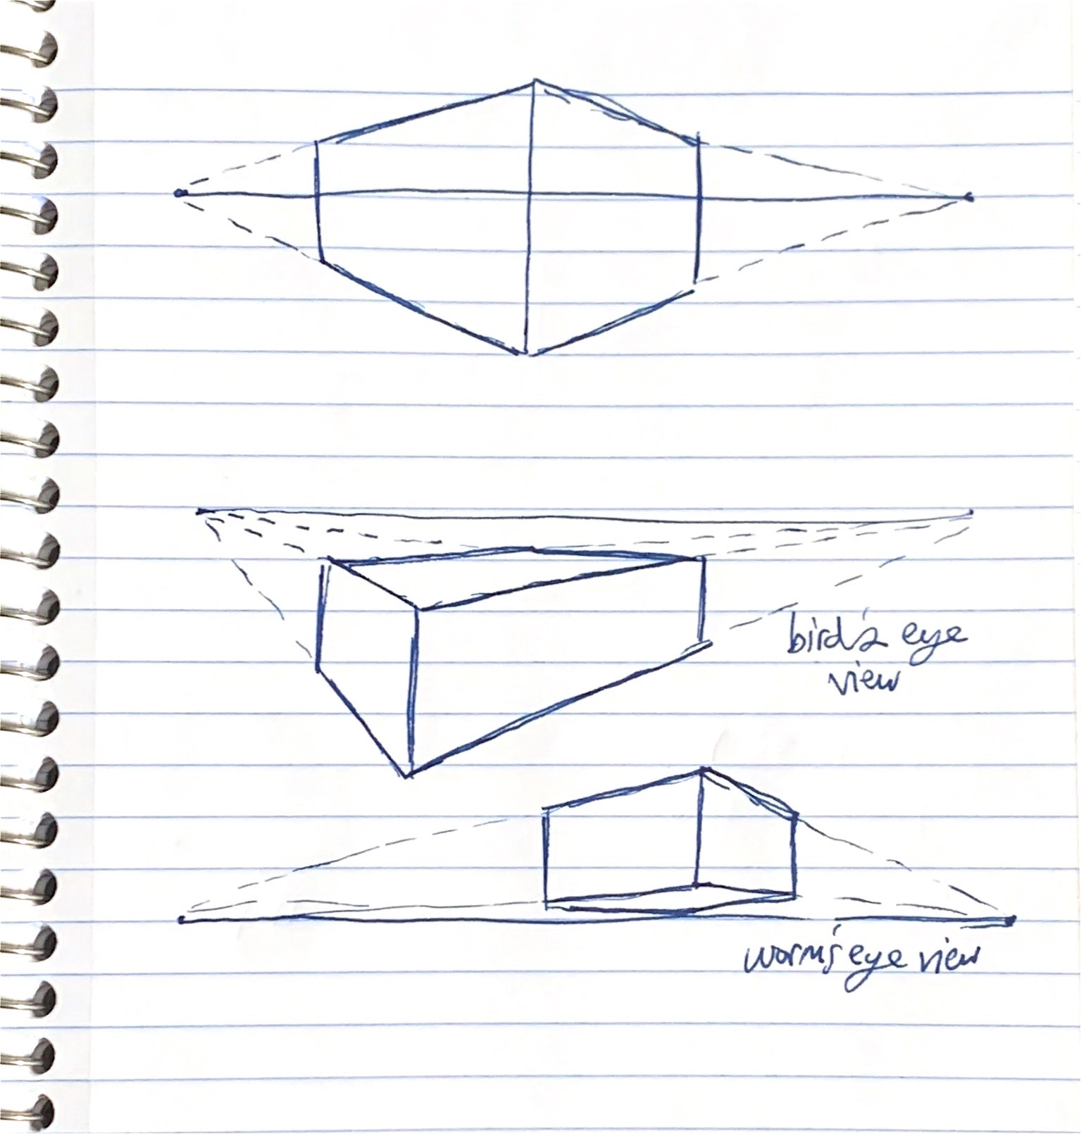
Photo of examples you made while watching Mrs. Kapperman practice

Slide 3
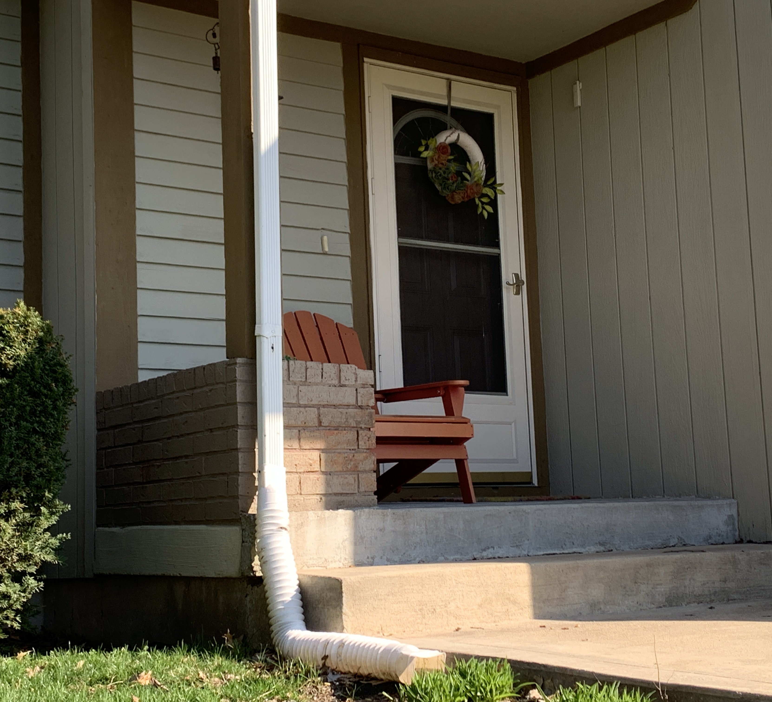
Photo of what you drew from observation of 2-point perspective

Slide 4
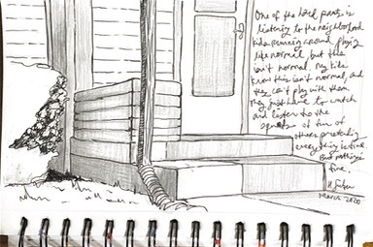
Your drawing from observation of 2-point perspective

