Slide 1
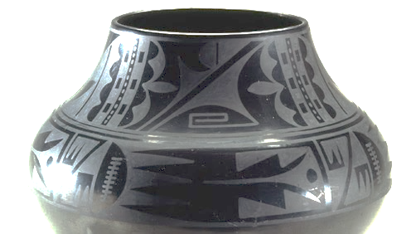
Puebloan: Maria Martinez, Black-on-black ceramic vessel

Slide 2
Draw both of these forms in your SB

Slide 3
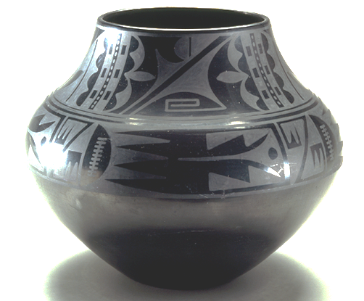
How are these forms different?

Slide 4
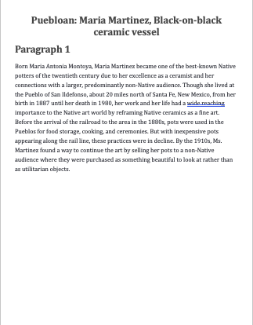
Read the paragraph given to you
Highlight two key sentences
Write them onto your note page
Illustrate what you wrote

Slide 5
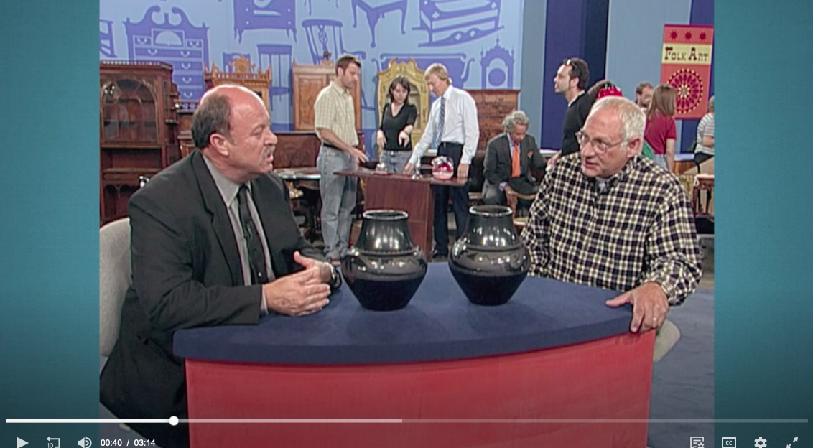
https://www.pbs.org/video/appraisal-maria-martinez-pots-ca-1930-ig9r6t/

Slide 6
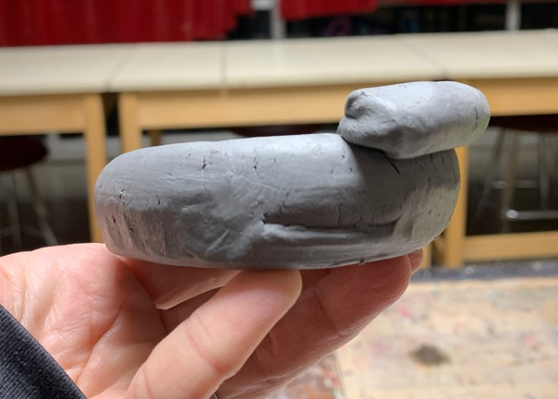
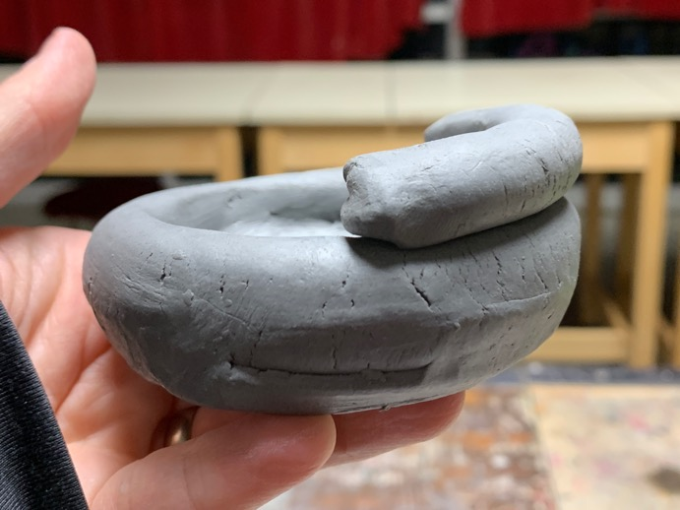
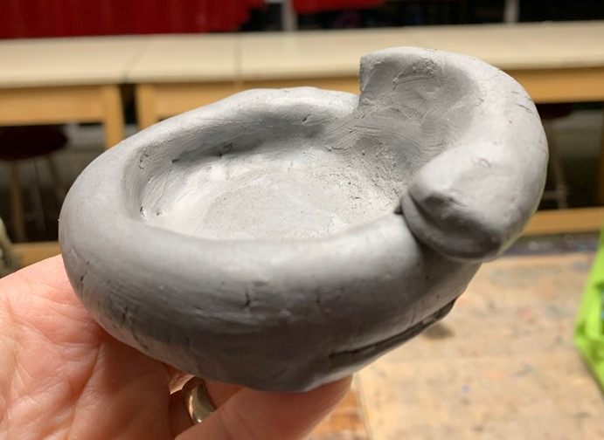

Slide 7
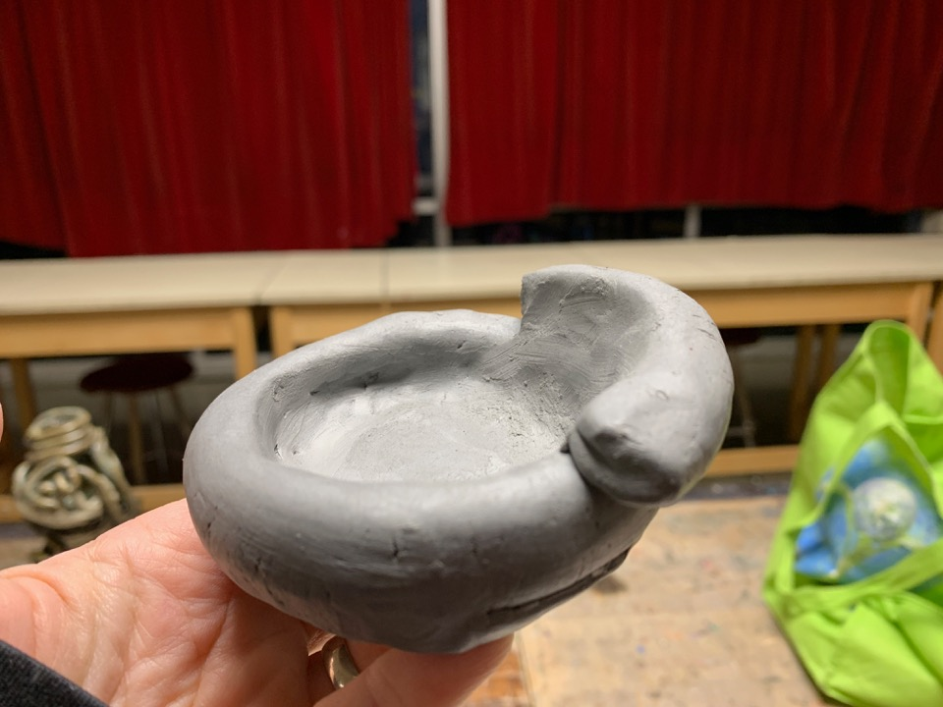

Slide 8
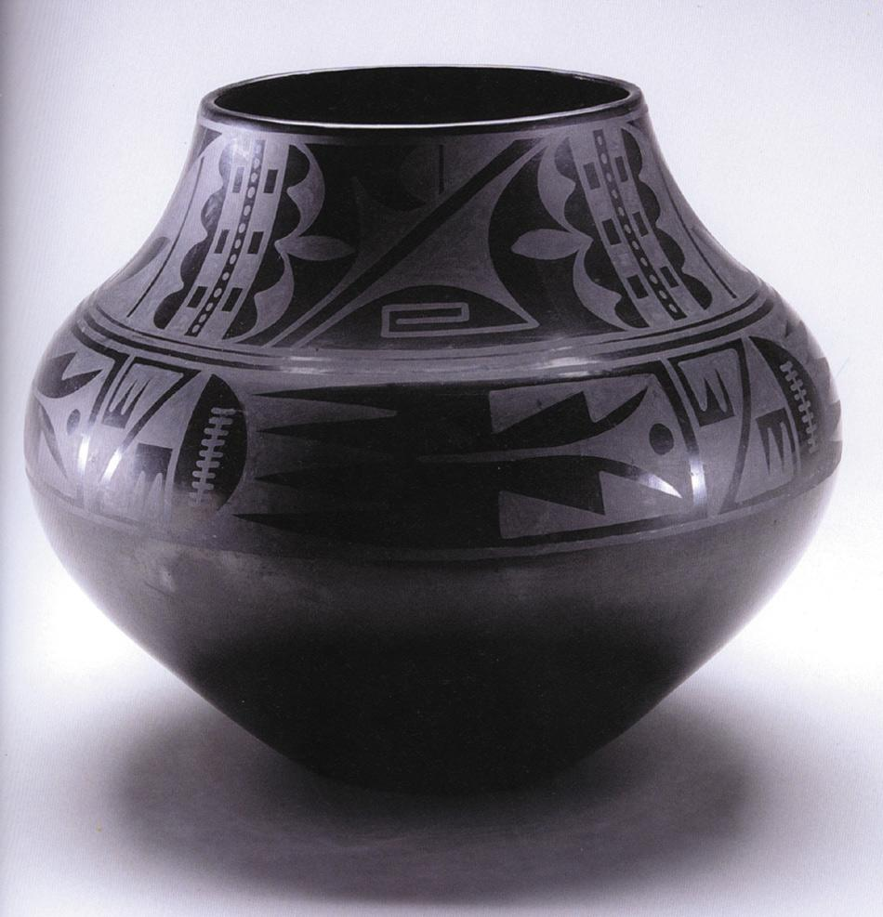
166. Black-on-black ceramic vessel. Maria Martínez and Julian Martínez, Puebloan, San Ildefonso Pueblo, New Mexico. c. mid-20th century C.E. Blackware ceramic.
Notes:
166. Black-on-black ceramic vessel. Maria Martínez and Julian Martínez, Puebloan, San Ildefonso Pueblo, New Mexico. c. mid-20th century C.E. Blackware ceramic.

Slide 9
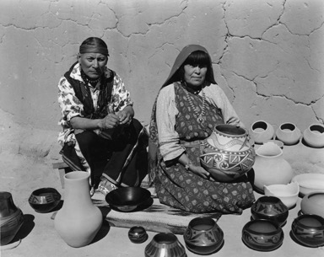
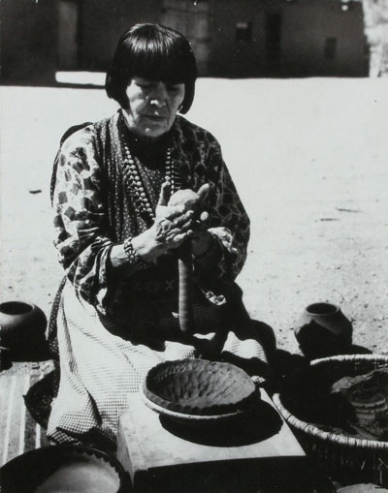
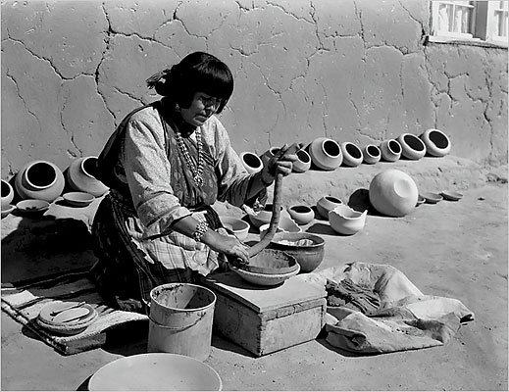
Longer Video: Maria Martinez - 26:46
Hands of Maria, pt 1, 7:26
Hands of Maria, pt 2, 7:27
Notes:
166. Black-on-black ceramic vessel. Maria Martínez and Julian Martínez, Tewa, Puebloan, San Ildefonso Pueblo, New Mexico. c. mid-20th century C.E. Blackware ceramic.
Maria Martinez became one of the best-known Native potters of the twentieth century
Because ofher excellence as a ceramist and her connections with a larger, predominantly non-Native audience.
She makes all hand built clay pieces- does not use the pottery wheel

Slide 10
Learning Targets
I can slip & score as I continue to add coils
I can intentionally place my coils to build a Maria Martinez inspired vessel that has a curved form.

Slide 11
How are these forms different?

Slide 13
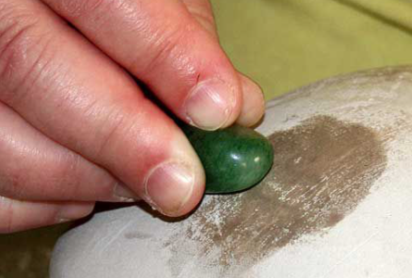
How do you get your vessel to be shiny and smooth??
Burnish the surface
What does BURNISH mean?
Burnish= polish by rubbing.

Slide 14
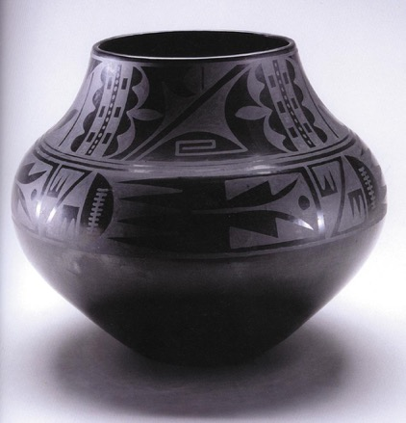
two bands of designs
Designs are abstract
Notes:
Process
Maria and Julian Martinez pioneered a style of applying a matte-black design over polished-black.
they discovered that smothering the fire with powdered manure removed the oxygen while retaining the heat and resulted in a pot that was blackened.
This resulted in a pot that was less hard and not entirely watertight, which worked for the new market that prized decorative use over utilitarian value.
The areas that were burnished (rubbed) had a shiny black surface and the areas painted with guaco were matte designs
Form
two design bands, one across the widest part of the pot and the other around the neck.
The elements inside are abstract but suggest a bird in flight with rain clouds above, perhaps a prayer for rain that could be flown up to the sky.

Slide 15
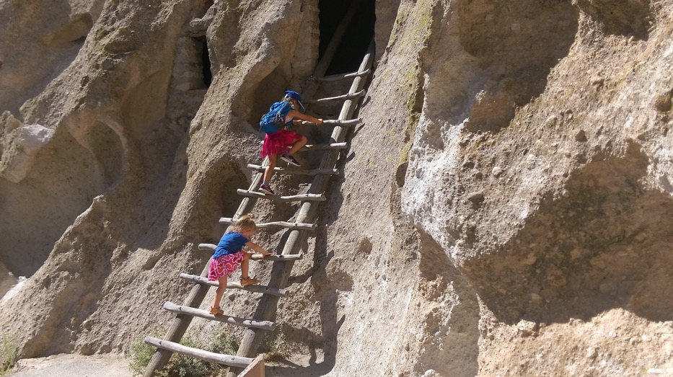
Bandelier
-Ancestral Pueblo Culture
-1100-1500 CE
Notes:
In 1908 Julian Martinex (Maria’s husband) was working on the excavation site for Bandelier National Monument= Ancestral Pueblo dig site
At Bandelier National Monument they found black-on-black prehistoric ceramic sherds unlike any previously seen.
Not long after her marriage to Julian Martínez, María was asked to replicate some pre-historic pottery styles that had been discovered in an archaeological excavation of an ancient pueblo site near San Ildefonso.
After much trial and error, Maria and Julian successfully created black pottery that looked just like the excavated sherds.
This began an artistic collaboration that would last throughout their lives together.
http://newmexicohistory.org/people/maria-martinez
https://www.nps.gov/museum/exhibits/band/contemporary.html
Asch & Curless
https://artsandculture.google.com/exhibit/eQJyr8ywtOJAIQ
Pic from 2015

Slide 16
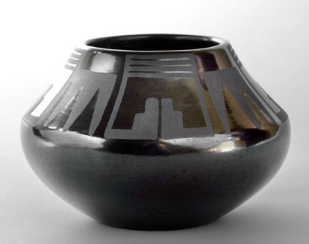
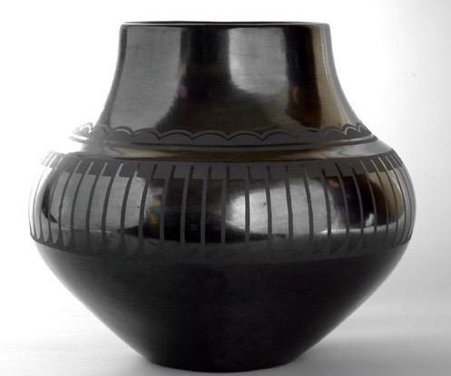
Design needs to have two bands that wrap around whole vessel
Shapes need to reoccur (happen more than once)- creating a pattern
Shapes are non-objective/ non-identifiable objects
Notes:
Design needs to have two bands that wrap around whole vessel
Shapes need to reoccur (happen more than once)- creating a pattern
Shapes are non-objective/ non-identifiable objects

Slide 17
Design needs to have two bands that wrap around whole vessel
Shapes need to reoccur (happen more than once)- creating a pattern
Shapes are non-objective/ non-identifiable objects
Notes:
Many obviously came from natural forms, while others are simple developments of geometric or lineal motifs.

Slide 18
Design needs to have two bands that wrap around whole vessel
Shapes need to reoccur (happen more than once)- creating a pattern
Shapes are non-objective/ non-identifiable objects

Slide 19
Design needs to have two bands that wrap around whole vessel
Shapes need to reoccur (happen more than once)- creating a pattern
Shapes are non-objective/ non-identifiable objects

Slide 20
Design needs to have two bands that wrap around whole vessel
Shapes need to reoccur (happen more than once)- creating a pattern
Shapes are non-objective/ non-identifiable objects

Slide 22
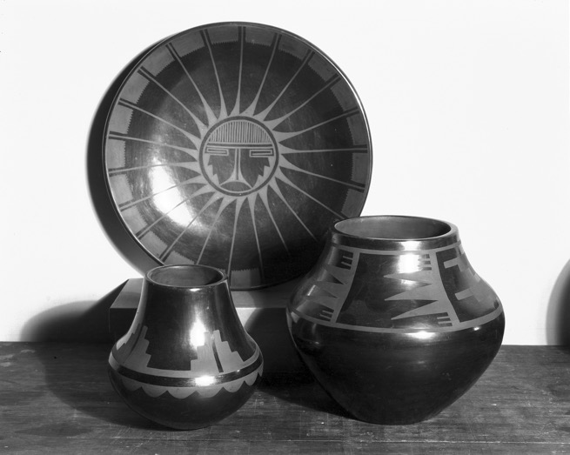
Notes:
How does the community help shape the art?
Making ceramics in the Pueblo was considered a communal activity
different steps in the process were often shared
The potters helped each other with tasks such as mixing the paints and polishing the slip
Ms. Martinez would form the perfectly symmetrical vessels by hand and leave the decorating to others.
Throughout her career, she worked with different family members, including her husband Julian, her son Adam and his wife Santana, and her son Popovi Da.

Slide 23
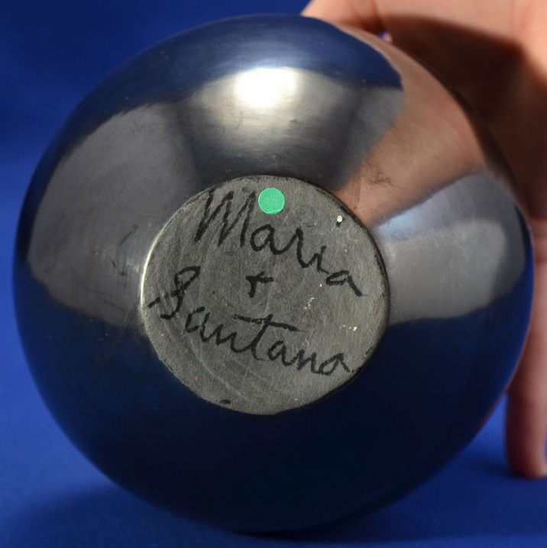
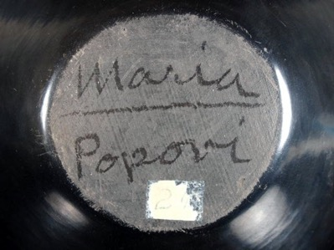
Notes:
What’s in a name??!
As the pots moved into a fine art market, Ms. Martinez was encouraged to sign her name on the bottom of her pots. Though this denied the communal nature of the art, she began to do so as it resulted in more money per pot. To help other potters in the Pueblo, Ms. Martinez was known to have signed the pots of others, lending her name to help the community. Helping her Pueblo was of paramount importance to Ms. Martinez. She lived as a proper Pueblo woman, avoiding self-aggrandizement and insisting to scholars that she was just a wife and mother even as her reputation in the outside world increased.

Slide 24
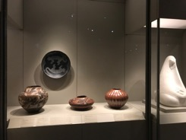
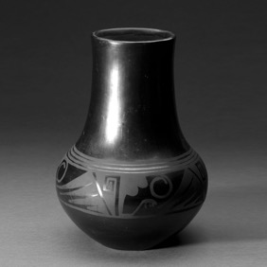
Notes:
Maria Martinez on view at the Nelson! (center photo)
Significance
The work of Maria Martinez marks an important point in the long history of Pueblo pottery.
reframed Native ceramics as a fine art.
they were purchased as something beautiful to look at rather than as utilitarian objects.
She brought the distinctive Pueblo style into a wider context, allowing Native and non-Native audiences to appreciate the art form.

Slide 25
Notes:
Compare & Contrast
Both are hand-built- no pottery wheel was used
Geometric/abstract designs
Influence/harmony with nature

Slide 26
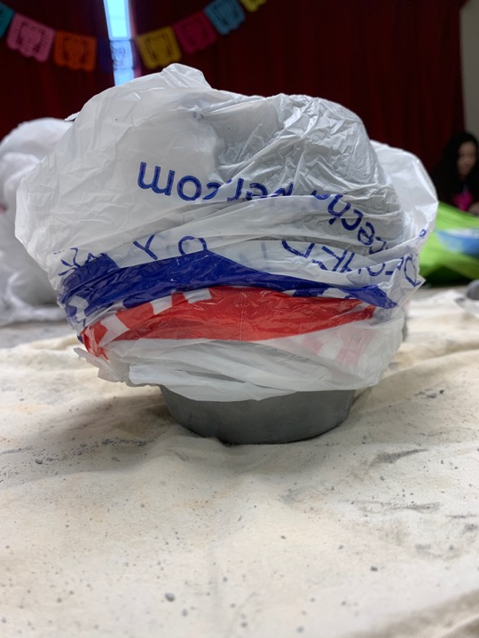
To clean up…
Wrap your bag only on the top half of your clay pot
Put the whole thing on the top of the cabinet, towards the back
ONE MORE DAY OF COIL BUILDING!

Slide 27
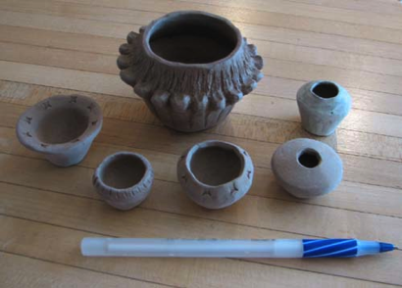
What are the 4 Stages of Clay?
It’s alive!

Slide 28
What are the 4 Stages of Clay?
Greenware- (1st Stage of Clay) a term used for clay that has not had an initial firing. Still malleable
It’s alive!

Slide 29
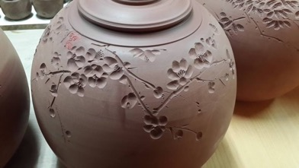
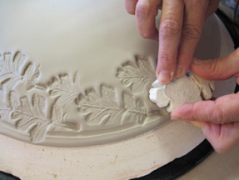
What are the 4 Stages of Clay?
Greenware- (1st Stage of Clay) a term used for clay that has not had an initial firing. Still malleable
Leather-hard- the state of semi-dryness in an unfired piece of clay. This is the preferred time for building, final tooling, carving and surface design.

Slide 30
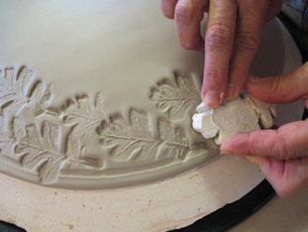
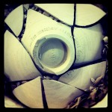
What are the 4 Stages of Clay?
Greenware- (1st Stage of Clay) a term used for clay that has not had an initial firing. Still malleable
Leather-hard- the state of semi-dryness in an unfired piece of clay. This is the preferred time for building, final tooling, carving and surface design.
Bone-dry- The final stage of greenware, clay dried to a completely dry state and ready to be fired. In this stage, the clay is very fragile

Slide 31
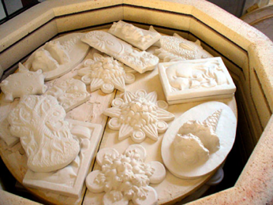
What are the 4 Stages of Clay?
Greenware- (1st Stage of Clay) a term used for clay that has not had an initial firing. Still malleable
Leather-hard- the state of semi-dryness in an unfired piece of clay. This is the preferred time for building, final tooling, carving and surface design.
Bone-dry- The final stage of greenware, clay dried to a completely dry state and ready to be fired. In this stage, the clay is very fragile
Bisqueware- fired but unglazed clay.

Slide 32
What are the 4 Stages of Clay?
Greenware- (1st Stage of Clay) a term used for clay that has not had an initial firing. Still malleable
Leather-hard- the state of semi-dryness in an unfired piece of clay. This is the preferred time for building, final tooling, carving and surface design.
Bone-dry- The final stage of greenware, clay dried to a completely dry state and ready to be fired. In this stage, the clay is very fragile
Bisqueware- fired but unglazed clay.

Slide 33
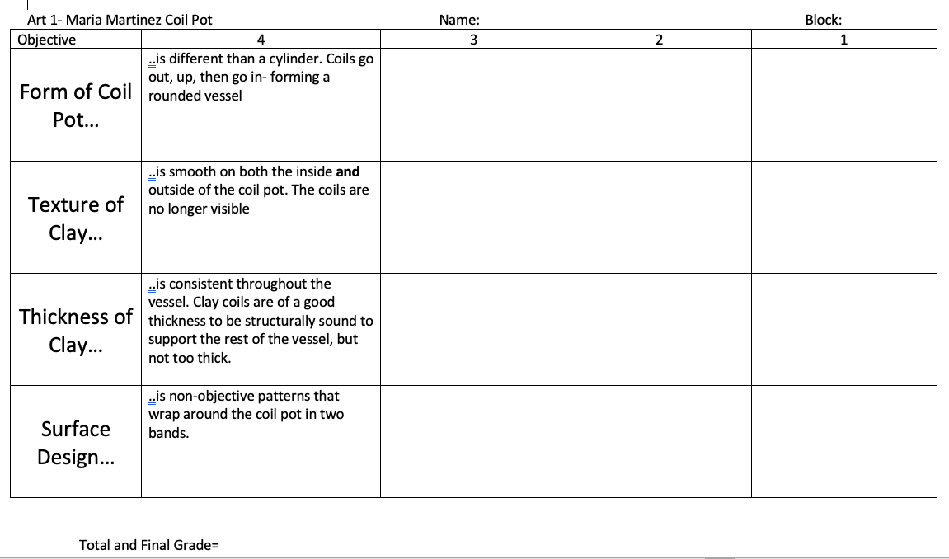

Slide 34
There is an element of relief that has been repeated in a pattern

Slide 35
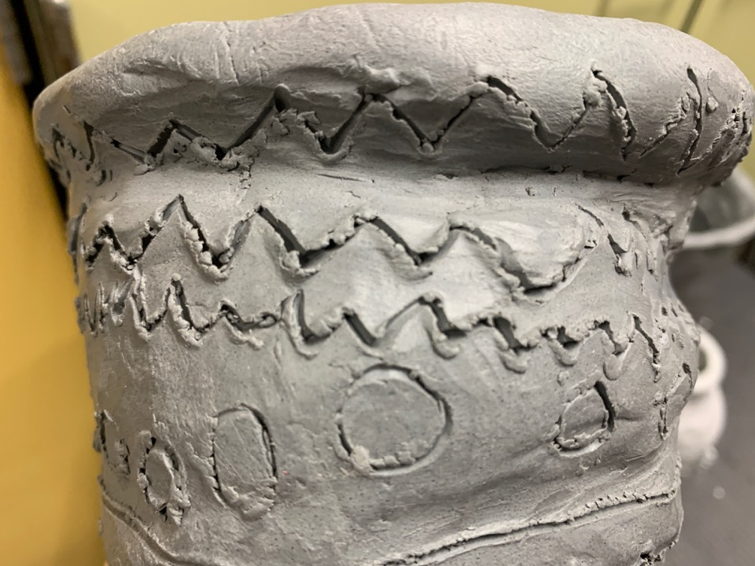
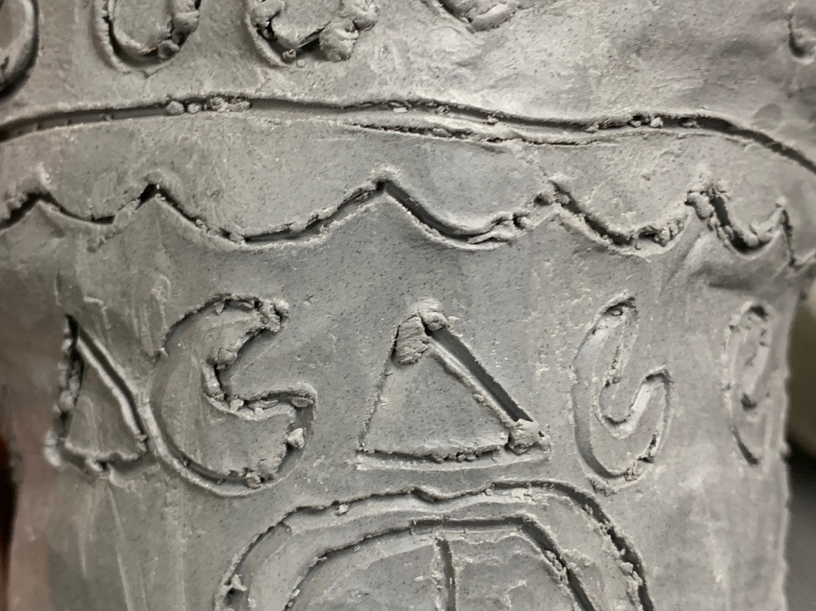

Slide 36
What is Glaze?
) A smooth, shiny coating on food
) A substance fused to the surface of pottery to make it water-proof and decorated
) A thin transparent layer on a painting

Slide 37
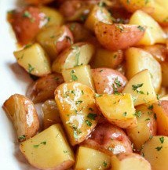
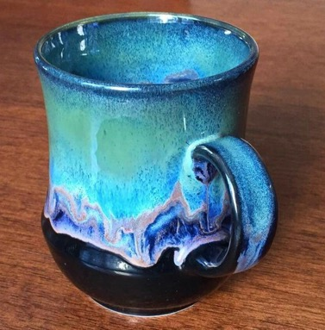
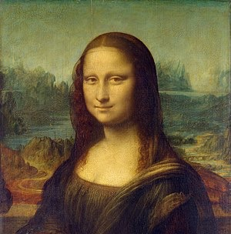
What is Glaze?
A smooth, shiny coating on food
A substance fused to the surface of pottery to make it water-proof and decorated
A thin transparent layer on a painting

Slide 38
What is Glaze?
A smooth, shiny coating on food
A substance fused to the surface of pottery to makes clay water-proof and decorated
A thin transparent layer on a painting

Slide 39
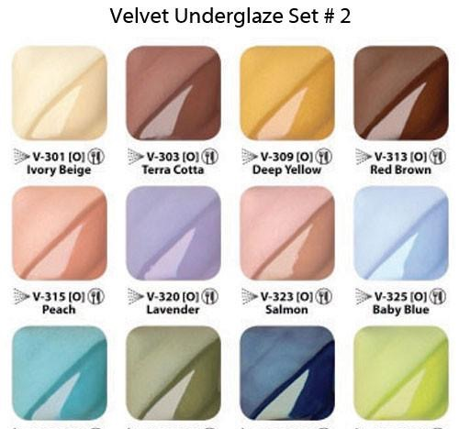
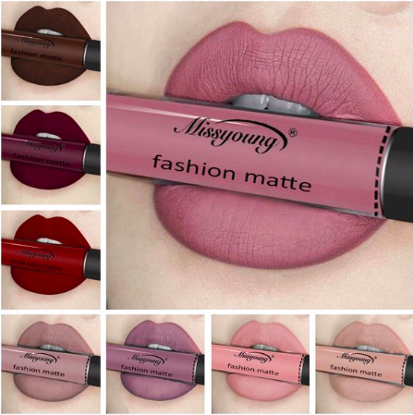
Underglaze=NOT shiny.. Matte
Clear Glaze on top= shiny

Slide 40
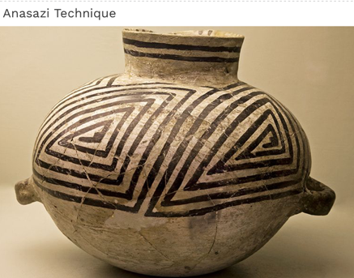
Step 1: Select any color for the inside of the coil pot
Step 2: Apply 3 coats of that color to the inside by painting it on
Step 3: Select an Anasazi Technique or a Puebloan Technique to glaze the outside of your piece
Martinez-Puebloan technique

Slide 41
Step 3: Anasazi Technique
Paint with the Black UNDERGLAZE, simple designs that repeat to make patterns
Go over the designs at least twice to have two coats
Cover entire outer surface with clear glaze, use 2-3 coats
Step 3: Puebloan Technique
Cover entire outer surface with black UNDERGLAZE at least 2 times- having 2 coats
Enhance your relief design by using the clear glaze to only have certain parts be shiny
Use 2-3 coats of the clear glaze
Martinez-Puebloan technique

Slide 42
I can use either an Anasazi or Puebloan glazing technique using both underglaze and clear glaze
Martinez-Puebloan technique

Slide 43
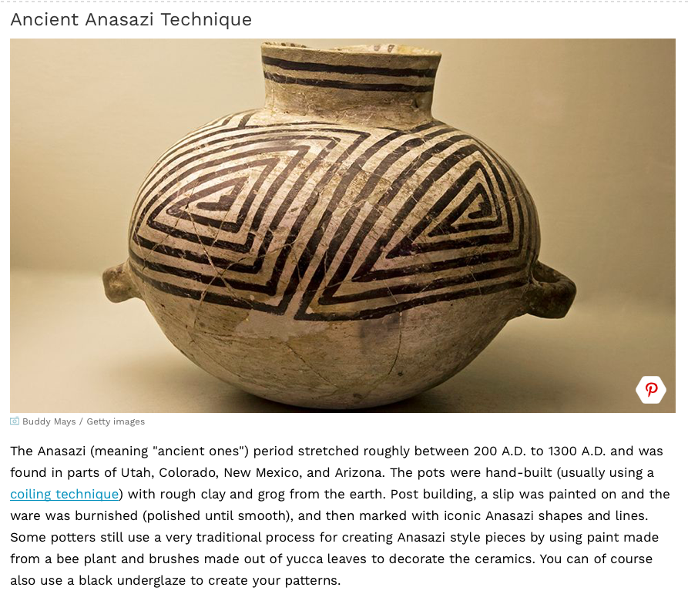

Slide 44
Ancient Anasazi pottery shards that influenced Martinez family
Notes:
(In archaeology, a sherd, or more precisely, potsherd, is commonly a historic or prehistoric fragment of pottery, although the term is occasionally used to refer to fragments of stone and glass vessels, as well. Occasionally, a piece of broken pottery may be referred to as a shard.)
Pottery sherds from Bandelier
Bandelier’s influence on the Geometric designs
Julian Martinez spent time drawing and painting the designs found on the walls and on the sherds of pottery into his notebooks from Bandelier
These are the designs he later recreated on pots.

Slide 45
