Slide 1
EQ: Why study other artists?
Notes:
The evolution of art
How did artists go from painting like this on the left (1790)
Tradition of painting started in the Renaissance/ 1400’s
, 500 years later, Mondrian on right (1930)

Slide 2
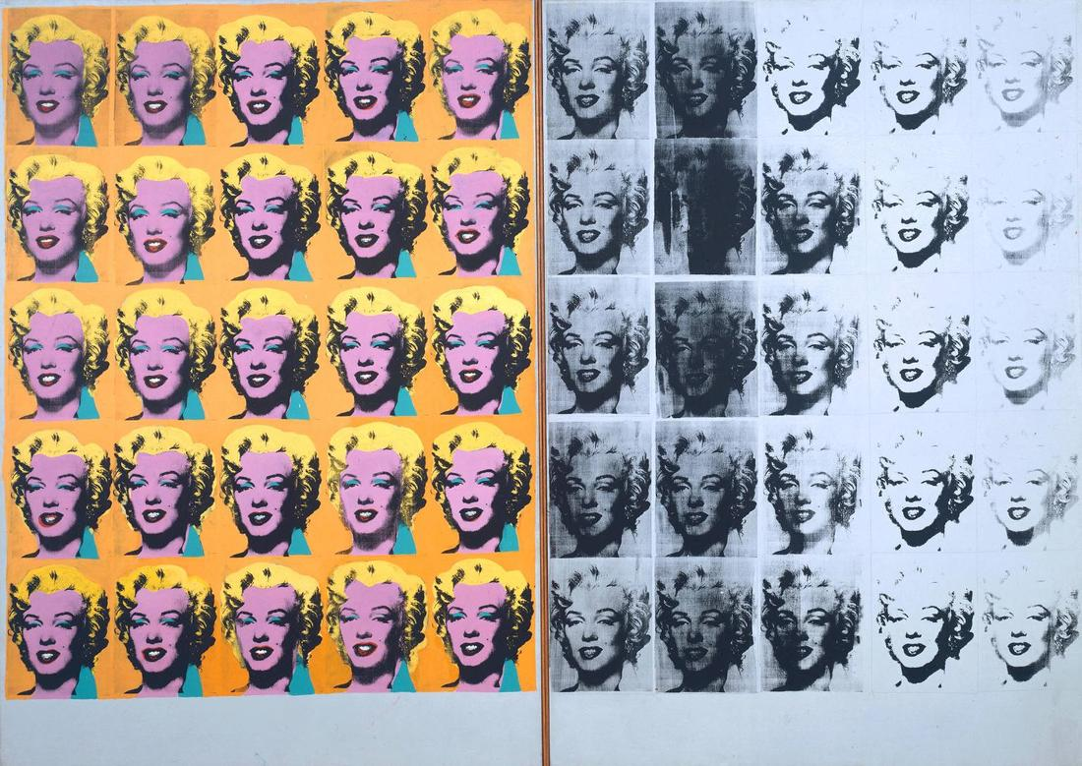
Notes:
The evolution of art
How did artists go from painting like this on the left (1790)
Tradition of painting started in the Renaissance/ 1400’s
, 500 years later, Mondrian on right (1930)
Andy Warhol/ Pop Art 1960’s

Slide 3
Hard edge painting is an approach to abstract painting that became widespread in the 1960s and is characterized by areas of flat color with sharp, clear (or 'hard') edges.
Notes:
Hard edge painting is an approach to abstract painting that became widespread in the 1960s and is characterized by areas of flat color with sharp, clear (or 'hard') edges.

Slide 4
Notes:
Alex Katz
Hard-edge painting is known for its economy of form, fullness of color, impersonal execution, and smooth surface planes.
He’s been painting portraits of his wife/ his muse, since 1958

Slide 5
Notes:
What do you think his style of painting could say about his personality?
Not only does he wear gloves while painting, those who visit his studios often note that paint doesn’t stay anywhere except on the canvas. Everything gets thoroughly cleaned. “I don’t like mess,” says Katz. “I don’t like paint on my clothes or my hands or my furniture.”
https://hamiltonselway.com/alex-katz-10-interesting-facts-didnt-know/

Slide 6
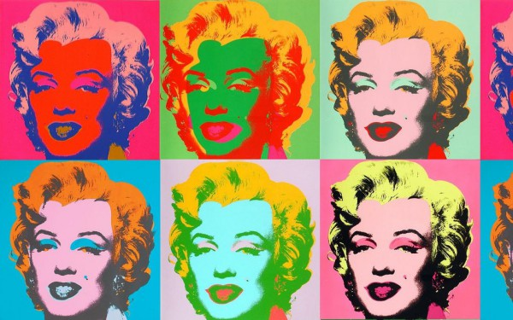
Notes:
Examples of artists who work with flat shapes of color
-Alex Katz
-Shepard Fairey
-Andy Warhol

Slide 7
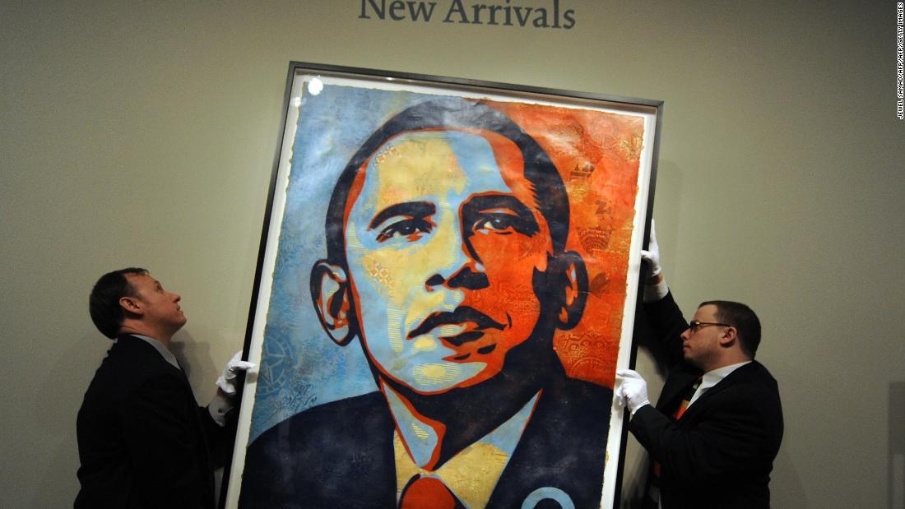
-Shepard Fairey
Notes:
Examples of artists who work with flat shapes of color
-Alex Katz
-Shepard Fairey
-Andy Warhol
Workers install Shepard Fairey's portrait of US President-elect Barack Obama at the National Portrait Gallery in Washington on January 17, 2009.
https://www.cnn.com/2017/11/20/politics/shepard-fairey-obey-giant/index.html

Slide 8
Notes:
Examples of artists who work with flat shapes of color
-Alex Katz
-Shepard Fairey
-Andy Warhol

Slide 9
Notes:
Examples of artists who work with flat shapes of color
-Alex Katz
-Shepard Fairey
-Andy Warhol

Slide 10
Notes:
Examples of artists who work with flat shapes of color
-Alex Katz
-Shepard Fairey
-Andy Warhol

Slide 11
Notes:
Examples of artists who work with flat shapes of color
-Alex Katz
-Shepard Fairey
-Andy Warhol

