Slide 2
Creating an illusion of SPACE
I CAN create a drawing with an illusion of space/depth.

Slide 3
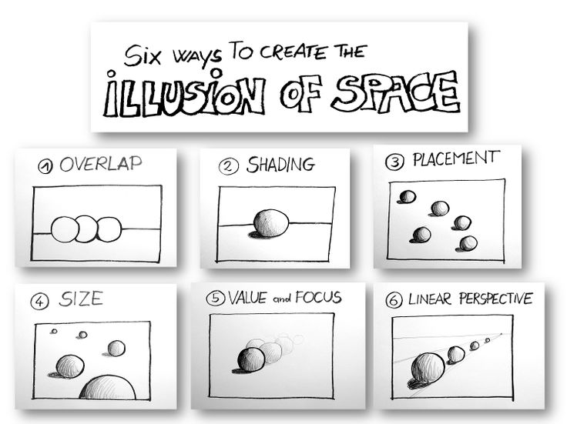

Slide 8
Notes:
Atmospheric Perspective

Slide 9
Notes:
Vanishing Point

Slide 11
Small square in the center of the paper
VP in center of square
Notes:
Draw this together in notes

Slide 12
Draw four lines touching VP and corners of square
This makes the sides, floor and ceiling

Slide 13
Notes:
Doorways and lockers are vertical with the tops and bottoms leading back to the VP

Slide 14
Notes:
Doorways and lockers are vertical with the tops and bottoms leading back to the VP

Slide 15
To create an open doorway draw a horizontal line here
Notes:
Doorways and lockers are vertical with the tops and bottoms leading back to the VP

Slide 16
Notes:
Floor tiles are made of horizontal lines and the sides of the tiles lead back to the VP
They will be small in the distance and larger closer to you

Slide 17
Notes:
Floor tiles are made of horizontal lines and the sides of the tiles lead back to the VP
They will be small in the distance and larger closer to you

Slide 18
Same idea with the ceiling tiles

Slide 19
Add details!!!

Slide 20
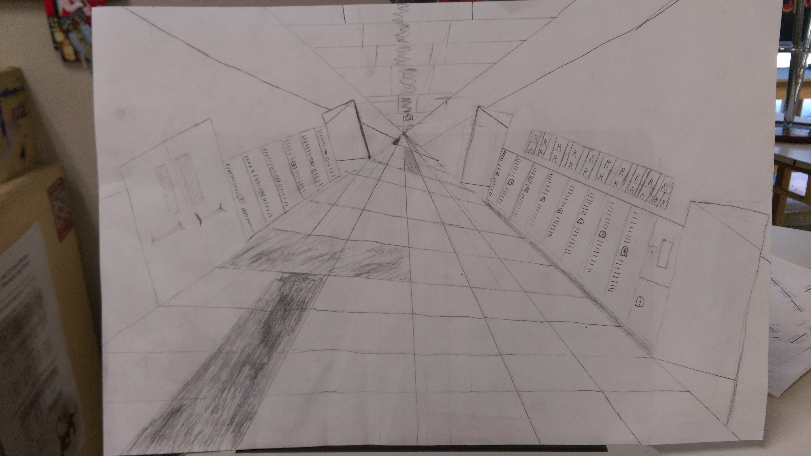
Notes:
What’s wrong with this one?

Slide 21
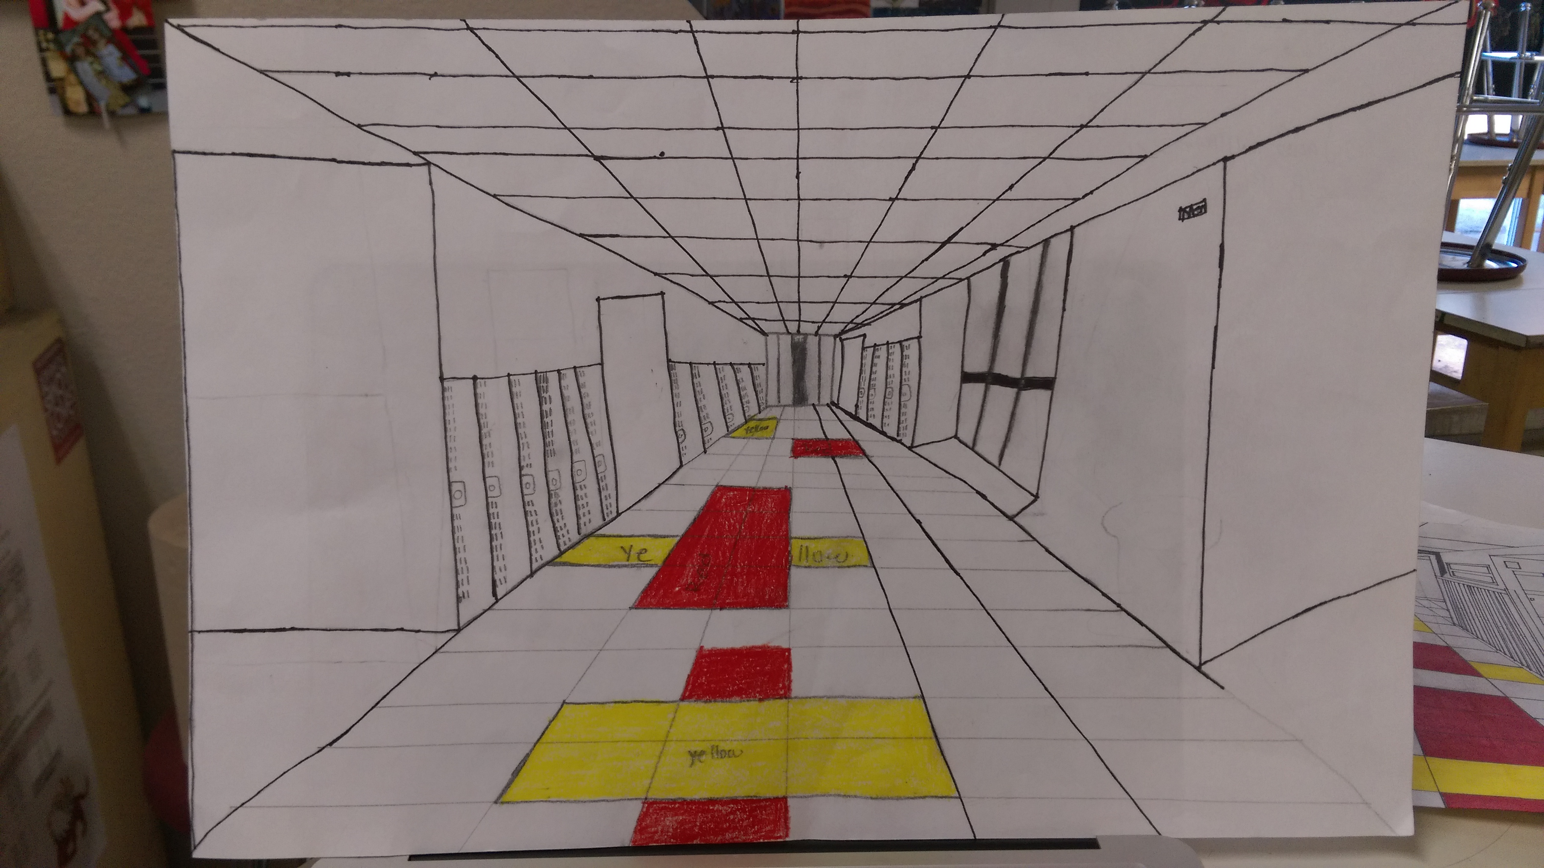

Slide 22
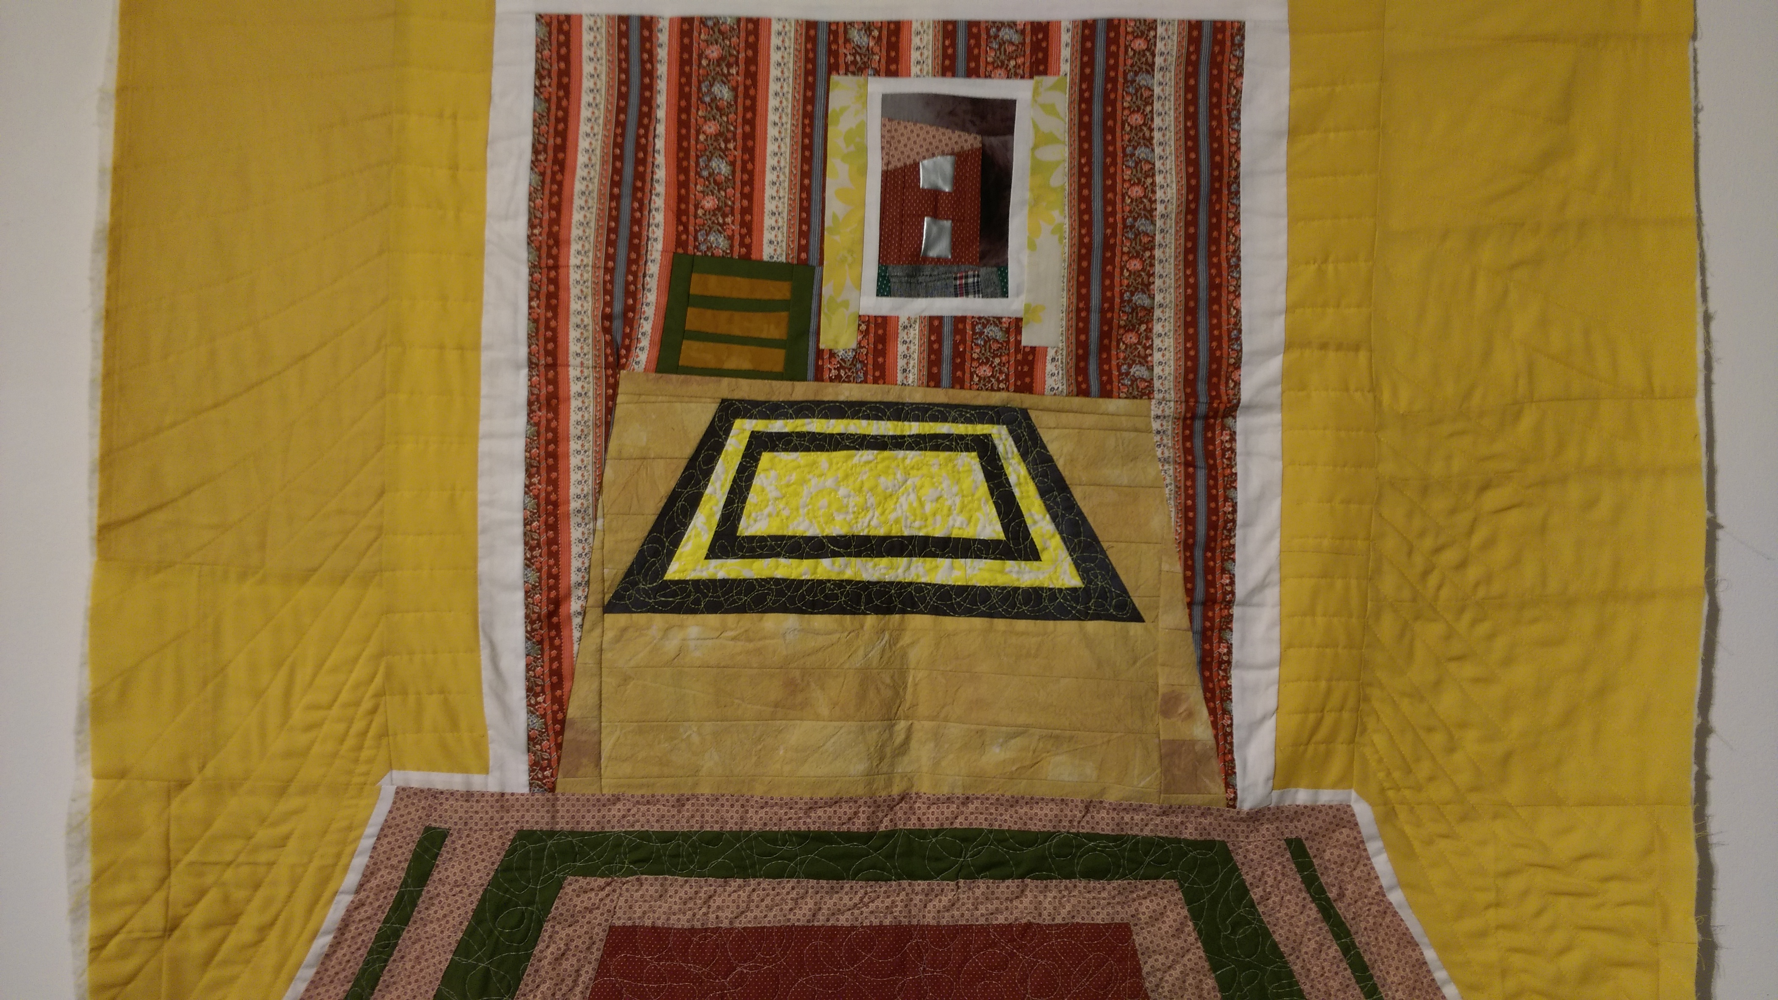

Slide 23
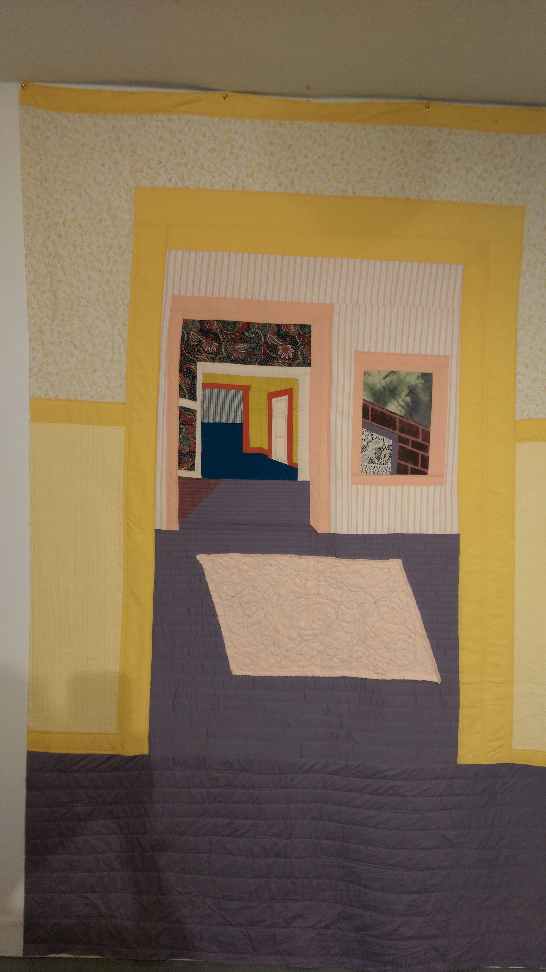
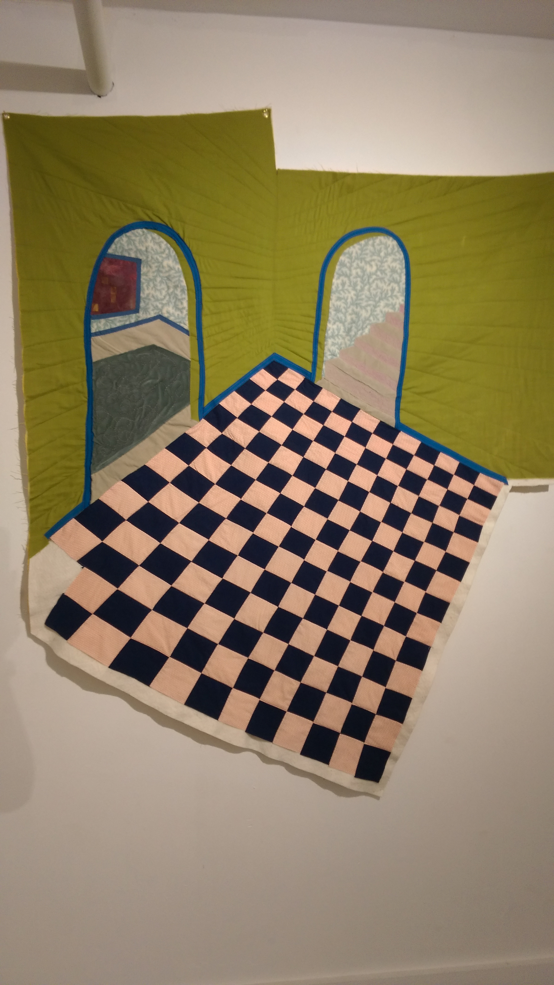

Slide 24
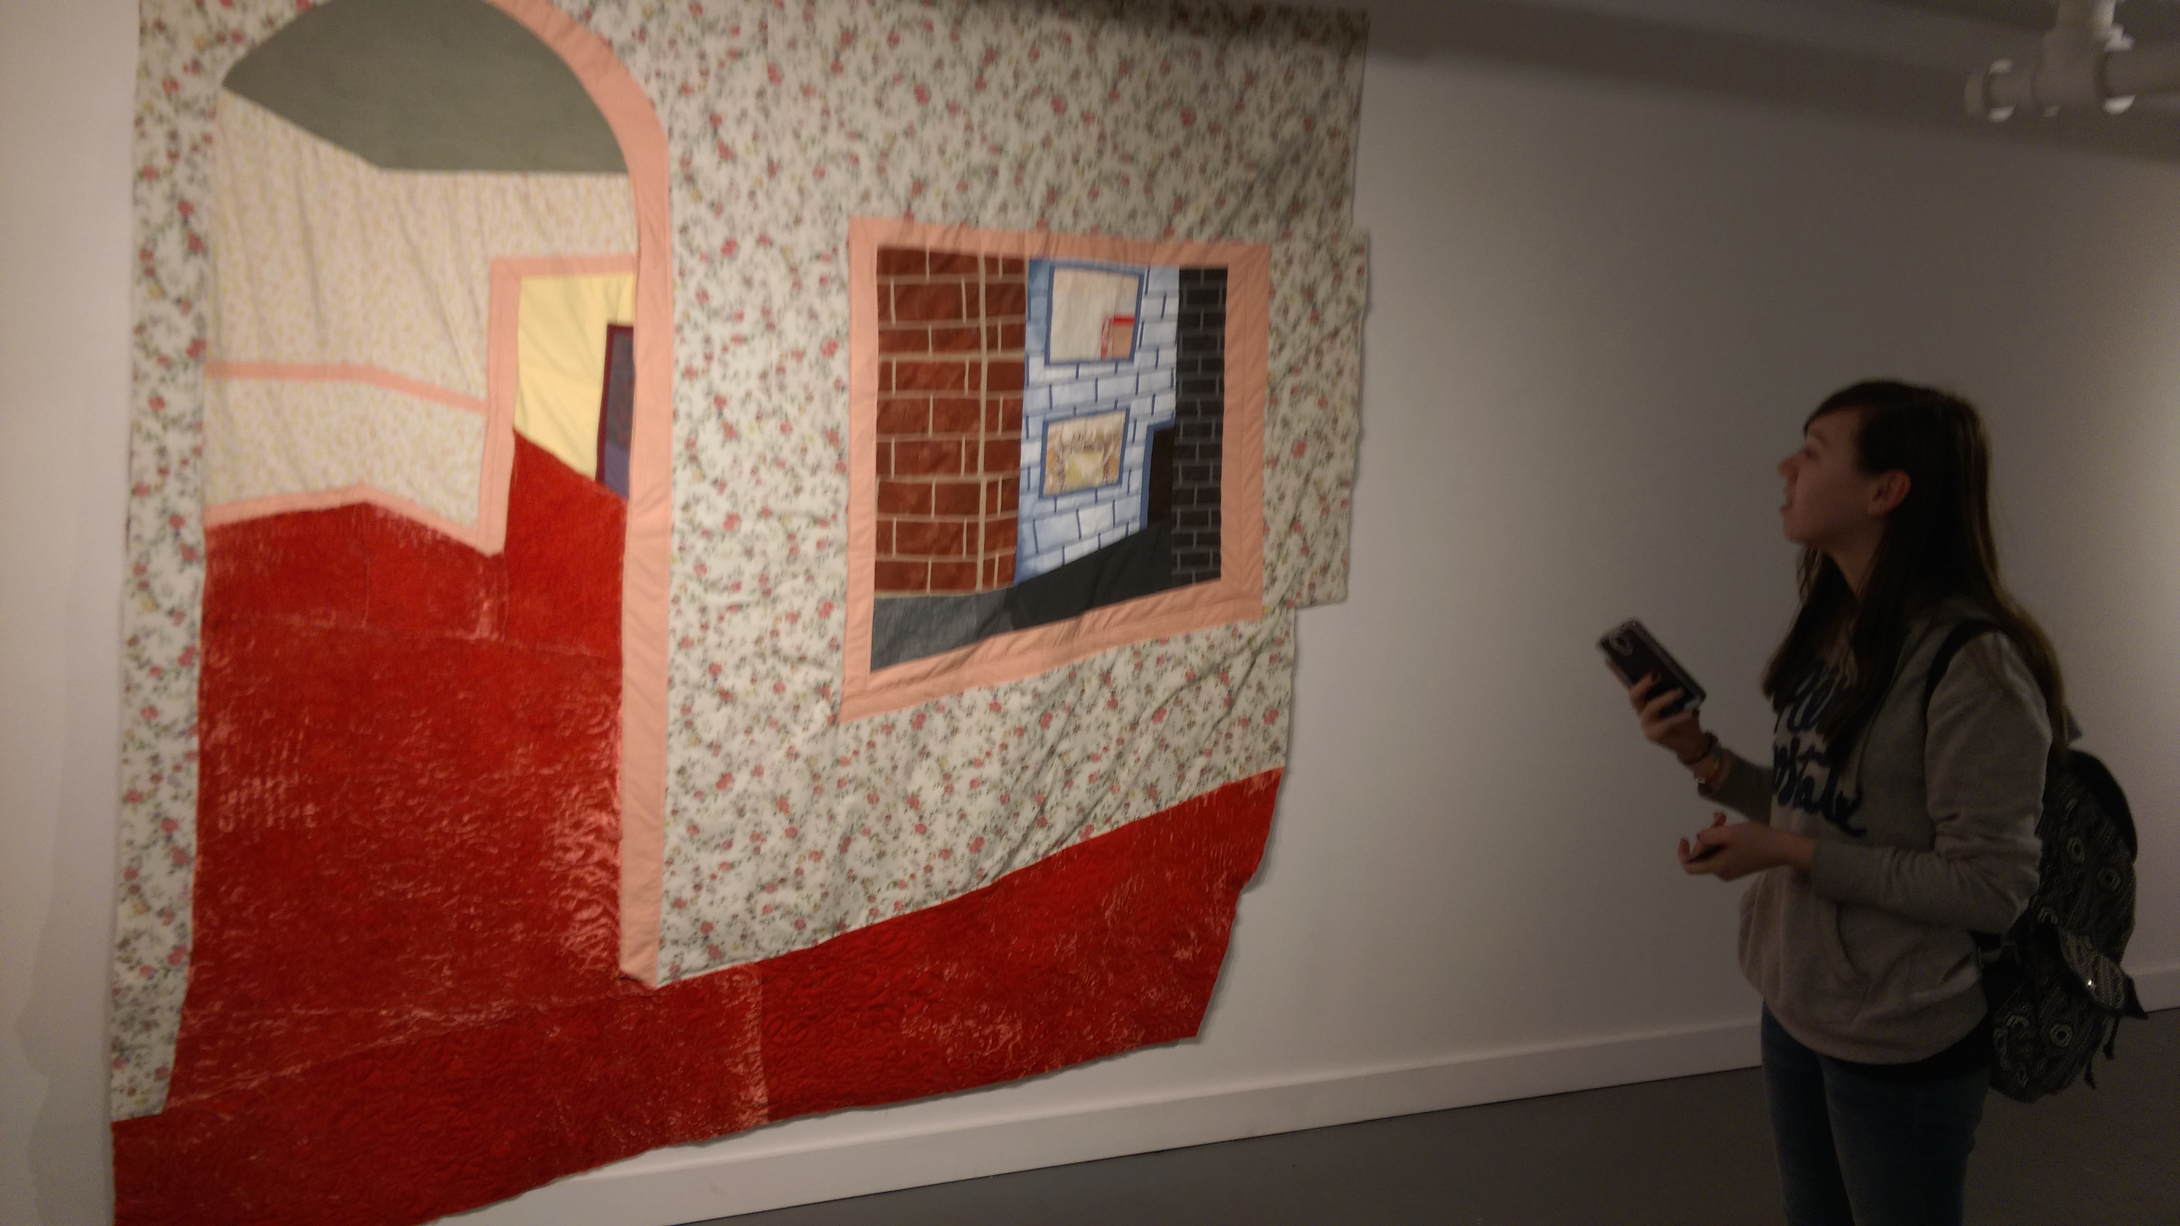

Slide 25
Ideas for when this is done
Sculpt 3D letters of name
Draw from three different angles; bird’s eye, worm’s eye & Linear
Cut out the best one and place into hallway drawing, add shadows!
Watercolor and pen

Slide 29
Goals with SHADING
Contrast: Have darks and lights throughout the drawing
Reflections: How can you make the floor look shiny?
Blending: There shouldn’t be lines in the shading- it should be smooth gradations of value

Slide 32
Goals with OUTLINING
Lines: lines are straight and clean and in pen or marker
Details: Details have been added to make the hallway be specific from observation
Emphasis: Either color, filled in black shapes or pencil has been added to emphasize features

Slide 33
Notes:
Working in groups- redraw one of the hallway drawings out of tape!!

Slide 34
I CAN use a flat wall or window space and using tape, create the
illusion of a 3D space
Lines are straight
Diagonals lead to a Vanishing Point
Vertical and Horizontal lines are parallel and perpendicular
Notes:
Working in groups- redraw one of the hallway drawings out of tape!!

Slide 35
Notes:
Perpendicular
Creates a 90 degree angle

Slide 36
Notes:
parallel

