Slide 1
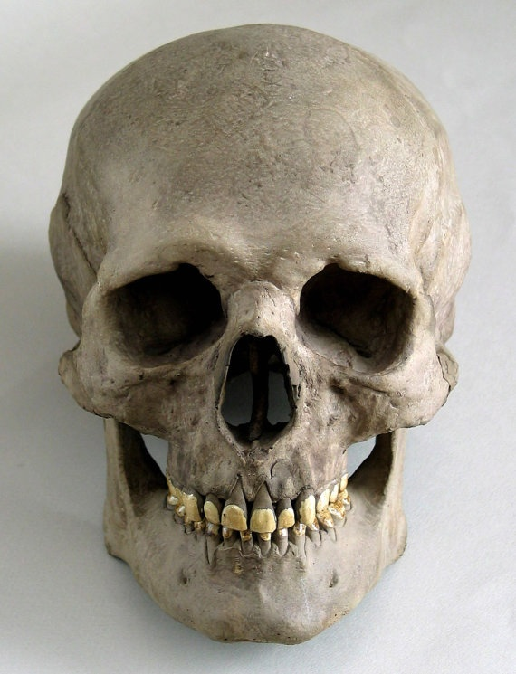
Straight on view

Slide 2
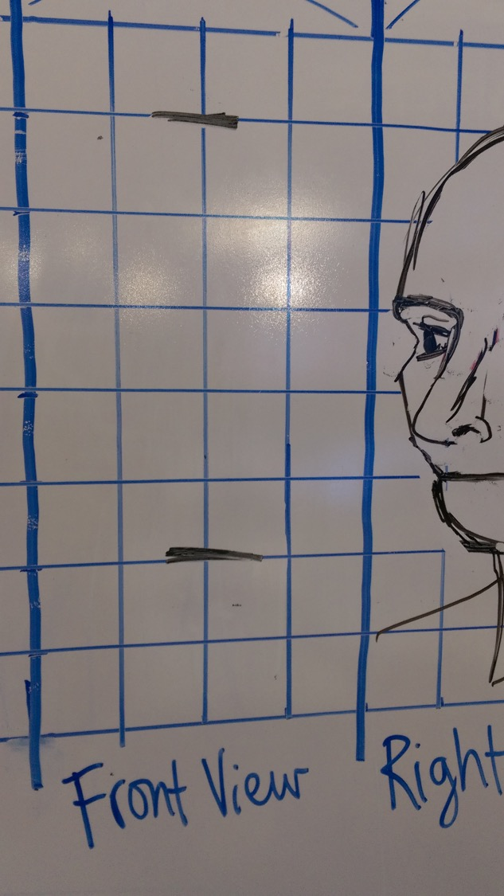
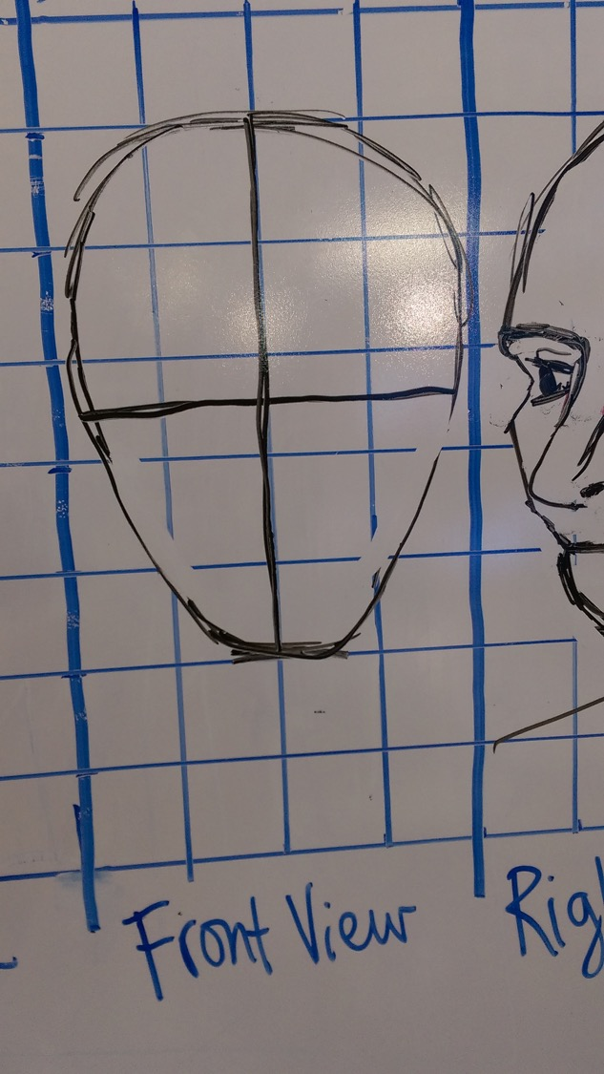
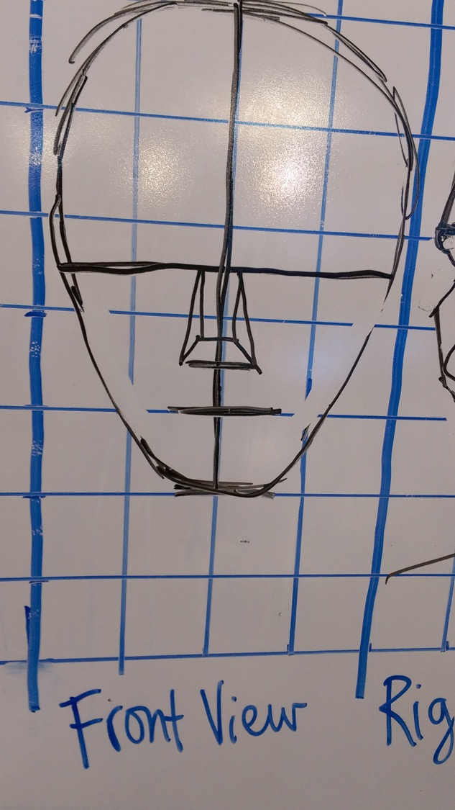

Slide 3
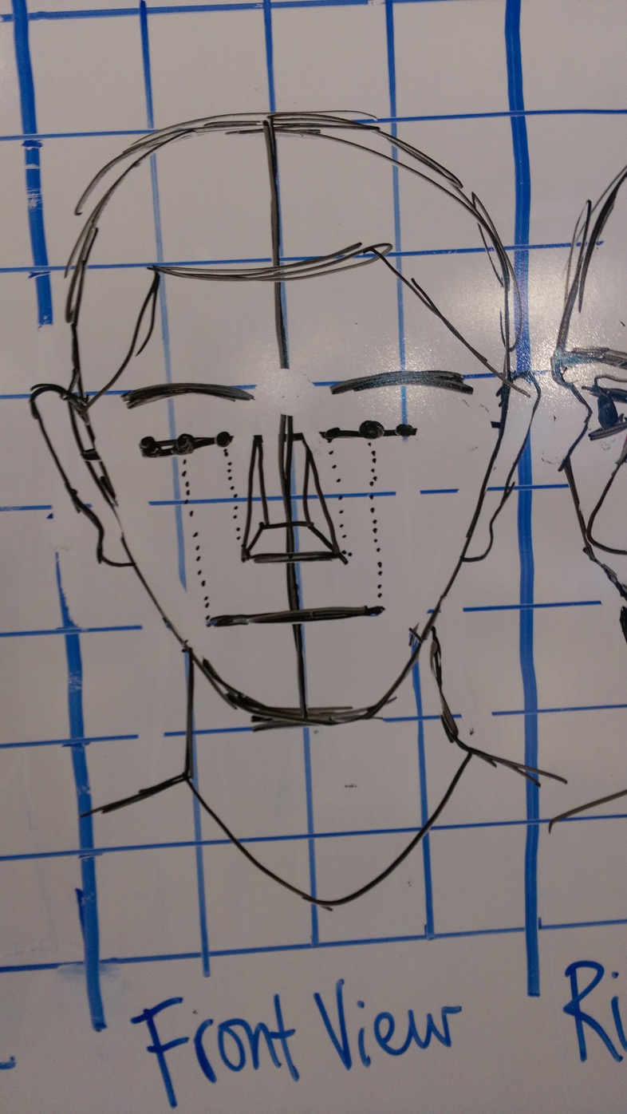
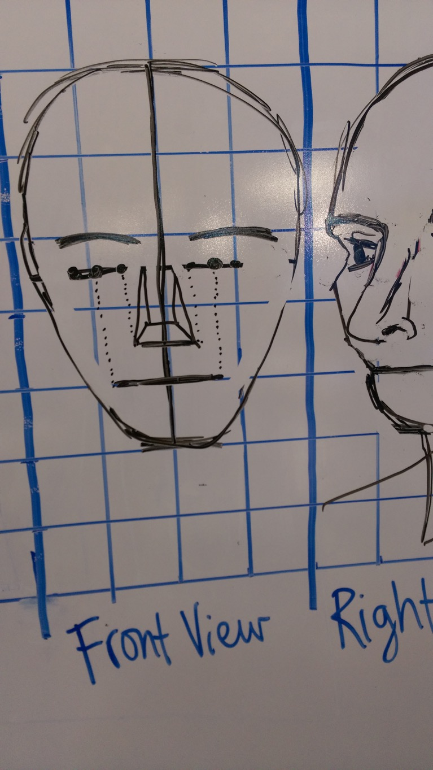
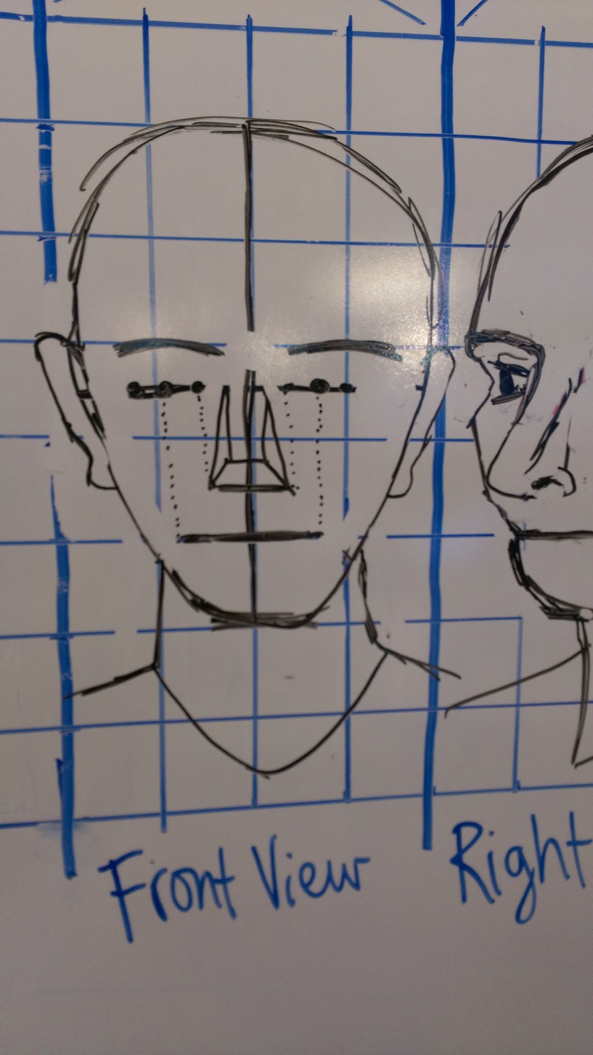

Slide 4
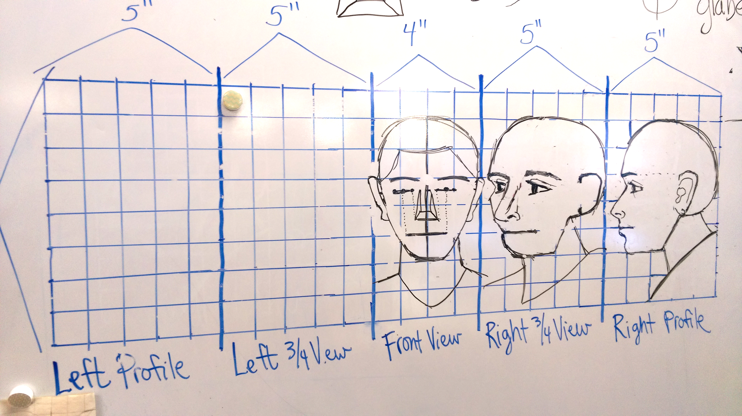
https://www.youtube.com/watch?v=QjcHhjt6bYo
Your job is to now finish the missing faces on the left using the ones we made together as your guide

Slide 5
Notes:
Front view facial features

Slide 6
Notes:
Front view facial features

