Slide 1
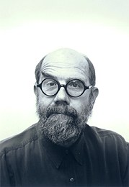
Chuck Close
Photo-realist Artist
LEARNING TARGET:
I can be inspired by the work of other artists.

Slide 2
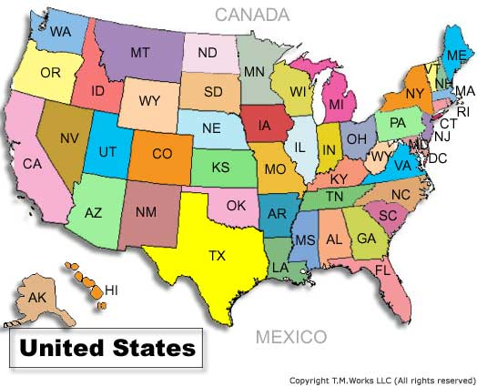
Chuck was born in 1940 in Washington State.
Monroe,
Washington
When Chuck was young, he was big and clumsy and not very athletic.

Slide 3
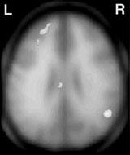
He had dyslexia which made people think he wasn’t very smart.

Slide 4
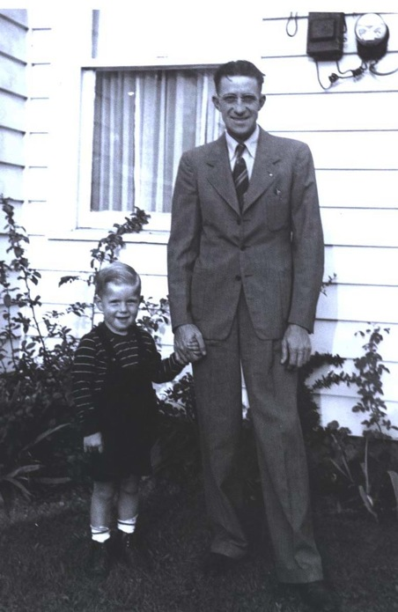
His father, who seemed to always be ill, died when Chuck was 11 years old.

Slide 5
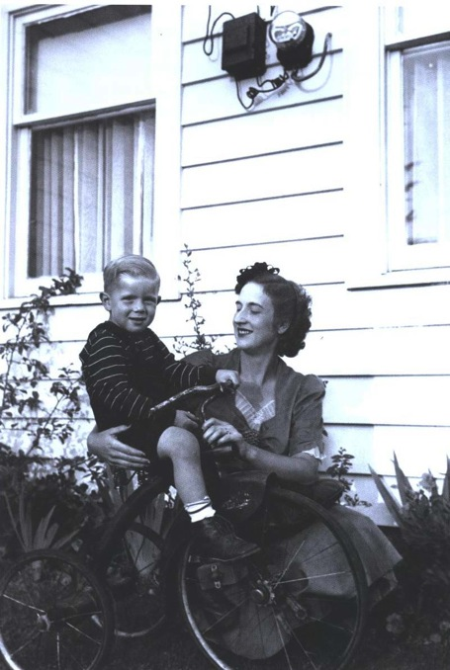
His mother, a trained pianist who gave up her career during the great depression, became ill with breast cancer.

Slide 6
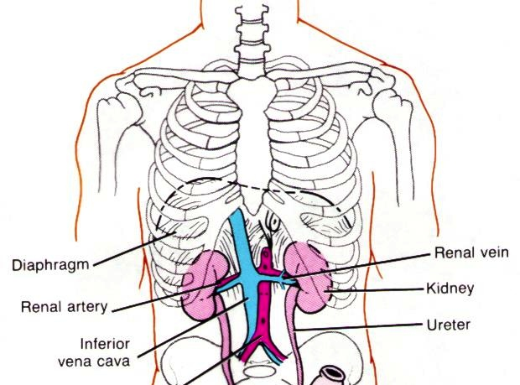
Chuck himself spent most of his childhood in bed with nephritis, a terrible kidney infection.

Slide 7
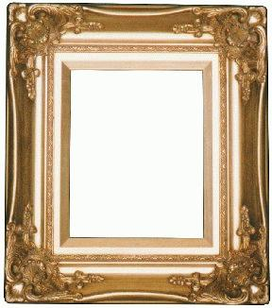
The only thing that kept him going through all of the sadness and misery was his art…
His talent was recognized and he knew he wanted to be an artist at 4 years old.

Slide 8
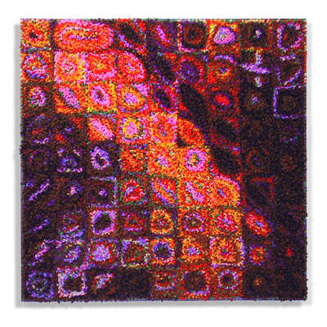
Despite what people thought, he graduated magna cum laude from the University of Washington and went on to get a graduate degree at Yale.

Slide 9
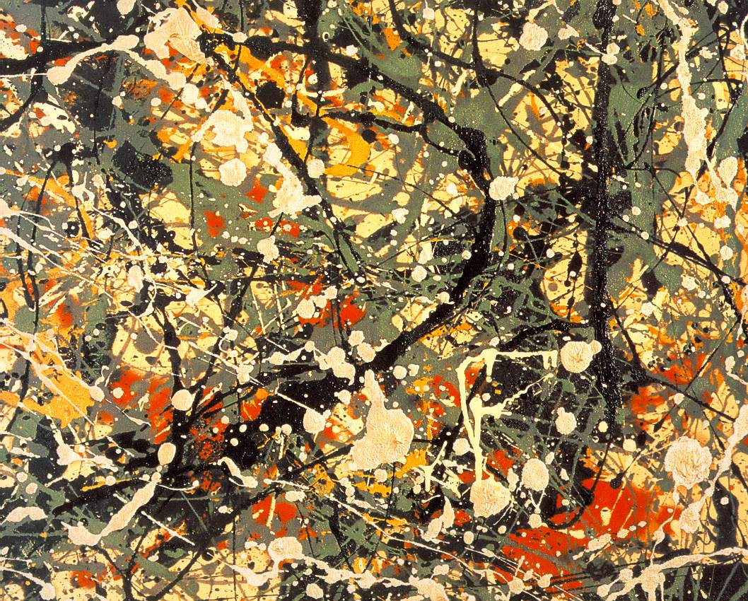
At the age of 14, he saw an exhibition of Jackson Pollock paintings. Pollock's style and flair had a great impact on Close, and, as he later recounted, it made him determined to become an artist.

Slide 10
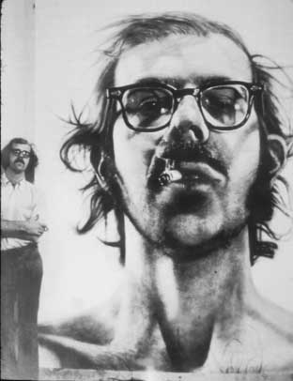
In 1964, Chuck began doing painstakingly realistic portraits of himself, friends, and family.

Slide 11
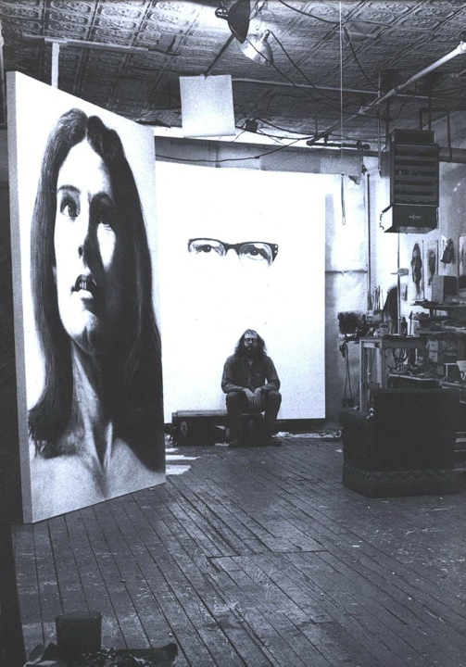
Here’s Chuck in his studio.

Slide 12
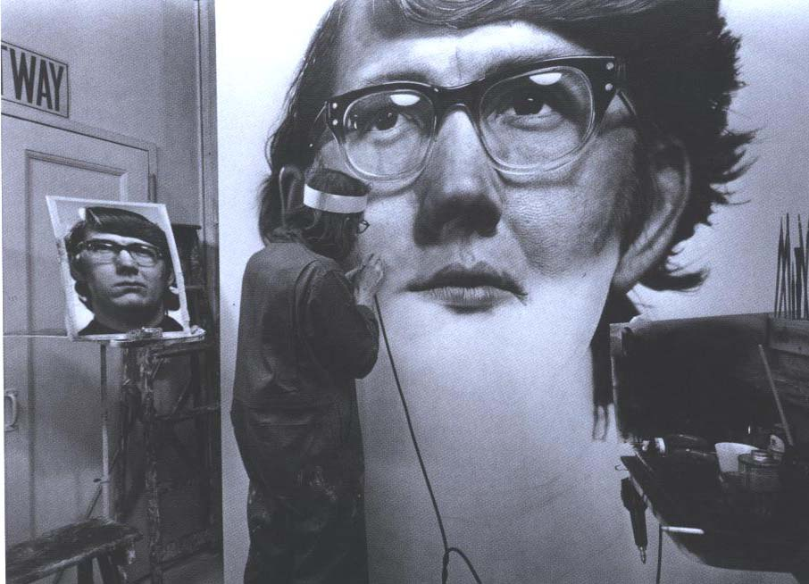
Chuck at work…

Slide 13
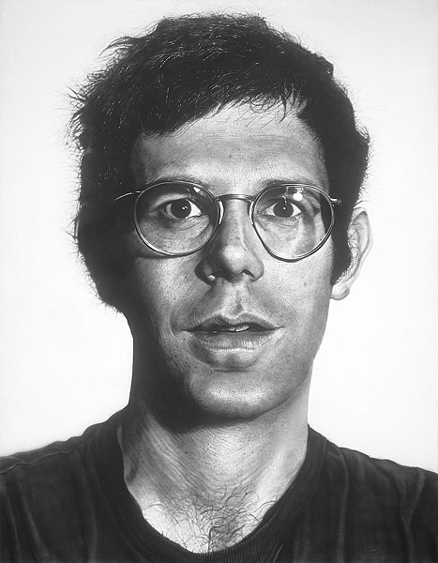
Because Chuck was obsessed with capturing every detail, his portraits were not flattering at all.
Bob, 1969

Slide 14
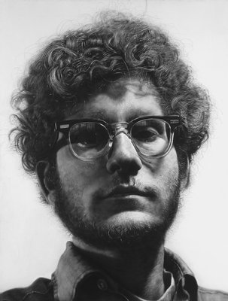
While most portrait artists accepted commissions to create portraits of famous or rich people, Chuck refused.
Frank, 1969

Slide 15
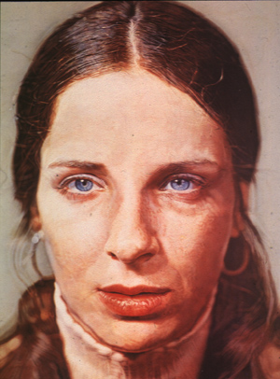
He wanted to draw people the way they really looked, not how people wanted to look.
Leslie (wife), 1973

Slide 16
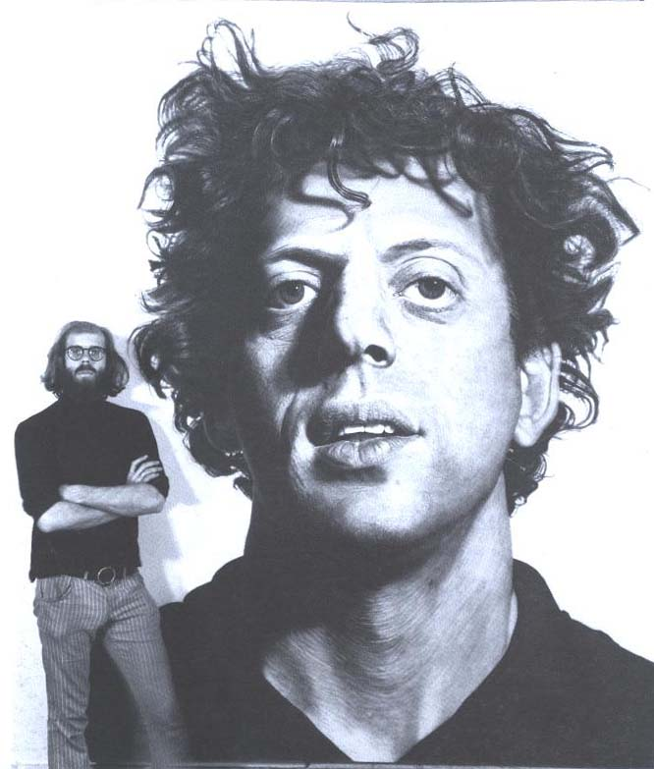
This is Chuck & Phil.

Slide 17
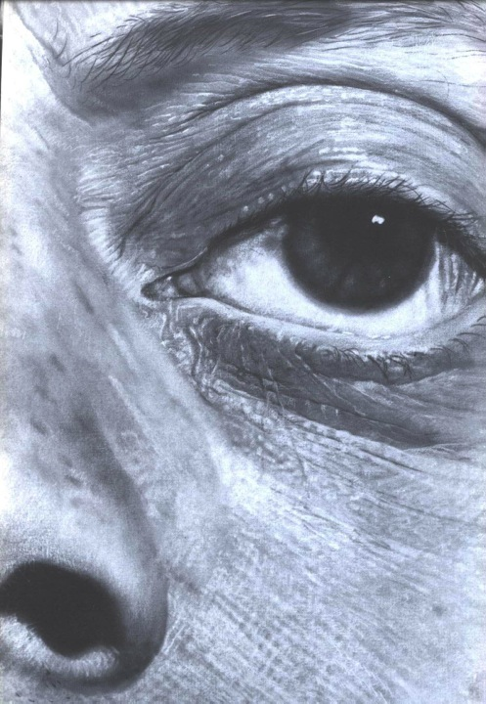
Here’s what Phil’s eye looks like close up.

Slide 18
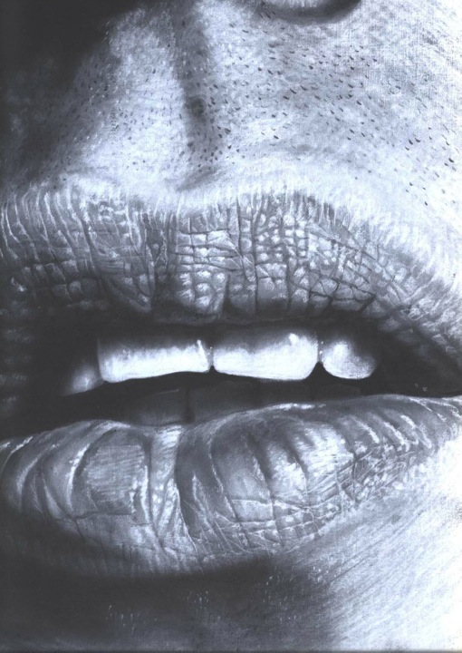
And these are his lips.

Slide 19
Since Chuck Close is considered a Photo-Realist Artist, what do you think Photo-Realism is?

Slide 20
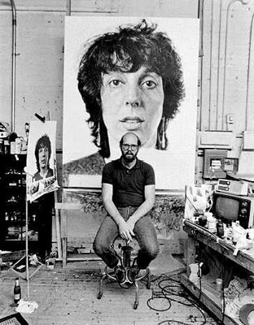
He created his large-scale “maps” of the human face by drawing a grid on a photograph. He transferred the image square by square…

Slide 21
Like this:
1
2
3
4
5
6
7
8
F,4
A
B
C
D
E
By breaking it down square by square—the image disappears.
F
G
H
I
J
K
L

Slide 22
Careful attention to the small squares gives emphasis only to the lines, shapes, and colors (or value).

Slide 23
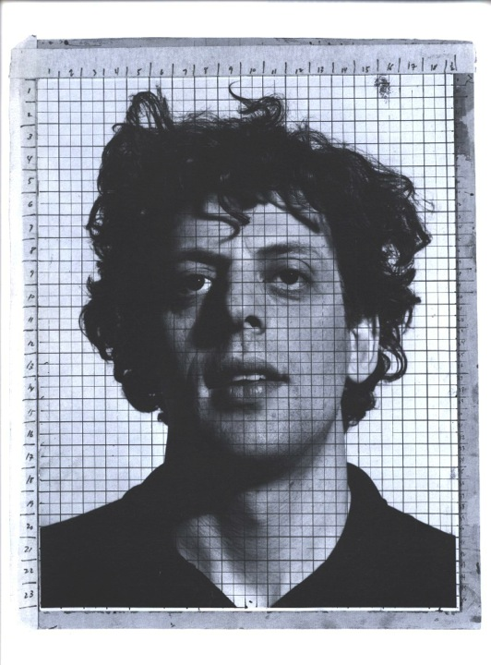
Here’s what Phil looked like as a photograph

Slide 24
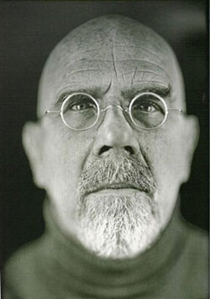
Chuck quickly grew bored with this method, so he began to experiment with different kinds of media and approaches to his portraits.

Slide 25
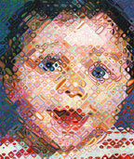
Chuck Close, Emma, Woodcut (120 colors) Took 3 years to complete

Slide 26
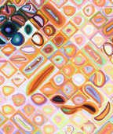
Chuck Close
Chuck Close, Emma, Woodcut (120 colors) Took 3 years to complete

Slide 27
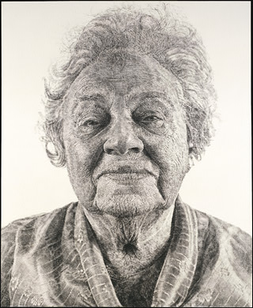
This portrait of his mother-in-law was done completely with fingerprints.
Fanny, 1985

Slide 28
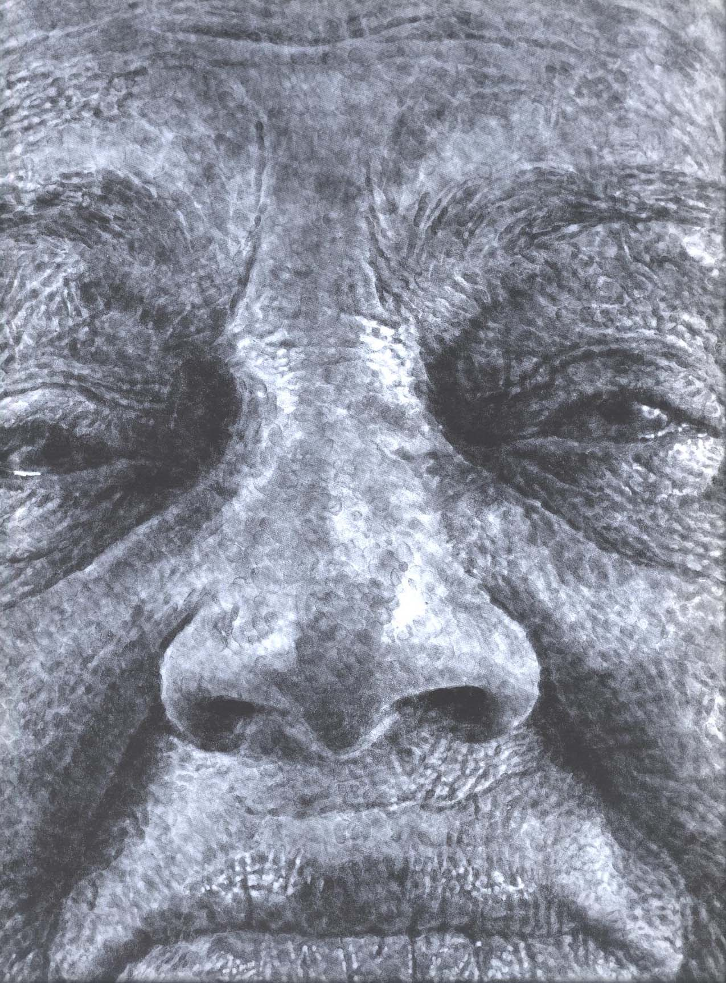

Slide 29
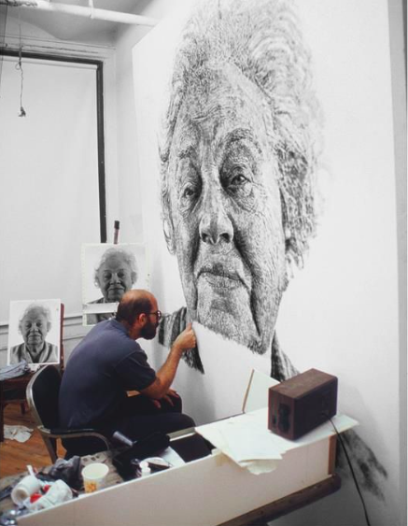

Slide 30
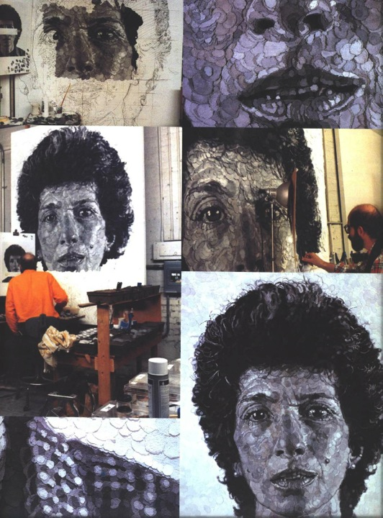
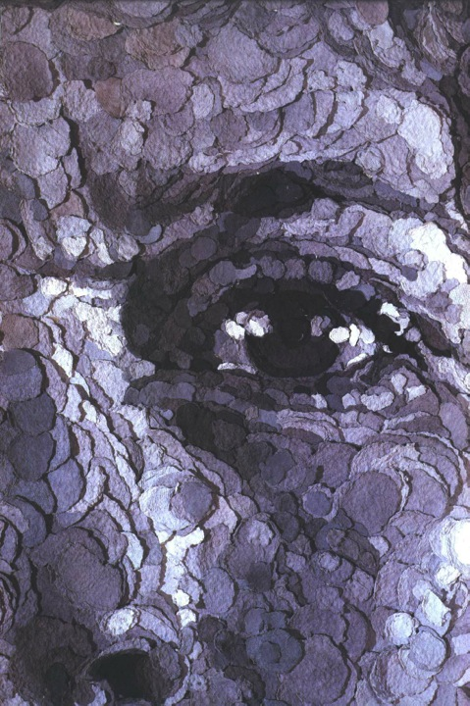

Slide 31
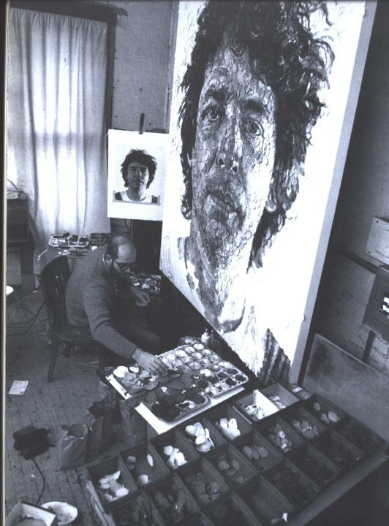
Here’s Chuck in his studio creating one of these “cut-paper” paintings.

Slide 32
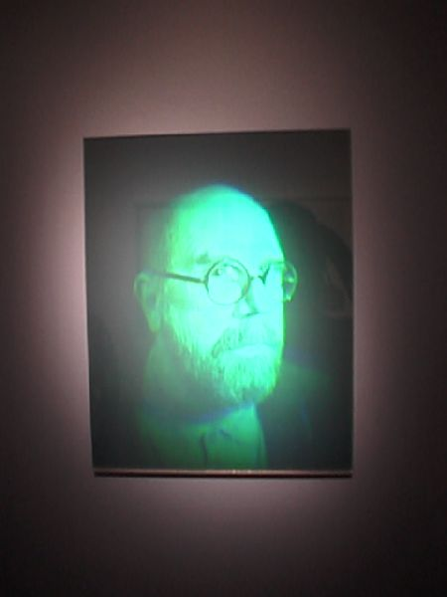
“The Event”
On December 7, 1988, Close felt a strange pain in his chest. That day he was at a ceremony honoring local artists in New York City and was waiting to be called to the podium to present an award. Close delivered his speech and then made his way across the street to the hospital where he suffered a seizure leaving him paralyzed from the neck down.

Slide 33
A blood clot reached his spine and left him a quadriplegic.

Slide 34
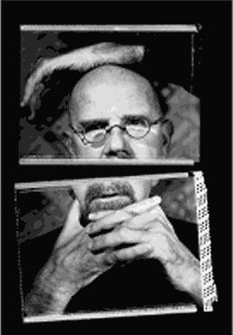
Slowly, he realized he could paint small paintings with a brush in his mouth and put them together to create a large work. He also taped his brush to his arm where he had little movement.

Slide 35
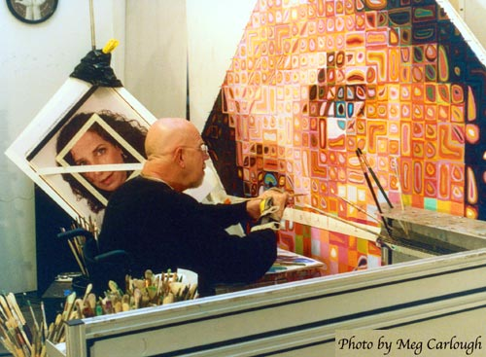
He slowly regained a little bit of movement in his right hand.

Slide 36
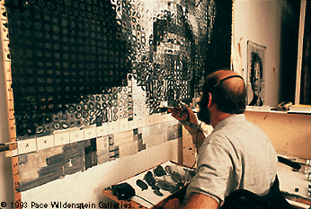
With the help of a mechanical easel and a device that helps him grip a paintbrush, Chuck continues to have a very successful career.

Slide 37
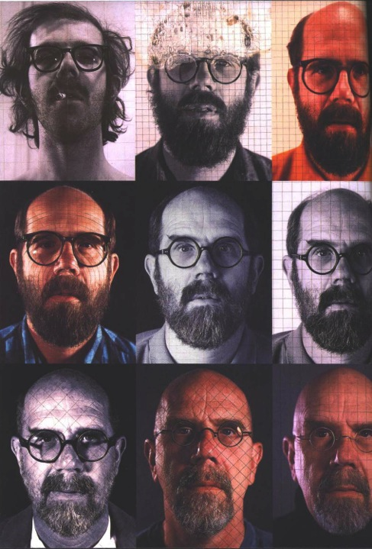
He is currently working on self-portraits. Lots of them.

Slide 38
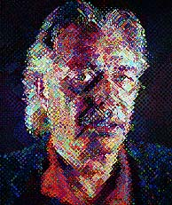
He took inspiration from the way pictures in magazines are printed and re-invented his style.
John, 1998

Slide 39
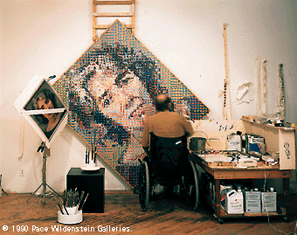
Chuck in his studio

Slide 40
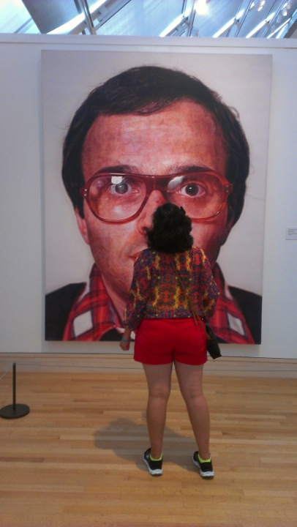
Notes:
Taken at the Met, summer 2013

Slide 41
Cornell Notes on ARTISTS
Write one question in the questions box
Person on the left answers the question. (write your name on that person’s notes)
Notes:
Day 2

Slide 42
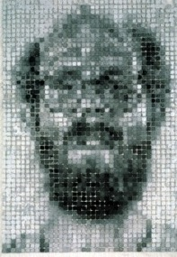
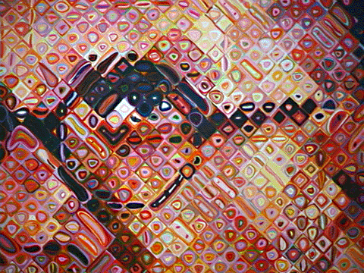
Value & Texture
I can draw a GRID onto the photograph using 1” boxes.
I can draw a GRID onto the drawing paper using 2” boxes.
Chuck Close

Slide 43
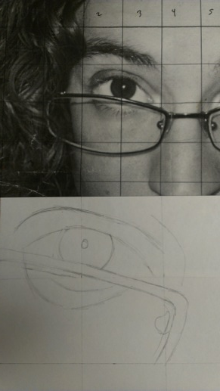
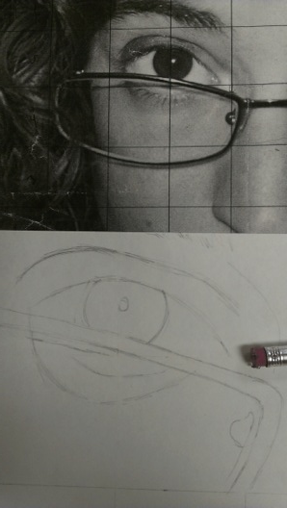
Value
I can use a pencil (lightly) and focus on the contour lines inside each box.
I can redraw those lines onto my paper.

Slide 44
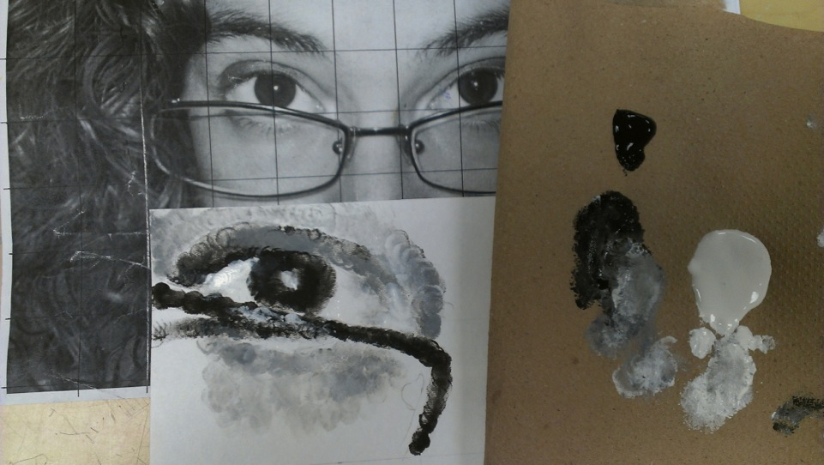
Value
I can fill in the different values using ONLY my finger and paint!
Redraw those lines onto your piece of paper.

Slide 45
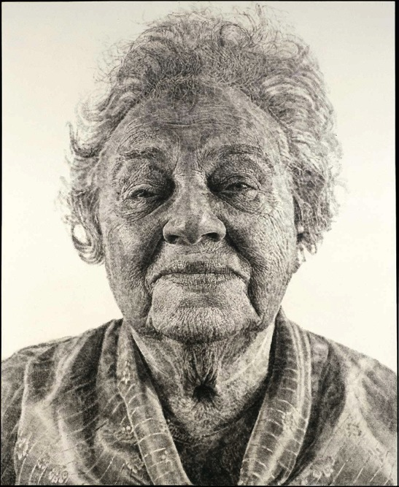
Value
Put black & white tempera paint onto a piece of folded paper towel.
I CAN replicate the values from a photograph using only black & white paint and my FINGER!
Chuck Close
Notes:
Critique when done.

Slide 46
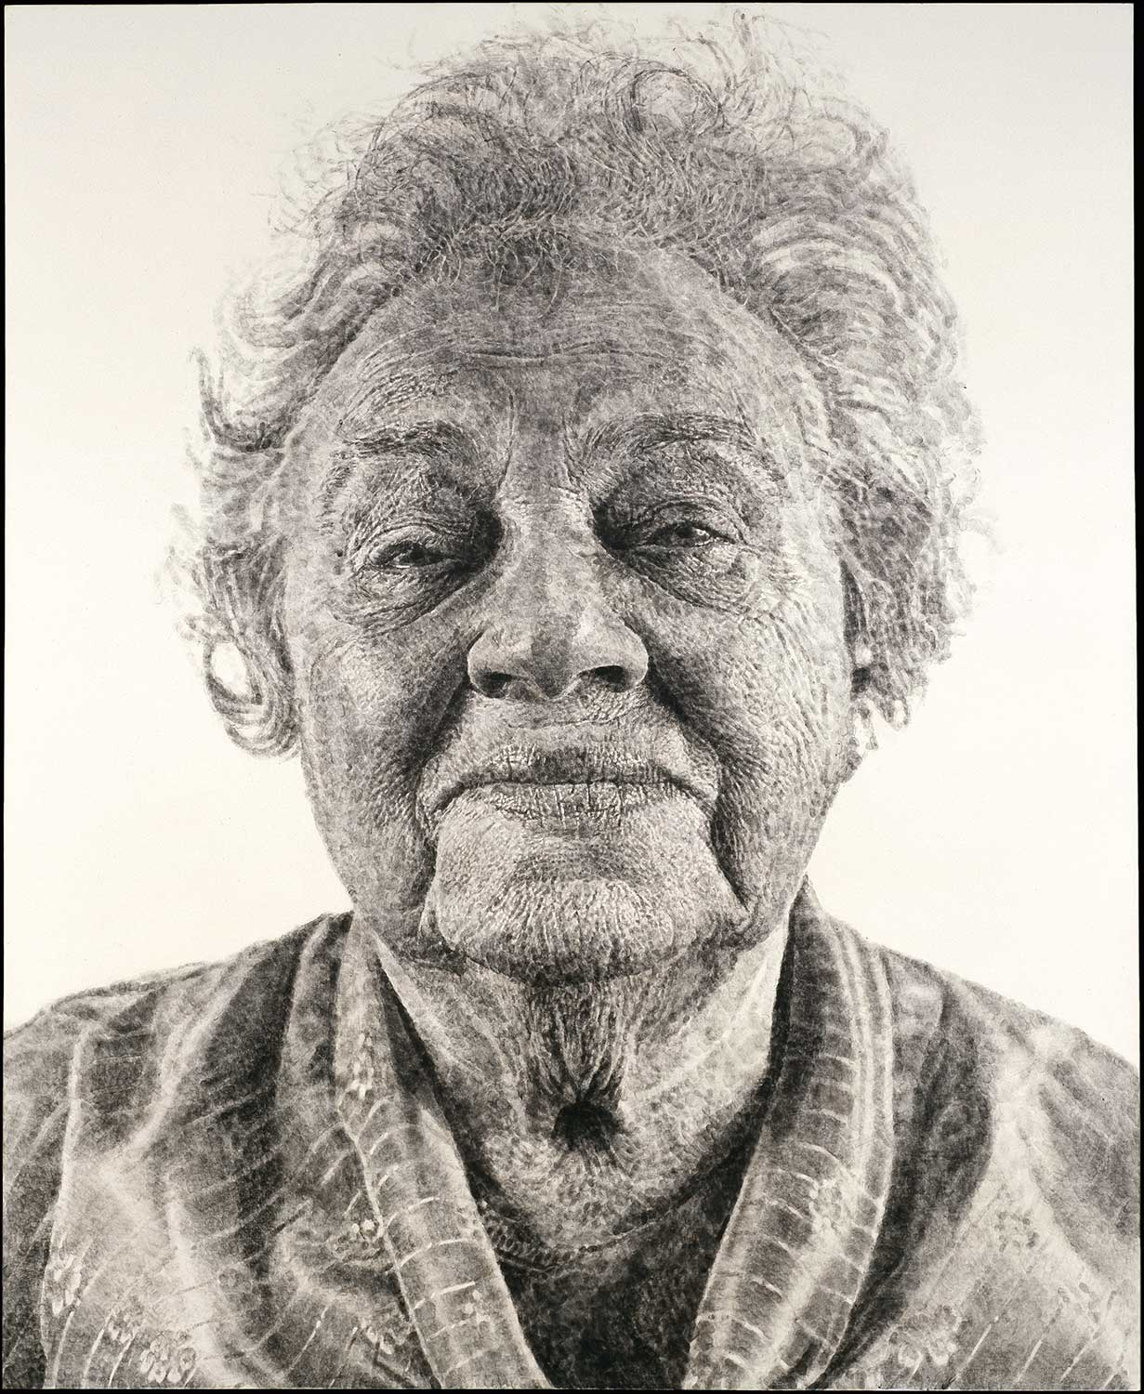
I CAN replicate the values from a photograph using only black & white paint and my FINGER!

Slide 47
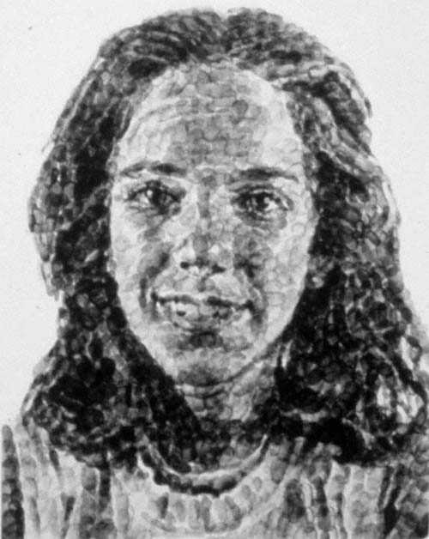
Value
Put black & white tempera paint onto a piece of folded paper towel.
Using only your finger and the paint, copy the portrait using several value tones.
Chuck Close
Notes:
Critique when done.

Slide 48
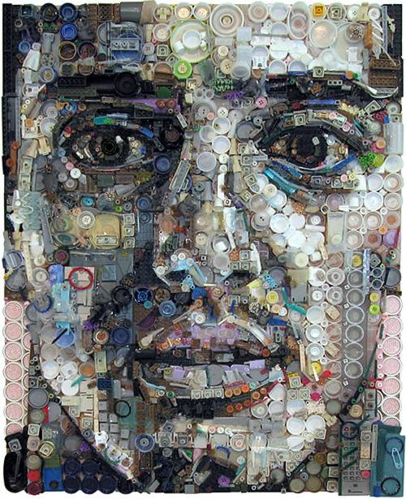
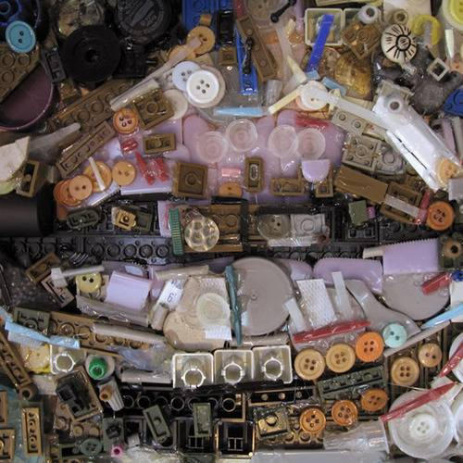
Check these out!
Portraits made entirely with found objects by Zac Freeman
Notes:
Critique when done.

Slide 49
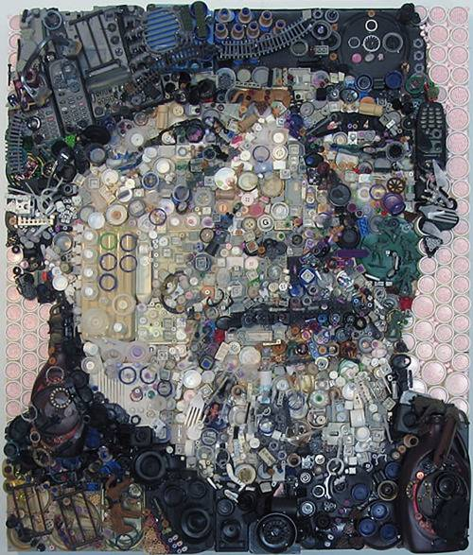
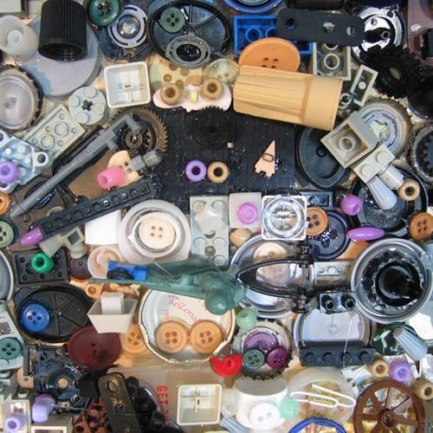
Check these out!
Portraits made entirely with found objects by Zac Freeman
Notes:
Critique when done.

Slide 50
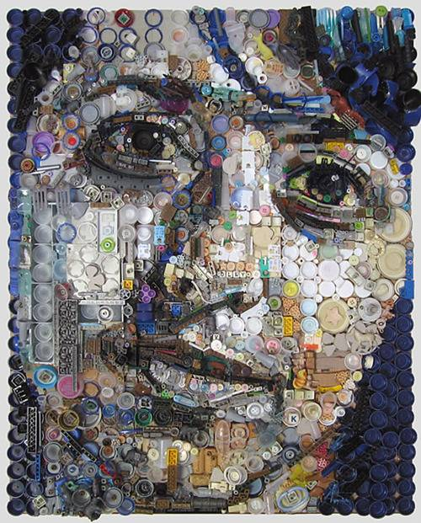
Check these out!
Portraits made entirely with found objects by Zac Freeman
Notes:
Critique when done.

Slide 51
Notes:
Critique when done.

Slide 52
http://www.youtube.com/watch?v=GxR3ELuZjLw&index=3&list=PL575A6CD41827AEB0
Video for day 2
Add one thing about Chuck Close to your notes.
Write one piece of advice to your-younger-self

