Slide 1
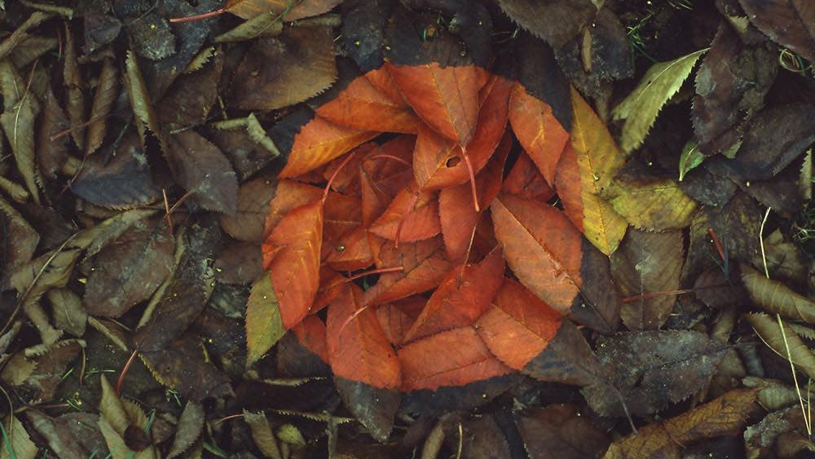
EPHEMERAL ART
AP STUDIO ART- FALL PHOTO & 2D PAINTING
Notes:
All students will be taking notes in their sketchbook (SB) and turning this in for a grade/ artist research

Slide 2
What does ephemeral mean??
Lasting for a very short time
Notes:
Write ideas in SB first before sharing out
Have students give ideas of ephemeral objects
How can you turn this into art??
Look through Goldsworthy examples once, then go back through and write elements of art the work relates to (have the words printed out)

Slide 3
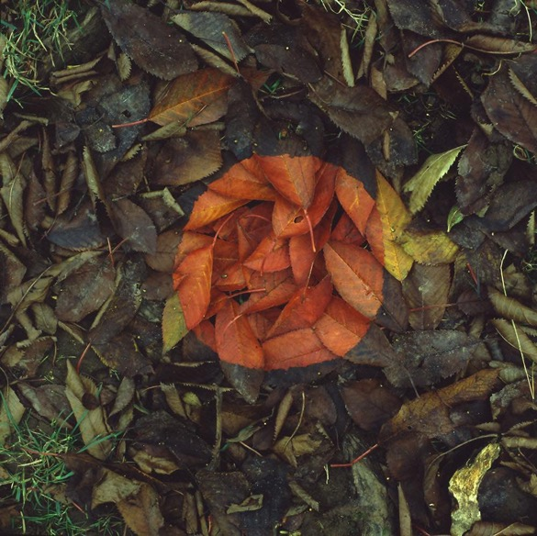
Andy Goldsworthy

Slide 4
Notes:
Andy Goldsworthy

Slide 5
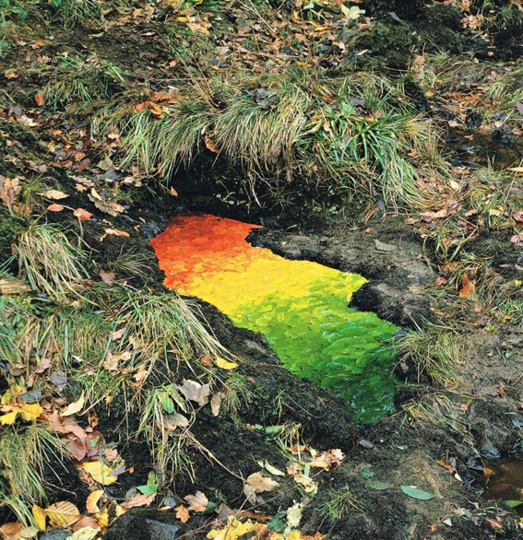

Slide 6
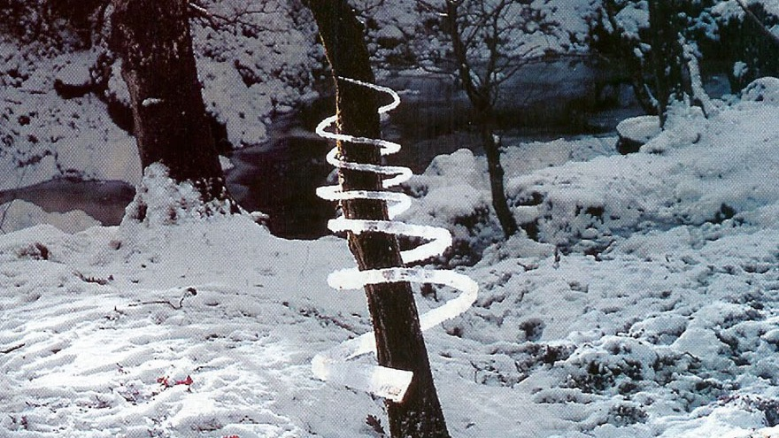

Slide 7
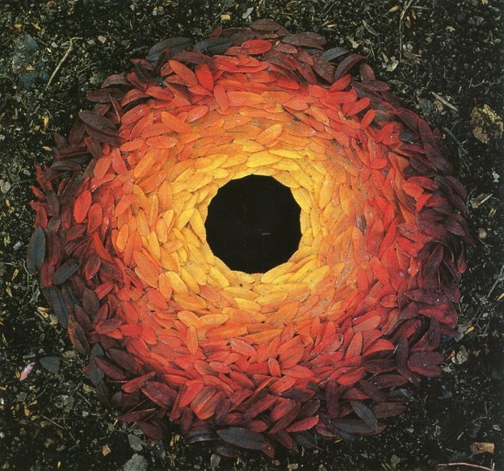

Slide 8
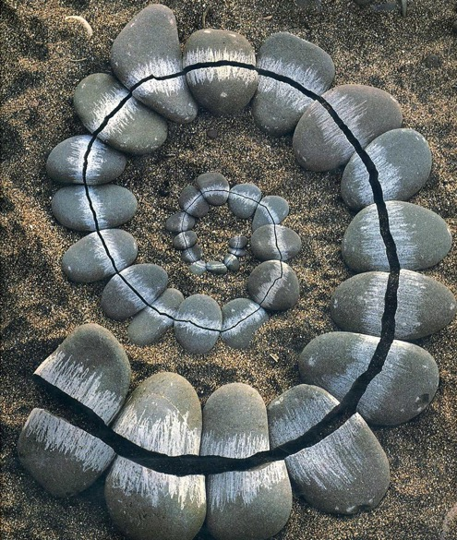

Slide 9
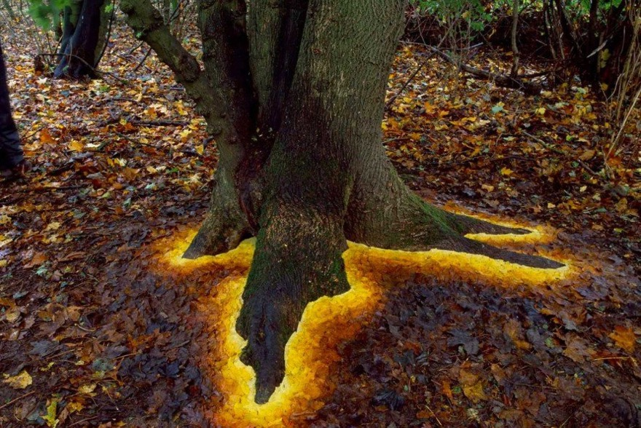

Slide 10
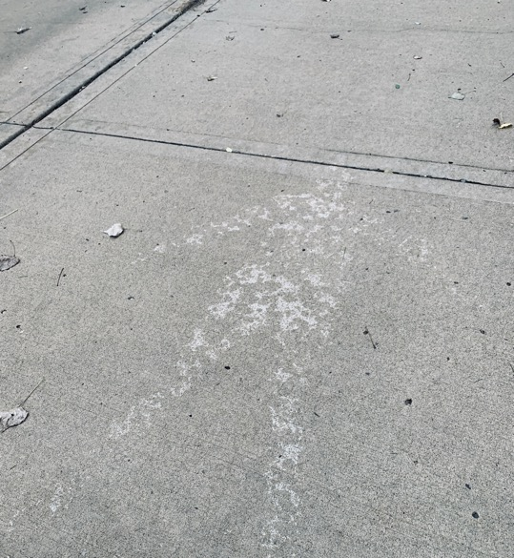
Notes:
Rainshadows, Andy Goldsworthy on the right and my own on the left

Slide 11
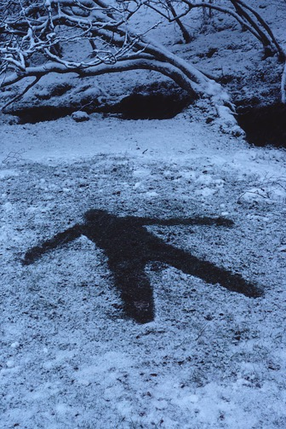
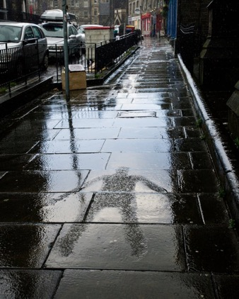

Slide 12
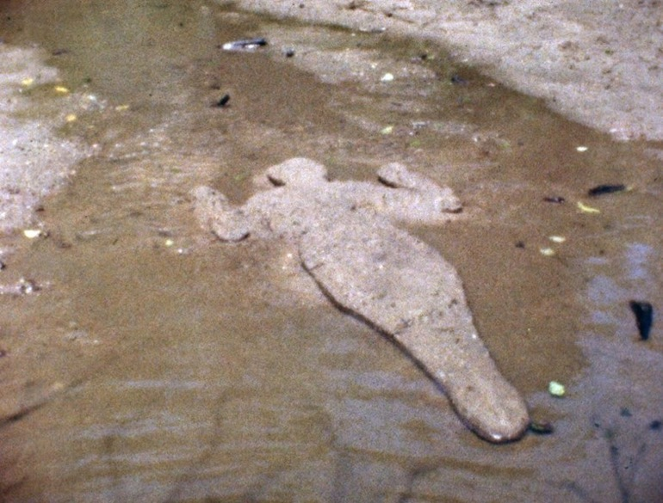
Ana Mendieta
Notes:
Ana Mendieta
Mendieta focused on a spiritual and physical connection with the land, most particularly in her Silueta pieces, which typically involved carving her imprint into sand or mud, making body prints or painting her outline or silhouette onto a wall.
In a 1981 artist statement, Mendieta said:
I have been carrying out a dialogue between the landscape and the female body (based on my own silhouette). I believe this has been a direct result of my having been torn from my homeland (Cuba) during my adolescence. I am overwhelmed by the feeling of having been cast from the womb (nature). My art is the way I re-establish the bonds that unite me to the universe. It is a return to the maternal source.^{[18]}

Slide 13
Notes:
Ana Mendieta
Mendieta focused on a spiritual and physical connection with the land, most particularly in her Silueta pieces, which typically involved carving her imprint into sand or mud, making body prints or painting her outline or silhouette onto a wall.
In a 1981 artist statement, Mendieta said:
I have been carrying out a dialogue between the landscape and the female body (based on my own silhouette). I believe this has been a direct result of my having been torn from my homeland (Cuba) during my adolescence. I am overwhelmed by the feeling of having been cast from the womb (nature). My art is the way I re-establish the bonds that unite me to the universe. It is a return to the maternal source.^{[18]}

Slide 14
Notes:
Ana Mendieta
Mendieta focused on a spiritual and physical connection with the land, most particularly in her Silueta pieces, which typically involved carving her imprint into sand or mud, making body prints or painting her outline or silhouette onto a wall.
In a 1981 artist statement, Mendieta said:
I have been carrying out a dialogue between the landscape and the female body (based on my own silhouette). I believe this has been a direct result of my having been torn from my homeland (Cuba) during my adolescence. I am overwhelmed by the feeling of having been cast from the womb (nature). My art is the way I re-establish the bonds that unite me to the universe. It is a return to the maternal source.^{[18]}

Slide 15
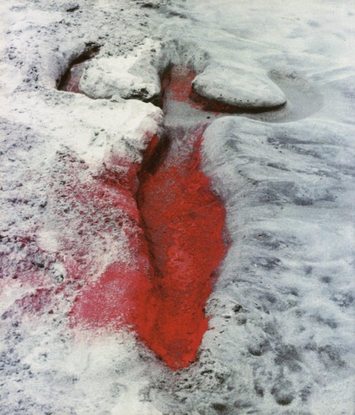
Notes:
She died on 8 September 1985 in New York from a fall from a 34th floor apartment in Greenwich Village. Eight months earlier Mendieta had married the minimalist sculptor Carl Andre. Andre was tried and acquitted of her murder; during the trial his lawyer described her death as a possible accident or a suicide. In the absence of any witness to her death, other than (possibly) Carl Andre, the exact cause of her death may never be known.
Just prior to her death, neighbors heard the couple arguing violently. There were no eyewitnesses to the events that led up to Mendieta's death. A recording of Andre's 911 call showed him saying: "My wife is an artist, and I'm an artist, and we had a quarrel about the fact that I was more, eh, exposed to the public than she was. And she went to the bedroom, and I went after her, and she went out the window." In 1988, Andre was tried and acquitted of her murder. During three years of legal proceedings, Andre's lawyer described Mendieta's death as a possible accident or suicide. The judge found Andre not guilty on grounds of reasonable doubt.

Slide 16
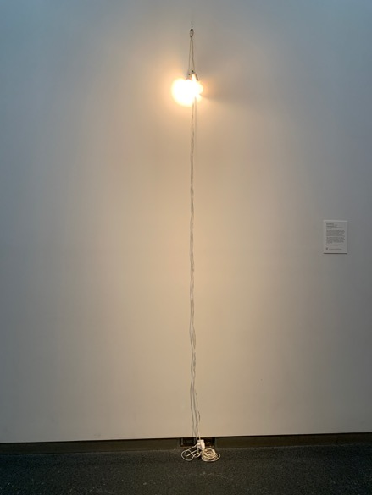
Felix Gonzalez Torres
Notes:
Felix Gonzalez Torres (at the Nelson)
It is two light bulbs with extension cords
Titled “Untitled (March 5th) #2”
What does this look like?
How could this be ephemeral?- not lasting for a long time?

Slide 17
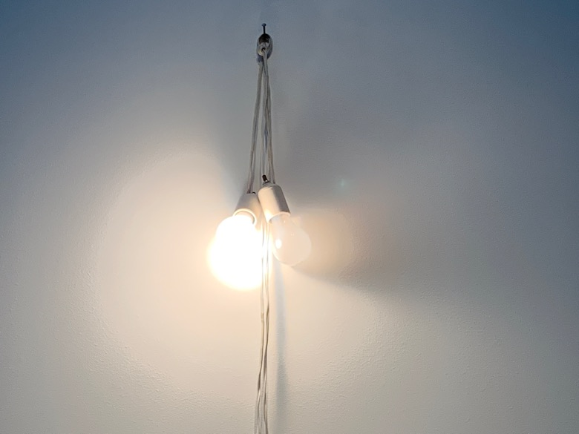
Notes:
Description from the Nelson
“Here two factory-made light bulbs shine bright together to suggest a pair of lovers in one shared point of illumination. Although they glow brightly in unison, one bulb will inevitably burn out before the other, reminding us of the transience of human relationships and the temporality of life”

Slide 18
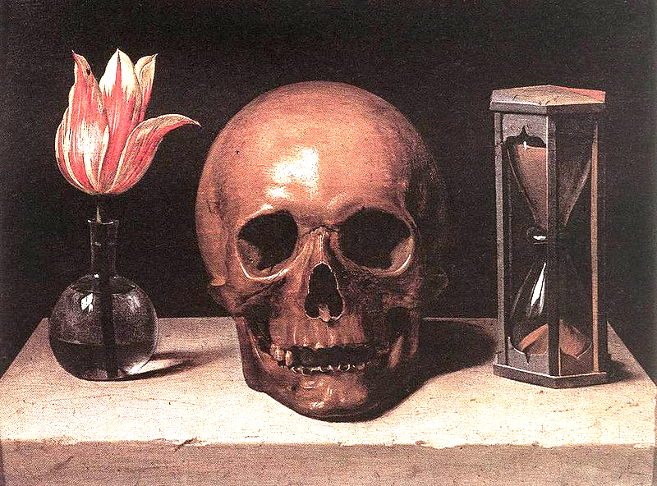
Vanitas
A still life artwork which includes various symbolic objects
A reminder that beauty fades and all living things must die
Notes:
What do you see here?
How can this relate to ephemeral art?
Flower- will wilt, brown, die
Skull- was once a person!
Time- fleeting, always moving
All the items can relate to the concept of not being around very long, fleeting- but this relates to the fleeting nature of existence
a reminder that beauty fades and all living things must die.
About the shortness and fragility of life
Vanitas stems from the word vanity
a reminder that beauty fades and all living things must die.
includes symbols such as skulls and extinguished candles.
However vanitas still-lifes also include other symbols such as musical instruments, wine and books to remind us explicitly of the vanity (in the sense of worthlessness) of worldly pleasures and goods.

Slide 19
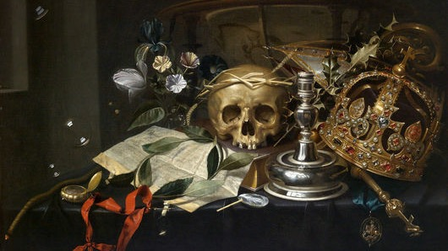
Material possessions are used to be reminded to not become too attached to their material goods
Notes:
What objects do you see here.. What makes this a vanitas painting?
Material possessions are used to be reminded to not become too attached to their material goods

Slide 20
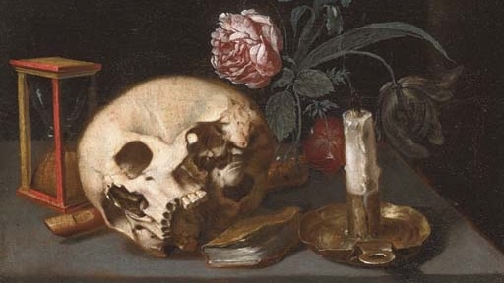

Slide 21
Rachel Ruysch
Notes:
What objects do you see here.. What makes this a vanitas painting?
Taken from a passage in the Christian bible, it was a reminder that beauty fades and all living things must die. While still life paintings celebrated the beauty and luxury of fine food or voluptuous flowers, vanitas was a warning about the fleeting nature of these material things and the shortness of life.
In Flowers Still Life, (not this painting) some flowers wilt and die while insects have eaten holes in the leaves. Wealthy Dutch consumers were being reminded to not become too attached to their material possessions and worldly pleasures

Slide 22
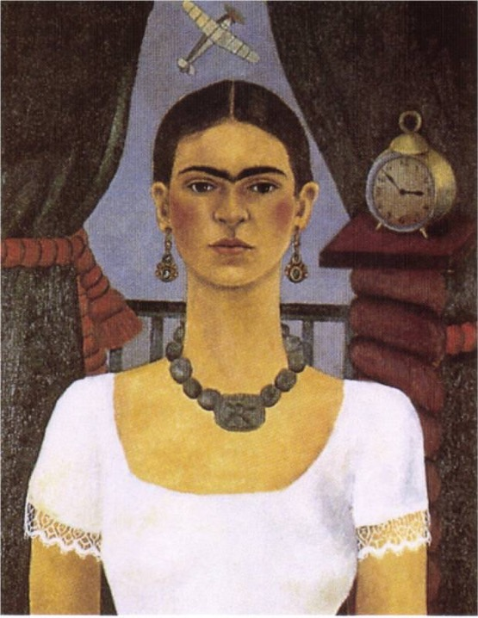
Frida Khalo
Notes:
What objects do you see here.. What could make this a vanitas painting?
Titled: Time Flies, 1929
The clock replaces the hourglass as a vanitas symbol of fleeting time
The airplane suggests the concept of time is flying= going fast
Large bead on her necklace is a circle and cross= two Aztec glyphs that represent movement or setting in motion and are associated with the Aztec god of death
https://www.jstor.org/stable/3566514?read-now=1&refreqid=excelsior%3A71cbf78c1f48c39e8cdeb5c95c023276&seq=3#page_scan_tab_contents

Slide 23
Notes:
What objects do you see here.. What could make this a vanitas painting?
Titled: Pitahayas, 1938
Frida Kahlo's painting is a still life of five pitahayas. The pitahaya is a desert fruit with a melon-like taste that grows on rocks or in thickets. It is ovoid with a thick yellow skin that swells with excrescences and bulges. The inside is a mass of dense, translucent white flesh that contains many small black edible seeds. Kahlo loved pitahayas for their sweetness and juiciness. In many respects, Kahlo's depiction is realistic, even including two pitted rocks and round cactus to suggest the fruit's habitat. But the artist takes liberties and makes certain decisions that give her still life its special meanings. First, these pitahayas are decomposing; the healthy yellow skin has over-ripened to a garish red-orange. The skins have burst open, and brown rot has set in. One has been sliced open to reveal what we would expect, the white flesh and black seeds. But the cuts are perfectly rounded rims. The sectioned fruits stare out with other-earthly eyes. Presiding over the fruits is a small seated skeleton who holds a scythe that identifies it as the grim reaper - death itself. This figure is a calavera. It is associated with El Dia de los Muertos (The Day of the Dead), Mexico's most popular holiday that commences for two days on November 1 - All Saints Day in the Catholic liturgical calendar. Kahlo's still life is a meditation on death. Because of its watery freshness that can provide sustenance in the most barren of terrains, the pitahaya is known as the "fruit of the shipwrecked man." But even this most life-giving of fruits is given to decay. If realistic in certain details, this still life is magical.
https://www.fridakahlo.org/pitahayas.jsp
“In the painting 5 pink pitahayas lean against a cactus and two volcanic rocks: the fruit in the forefront is sliced at one end, and a halved one nearly fills the center of the composition, revealing its fresh, grayish pulp. In the upper right corner, a small toy skeleton made of springs and clay sits on one of the rocks. It’s right hand holding holding Father Time’s scythe, points toward the open fruit. The moment to appreciate life is now, it says, otherwise it will be lost forever. Undoubtedly Kahlo identified with the skeleton. A photograph of the painting taken after its completion shows it smiling. Upon her return from France, greeted by divorce papers, Kahlo erased the smile and repainted it with a frown.”
https://www.jstor.org/stable/3566514?read-now=1&refreqid=excelsior%3A71cbf78c1f48c39e8cdeb5c95c023276&seq=2#page_scan_tab_contents

Slide 24
Notes:
You can see similar objects being used

Slide 25
How do we make a modern vanitas??

Slide 26
Notes:
What could be a modern vanitas???
What will eventually wilt, mold, decompose and die?
What in this painting will never decompose?
What does it do to juxtapose the two objects next to each other?

Slide 27
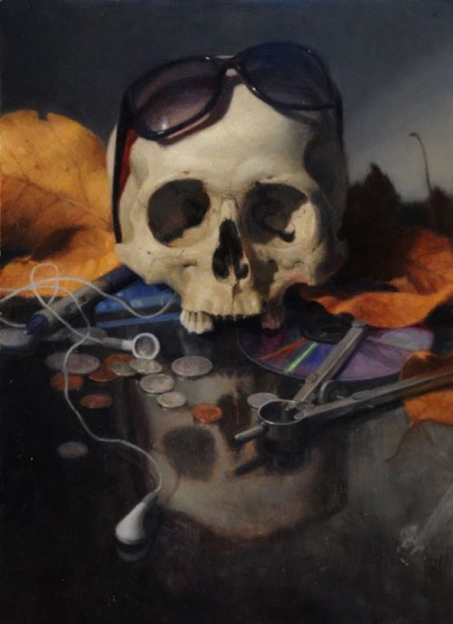
Notes:
What could be a modern vanitas???
What will eventually wilt, mold, decompose and die?
What in this painting will never decompose?
What does it do to juxtapose the two objects next to each other?

Slide 28
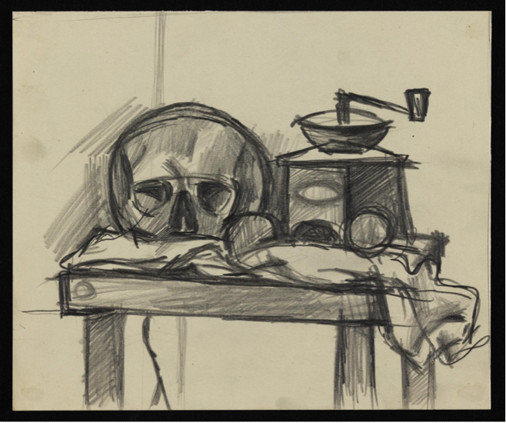
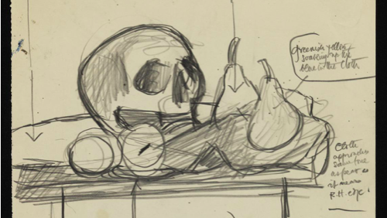
I can label the symbolic meaning of the items used in the thumbnail sketch
Notes:
I can label the symbolic meaning of the items used in the thumbnail sketch

Slide 29
Ephemeral Art Assignment- 2D Media- Painting
Write/plan in SB- what objects can you paint that relate to vanitas? These can be real objects and imaginative, objects that you can get a hold of and objects that you can’t.
Take four photographs of a still life you have created using Vanitas themed objects (4 objects min)
Place the four photos into one PowerPoint slide so the images become small thumbnails
Email the PP to lesta.campbell@nkcschools.org. In the subject put color print for Mrs. Sulzen please
Cut out all four of your thumbnail photos and glue them into your SB.
Class gallery walk and voting on successful compositions
LABEL on your most successful photo what the objects mean.
Redraw the photo in your SB, same size. Will you add anything imaginative into the image, like Frida Kahlo?
Color in the thumbnail using Prismacolor pencils, not using black, mixing/laying colors
LABEL on your drawing what different colors you layered to get the new color
Paint the drawn thumbnail onto Bristol paper (canvas board for 2nd & 3rd year students)

Slide 30
Ephemeral Art Assignment- AP Studio Art- Photos & SB
Photographic Documentation: Turn in 6 different photographs documenting the artistic process
In process (collecting, sorting, sketching, etc.)- 2 photos
Finished piece in the environment- 2 photos
Over Time- 2 photos
Sketchbook Process Page is also due with this assignment
Artist notes and photos of either Andy Goldsworthy or Ana Mendieta
Details of the assignment
Drawn sketch of one of your finished photos
Reflections on these questions
What elements of art does your final photo best relate to?
Would you consider this process art or performance art- why?
If this was making a comment about an issue today- what is it saying?
DUE DATE: November 6th

