Slide 1
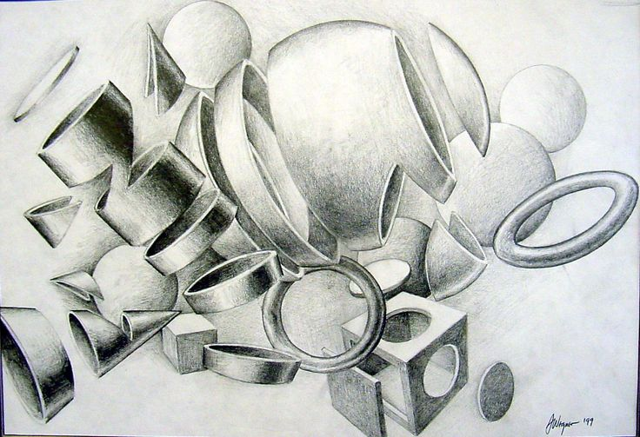
Dissected Forms

Slide 2
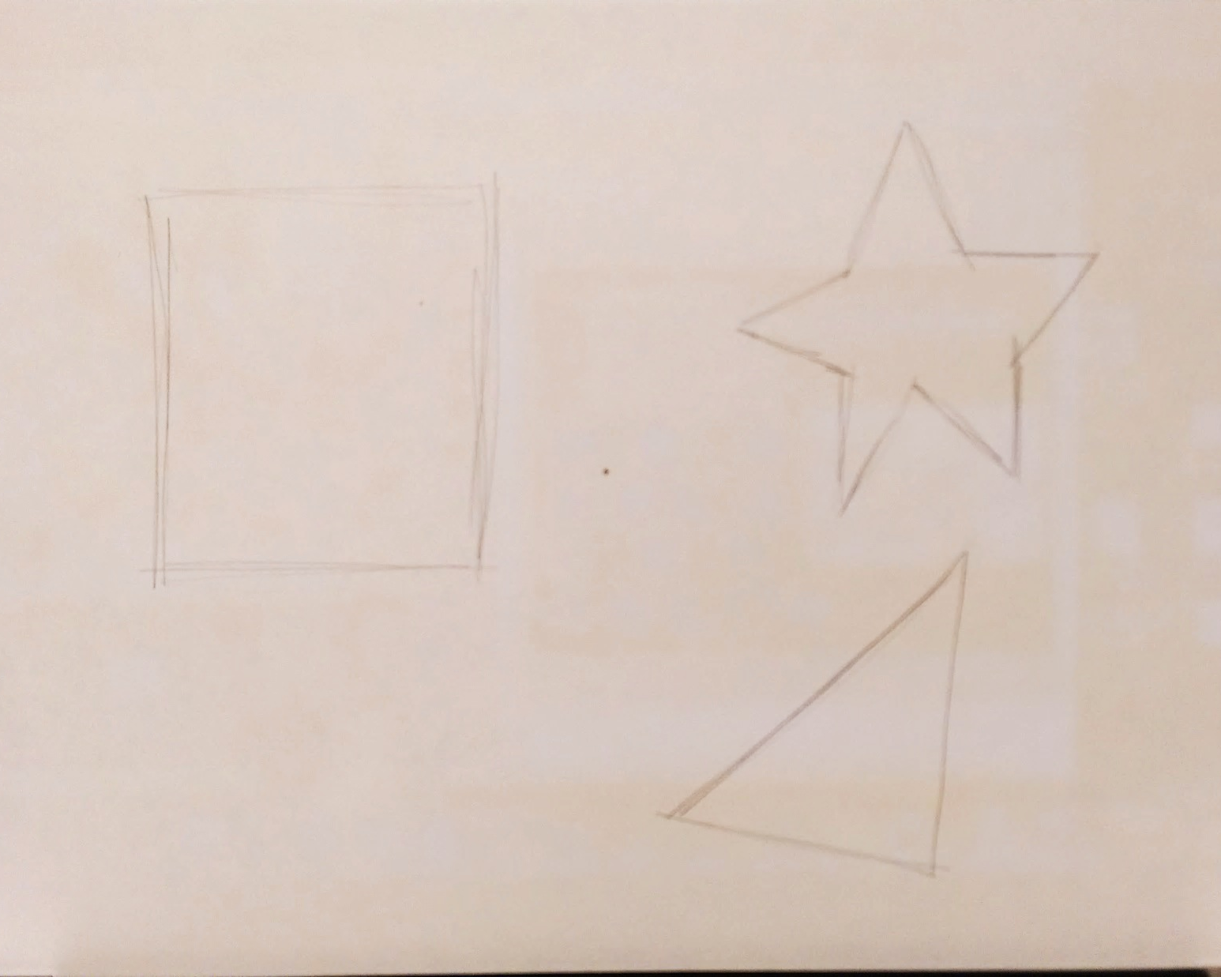
Dissected Forms
Draw a dot in the center of your paper (this is your Vanishing Point-VP)

Slide 3
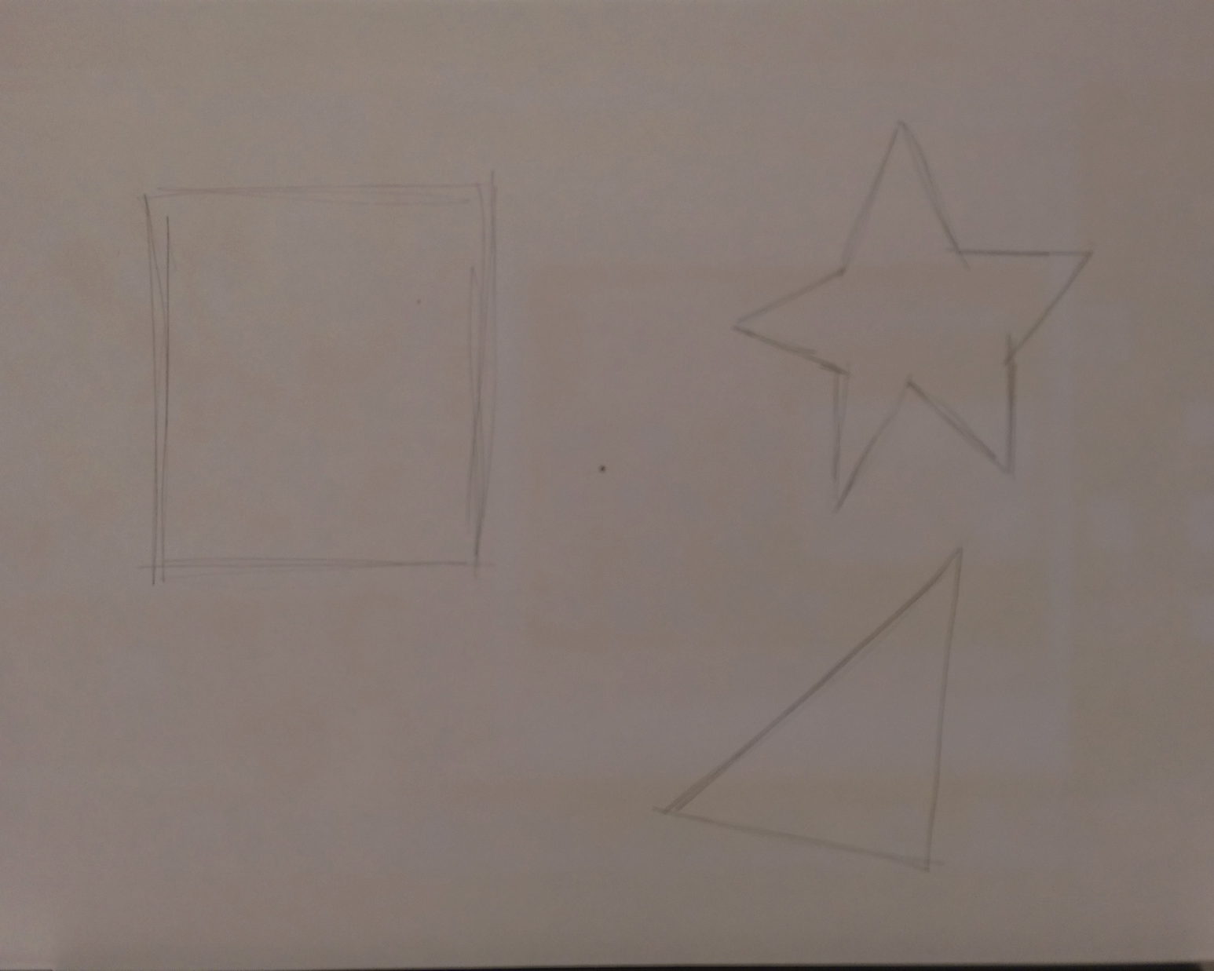
Dissected Forms
Draw at least 3 shapes WITH SHARP EDGES, of varying sizes on your paper

Slide 4
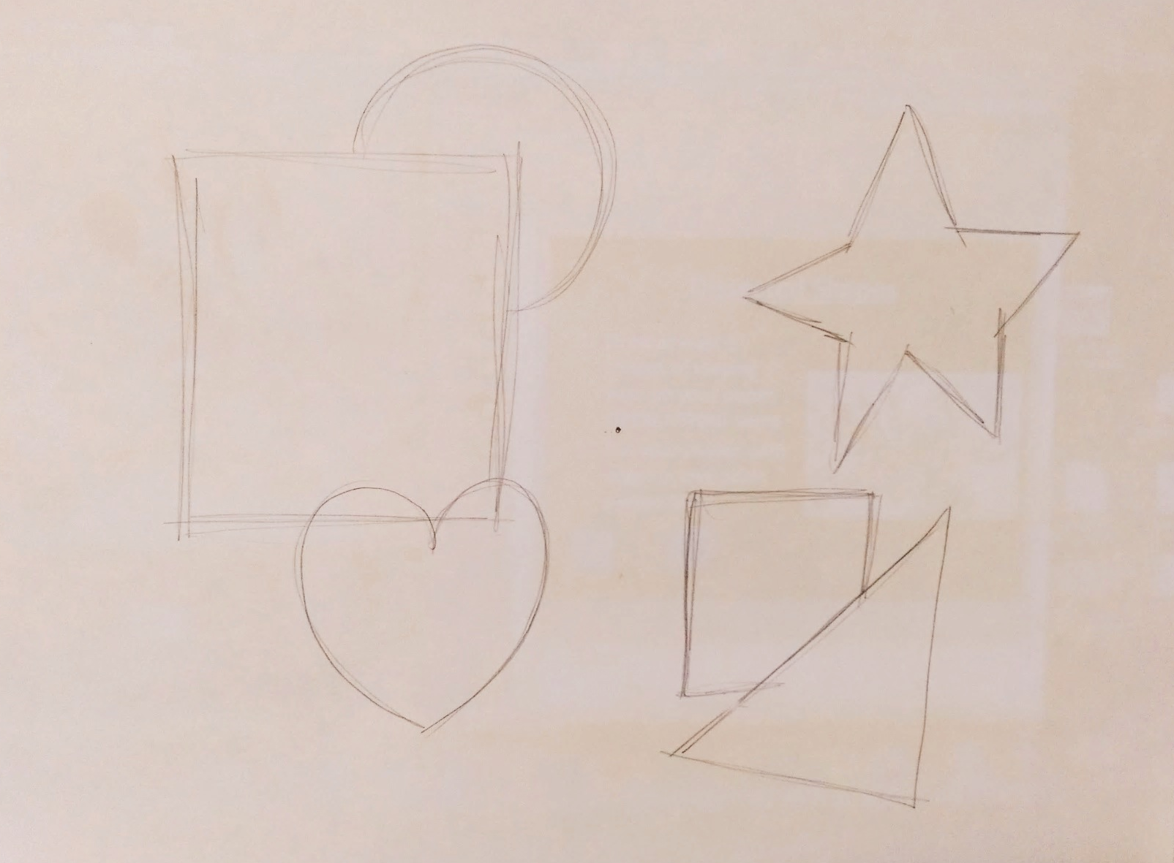
Dissected Forms
Draw at least 3 more shapes of varying sizes on your paper, OVERLAPPING some

Slide 5
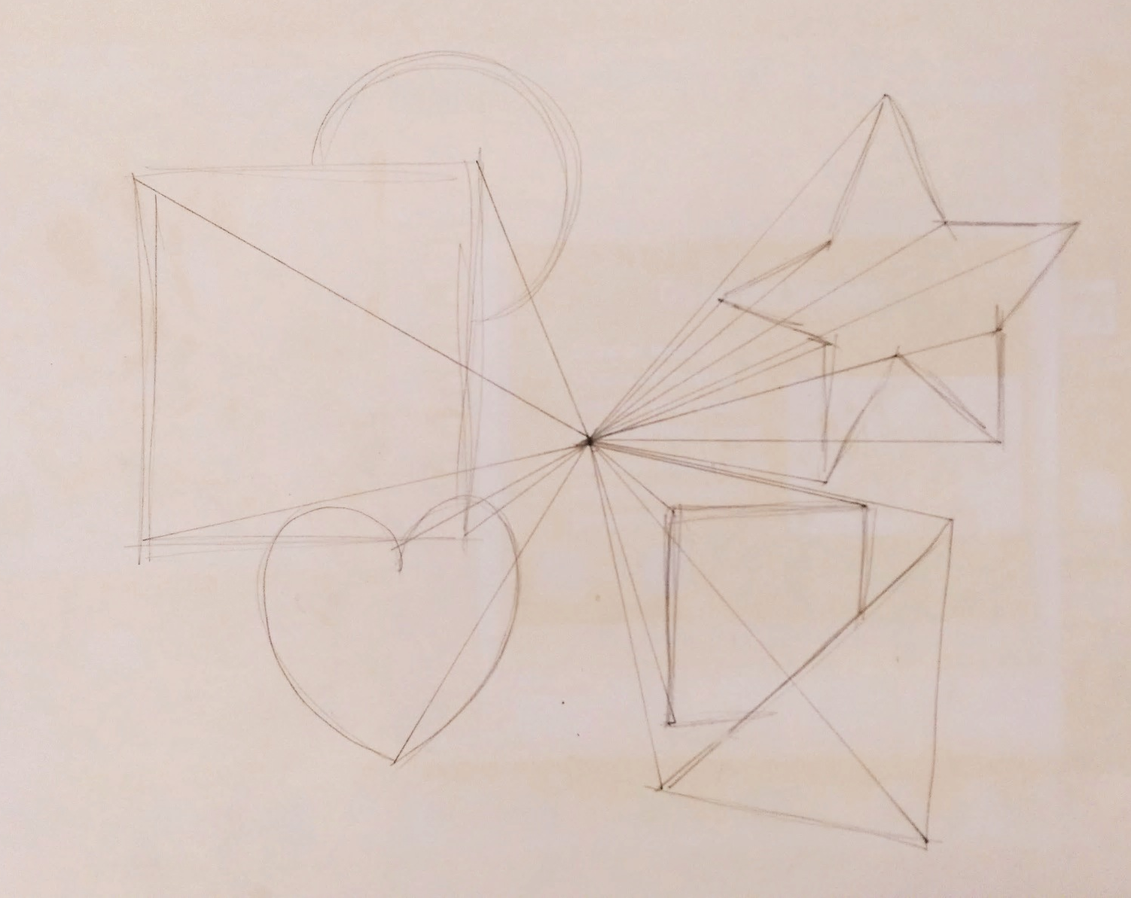
Connect all of your corners to the VP- LIGHTLY with a pencil & ruler

Slide 6
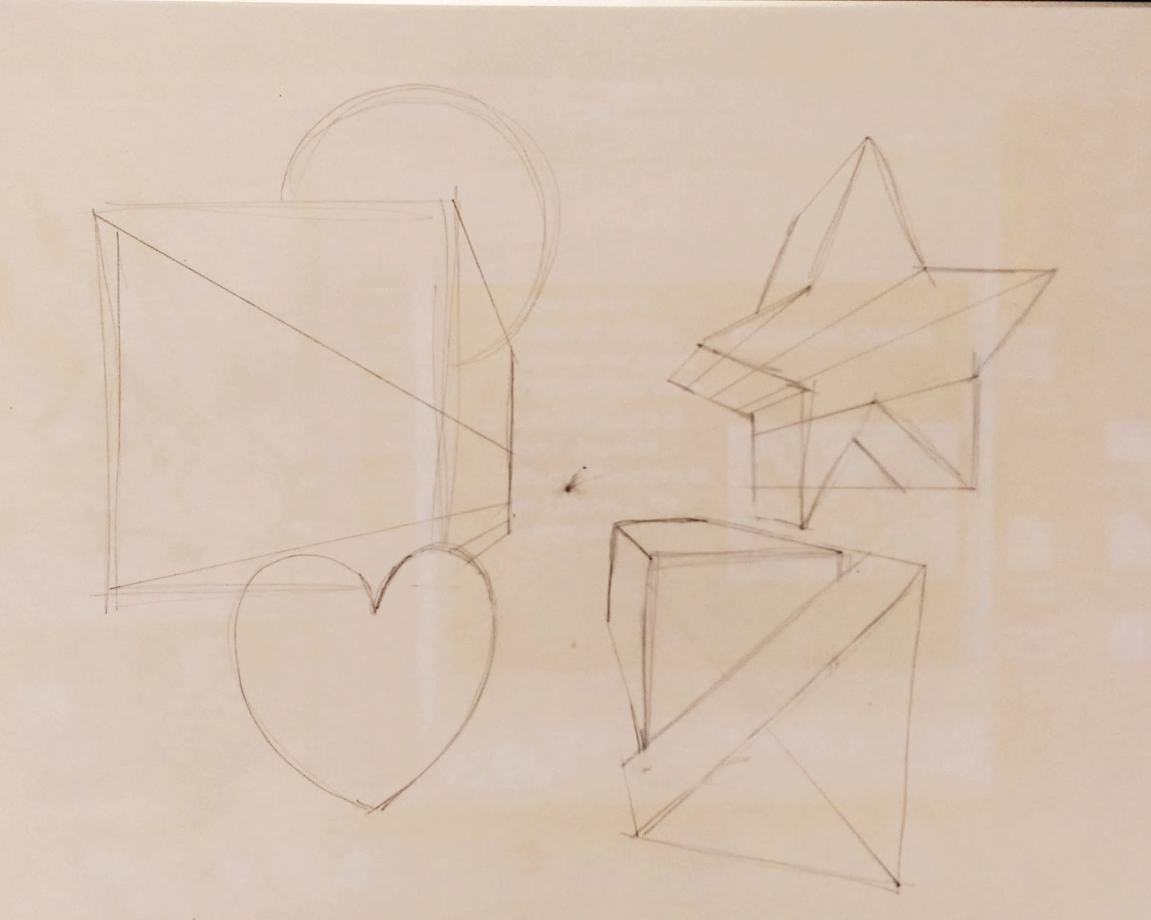
I can turn each shape into a form.
Close off your form by creating a side with a line. This line should be parallel to your form.
Erase the extra lines that lead back to the VP.

Slide 7
I can “dissect” my forms.
Slicing
How to “cut” your forms into slices.
Draw cylinders to represent the “inside ring” of your form
Repeat throughout the form
Inside wall of heart
Front wall of heart

Slide 8
I can “dissect” my forms.
Slicing
How to “cut” your forms into slices.
Erase the sides of the form that are NOT connected to the “front wall”
Inside wall of heart
Front wall of heart

Slide 9
Slicing

Slide 10
Draw “cross-contour” lines throughout your shape
Slicing
Give every other line a cylinder/ring
Erase lines that shouldn’t be there!

Slide 11
I can “dissect” my forms.
Holes
How to “cut” holes out of your forms.
Draw the shape that you want to “cut out” on a side of your form (can be the front, left or right side)

Slide 12
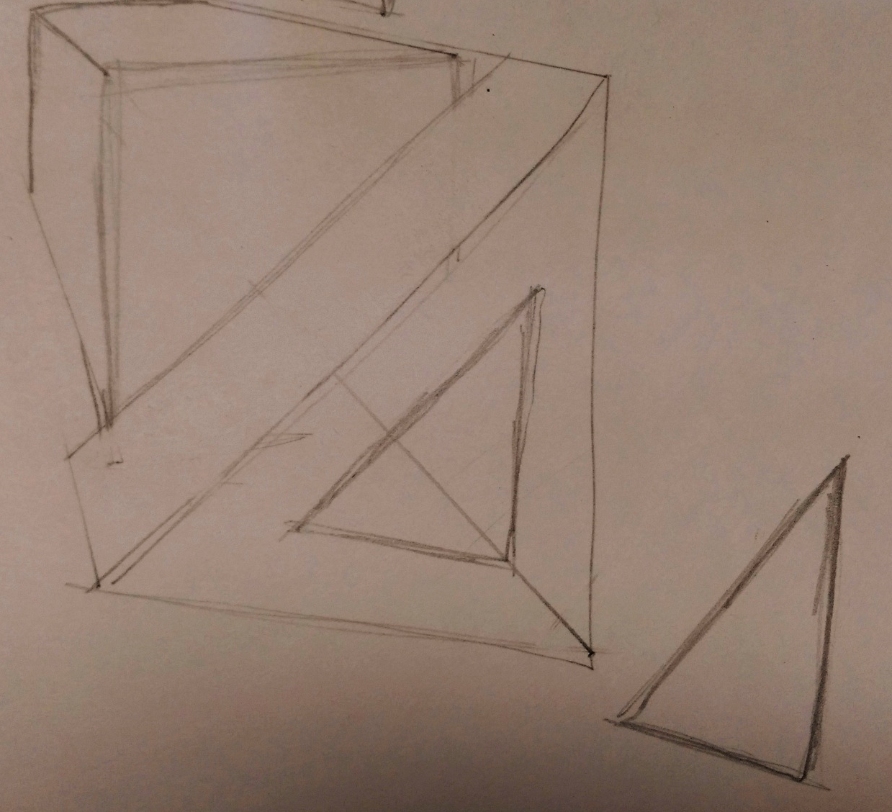
I can “dissect” my forms.
Holes
How to “cut” holes out of your forms.
Draw the shape that you want to “cut out” on a side of your form (can be the front, left or right side)
Draw that same shape somewhere close

Slide 13
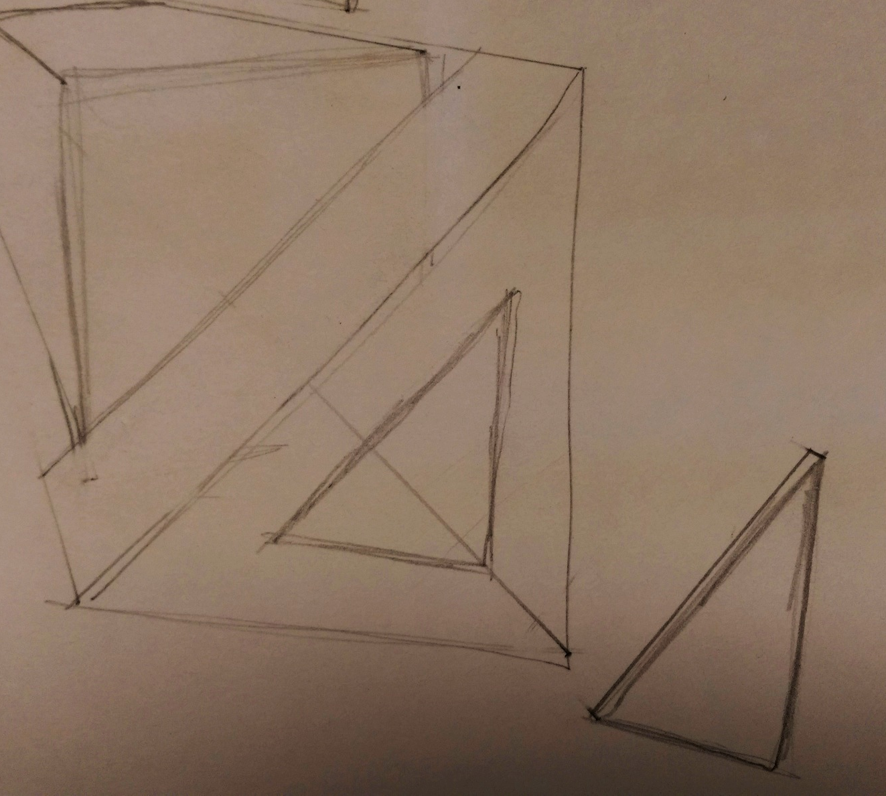
I can “dissect” my forms.
Holes
How to “cut” holes out of your forms.
Draw the shape that you want to “cut out” on a side of your form (can be the front, left or right side)
Draw that same shape somewhere close
Turn the shape that you cut out into a FORM by putting it in 1-PT. Perspective

Slide 14
I can “dissect” my forms.
Holes
How to “cut” holes out of your forms.
Draw the shape that you want to “cut out” on a side of your form (can be the front, left or right side)
Draw that same shape somewhere close
Turn the shape that you cut out into a FORM by putting it in 1-PT. Perspective
Make sure you can see an interior line from where you cut the hole out.

Slide 15
I can “dissect” my forms.
Holes
Add dimension to the interior of the hole you just cut out too!

Slide 16
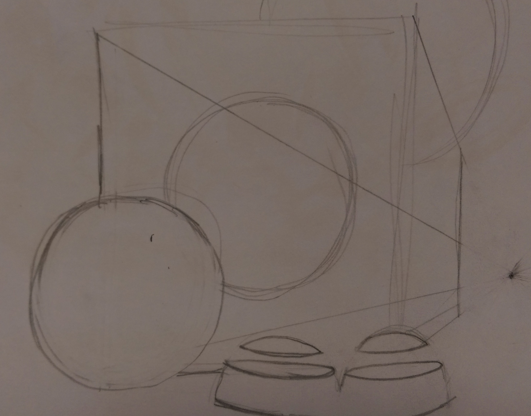
Add that shape close by (like it’s flying away or falling off)
Draw the shape you want “cut” out
Holes
Draw the inside of the form through the cut-out shape
Add dimension to the shape that got cut off and the interior of where it was cut away

Slide 17
I Can …
DRAW forms in One-Point Perspective
DRAW OVERLAPPING forms
DRAW dissected forms that have holes “cut” out of them or are “sliced”
SHADE forms in the foreground with an ebony pencil
SHADE forms in the background with a #2 pencil
SHADE the interiors darker
Add highlights to each form (exterior & interior)

