Slide 1
CLAY
I can create a clay sculpture using different hand-building techniques.
Chinese Coil Vase

Slide 2
Today’s Vocab (day 1)
Wedging
Air Pockets
Slip
Score
Three Hand-building Techniques
Slab
?
?

Slide 3
Today’s Vocab (day 2)
Three Hand-building Techniques
Slab
Coil
?
Four stages of clay
GREENWARE
?
?
?
Three surface design techniques
Impression
?
?

Slide 4
Today’s Vocab (day 3)
Three Hand-building Techniques
Slab
Coil
Pinch
Four stages of clay
GREENWARE
Leather-hard
?
?
Three surface design techniques
Impression
Incise
?

Slide 5
Today’s Vocab (day 4)
Four stages of clay
GREENWARE
Leather-hard
Bone-dry
Bisqueware
Three surface design techniques
Impression
Incise
Inlay
Vinegar
Fire
Kiln
Glaze

Slide 6
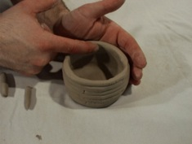
Today’s Vocab
Wedging-dropping the clay hard on the table top to force air bubbles/pockets out of clay.
Notes:
Day 1

Slide 7
Today’s Vocab
Wedging-dropping the clay hard on the table top to force air bubbles out of clay.
Air pockets/bubbles-collect steam in the kiln while firing and explode
Notes:
Day 1

Slide 8
3. Slip-water and clay mixed together to the consistency of heavy cream. It is used as an adhesive in building or mending. In other words, SLIP is the “glue” for clay ware when you are still building your piece.
Notes:
Day 1

Slide 9
4. Score-roughing up the surfaces of clay so different pieces of clay can be joined together.
Notes:
Day 1

Slide 10
Hand-building Wheel-throwing
Notes:
What does “hand-building” mean?
Day 1

Slide 11
What are the 3 Hand-building Techniques?
Slab -a hand-building technique where you are rolling out clay into a flat sheet.
Notes:
Day 1

Slide 12
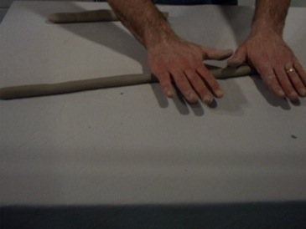
What are the 3 Hand-building Techniques?
Slab -a hand-building technique where you are rolling out clay into a flat sheet.
Coil -a method of hand-building where long round strips of clay are rolled with your hands & used to build.
Notes:
Day 2

Slide 13
What are the 3 Hand-building Techniques?
Slab -a hand-building technique where you are rolling out clay into a flat sheet.
Coil -a method of hand-building where long round strips of clay are rolled with your hands & used to build.
Pinch- a method of hand-building where the object is made by the fingers pinching the clay between them.
Notes:
Day 3

Slide 14
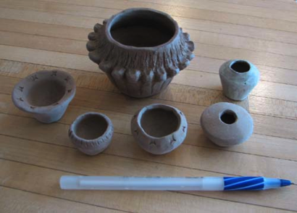
What are the 4 Stages of Clay?
Greenware- (1st Stage of Clay) a term used for clay that has not had an initial firing. Still malleable
It’s alive!

Slide 15
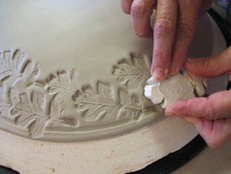
What are the 4 Stages of Clay?
Greenware- (1st Stage of Clay) a term used for clay that has not had an initial firing. Still malleable
Leather-hard- the state of semi-dryness in an unfired piece of clay. This is the preferred time for building, final tooling, carving and surface design.

Slide 16
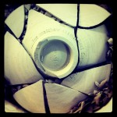
What are the 4 Stages of Clay?
Greenware- (1st Stage of Clay) a term used for clay that has not had an initial firing. Still malleable
Leather-hard- the state of semi-dryness in an unfired piece of clay. This is the preferred time for building, final tooling, carving and surface design.
Bone-dry- The final stage of greenware, clay dried to a completely dry state and ready to be fired. In this stage, the clay is very fragile

Slide 17
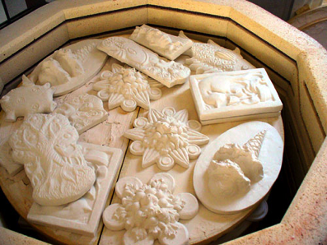
What are the 4 Stages of Clay?
Greenware- (1st Stage of Clay) a term used for clay that has not had an initial firing. Still malleable
Leather-hard- the state of semi-dryness in an unfired piece of clay. This is the preferred time for building, final tooling, carving and surface design.
Bone-dry- The final stage of greenware, clay dried to a completely dry state and ready to be fired. In this stage, the clay is very fragile
Bisqueware- fired but unglazed clay.

Slide 18
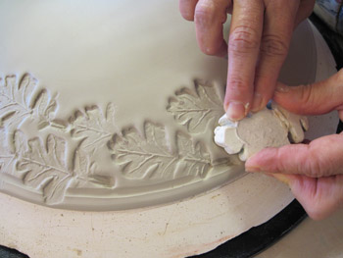
What are the 3 Surface Design Techniques?
Impression -Creating texture by pushing something into the leather-hard surface.
Notes:
Day 2

Slide 19
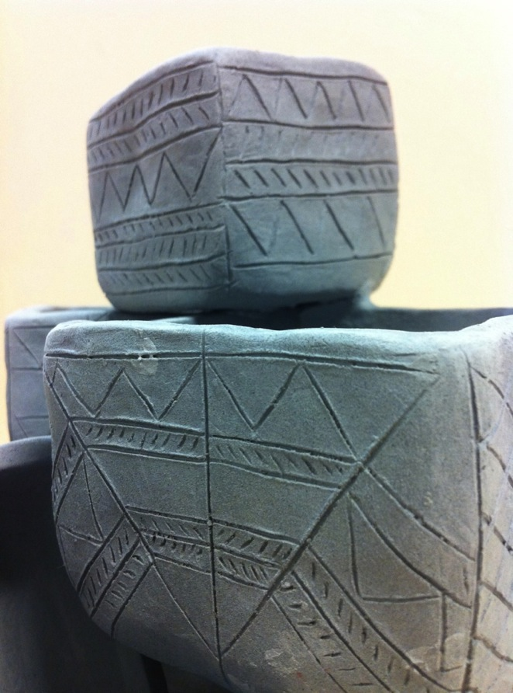
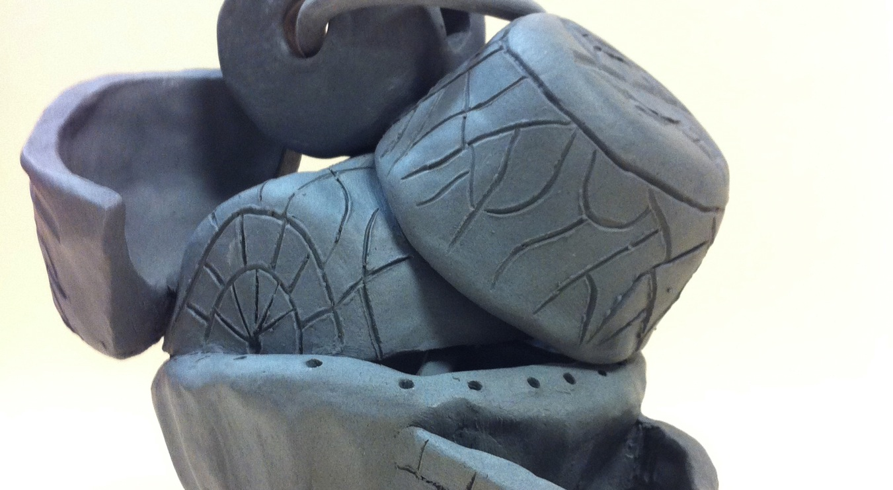
What are the 3 Surface Design Techniques?
Impression -Creating texture by pushing something into the leather-hard surface.
Incising- Decorating the surface of the clay by carving into leather-hard clay.
Notes:
Day 3

Slide 20
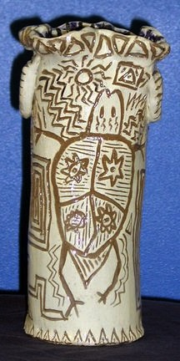
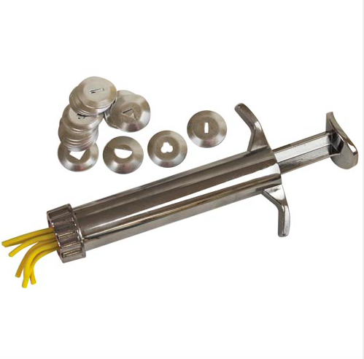
What are the 3 Surface Design Techniques?
Impression -Creating texture by pushing something into the leather-hard surface.
Incising- Decorating the surface of the clay by carving into leather-hard clay.
Inlay- Removing an area of clay to replace with another type of clay.
Clay extruder
Notes:
Day 4

Slide 21
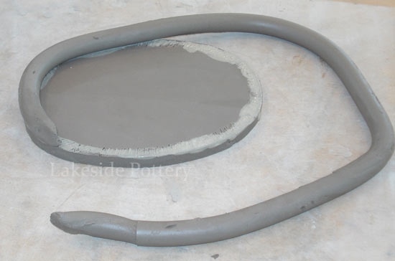
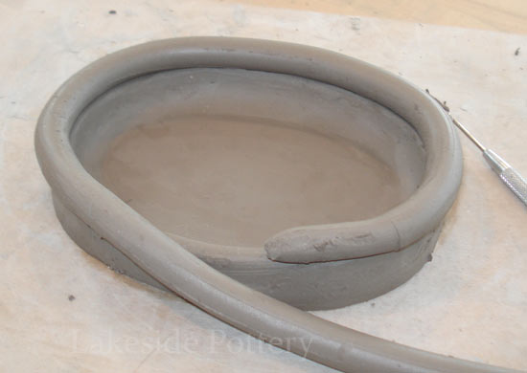
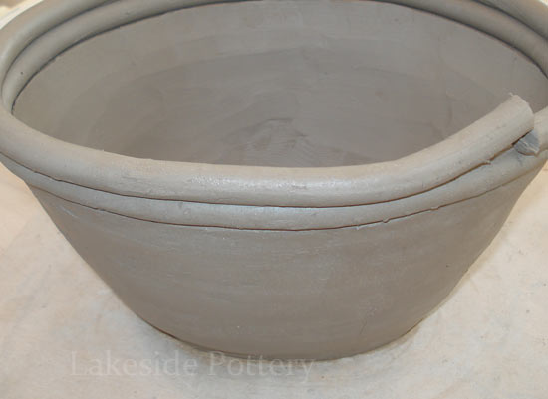
Goals for today/Day 1
I can…
Roll out a slab for the base/bottom of my vase.
(Use a circle shape to cut it out of the slab)
Add coils, slipping and scoring as I build.
Build the coils going out and not up

Slide 22
I CAN…
Smooth out my coils on the INSIDE and OUTSIDE of my vase

Slide 23
I CAN
Incise my designs that are inspired from the David Vases/Chinese culture, while filling the space
Notes:
Use a pencil for the incising

Slide 24
I CAN
Clean up my leatherhard clay so that it is ready to be fired

Slide 25
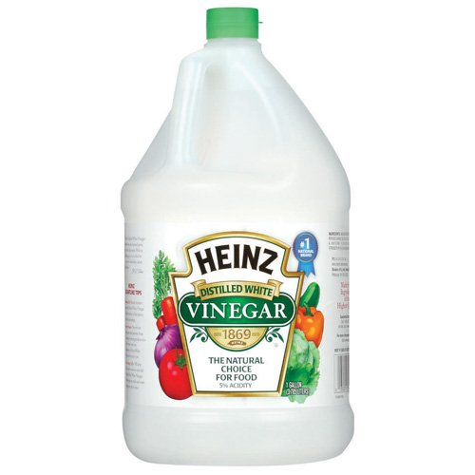
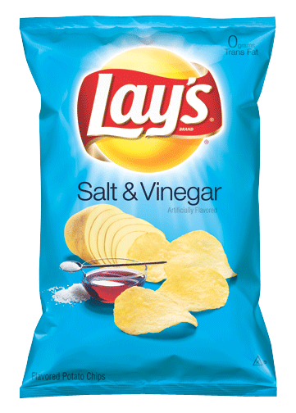
5. Vinegar
Notes:
Day 4

Slide 26
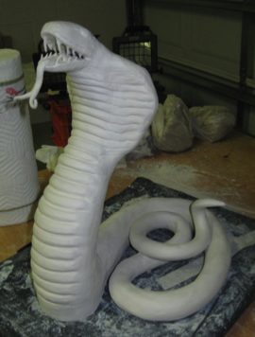
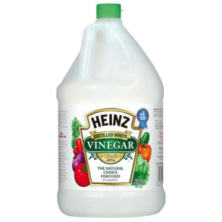
5. Vinegar
The acidity of vinegar makes it act like a glue for bone-dry clay. Apply it to both surfaces, slip & score, press the pieces together and smooth clay
Notes:
Day 4

Slide 27
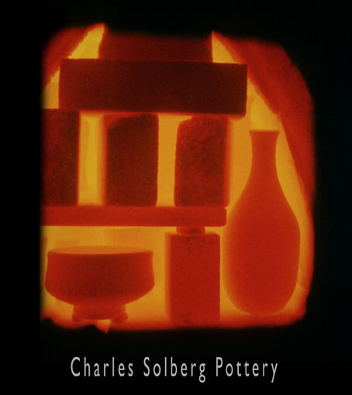
6. Firing- to heat clay in a kiln to the required temperature.

Slide 28
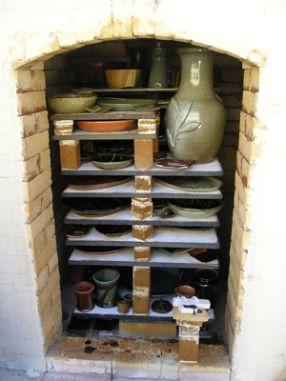
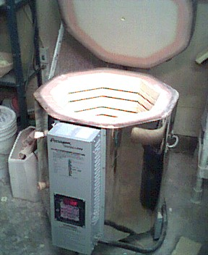
Vocab for Clay
Firing- to heat clay in a kiln to the required temperature.
7. Kiln- a furnace or oven for firing clay.
Notes:
Day 5

Slide 29
How hot do you think the kiln gets for firing greenware to bisqueware?
Notes:
Day 5

Slide 30
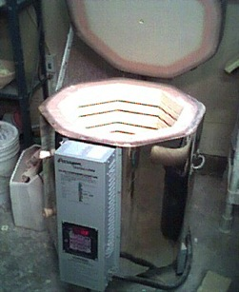
How hot do you think the kiln gets for firing greenware to bisqueware?
1888 degrees!
Notes:
Day 5

Slide 31
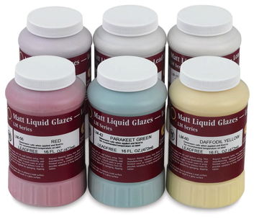
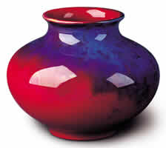
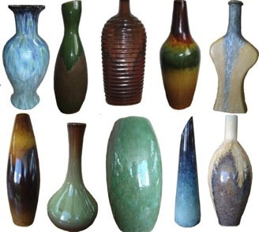
8. Glaze
Glaze- a coating chemically similar to glass, used on pottery as a finish. 3 coats is needed

