Slide 1
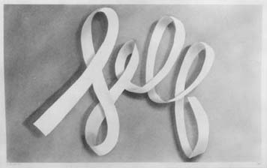
I can draw from observation a word-sculpture and make it appear 3D by using value.
Inspired by the work of Ed Ruscha.
3D Ribbon Letters
Notes:
Pre-test
Keep word sculpture in bin
Re-draw at end-of-semester for final
Reflection
2D-Advanced, instead of drawing- black and white or colored painting

Slide 2
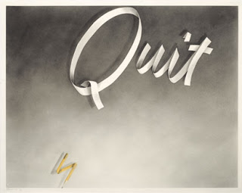
Notes:
Ed Ruscha, 1960’s, gunpowder and colored pencil on paper

Slide 3
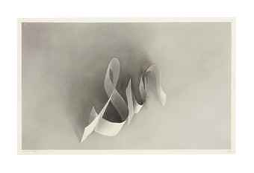
Notes:
Sin, in 2012 it sold for 962,500

Slide 4
Notes:
Ed Ruscha, painting
Example for 2D-Advanced

Slide 5
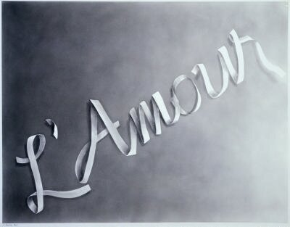

Slide 6
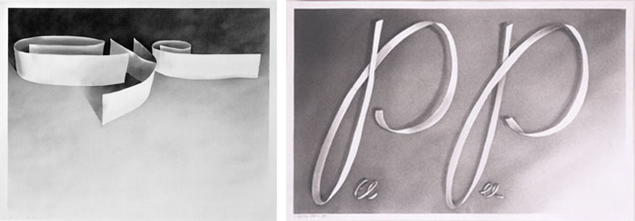
I can draw from observation a word-sculpture and make it appear 3D by using value.
Notes:
Gunpowder on paper

Slide 7
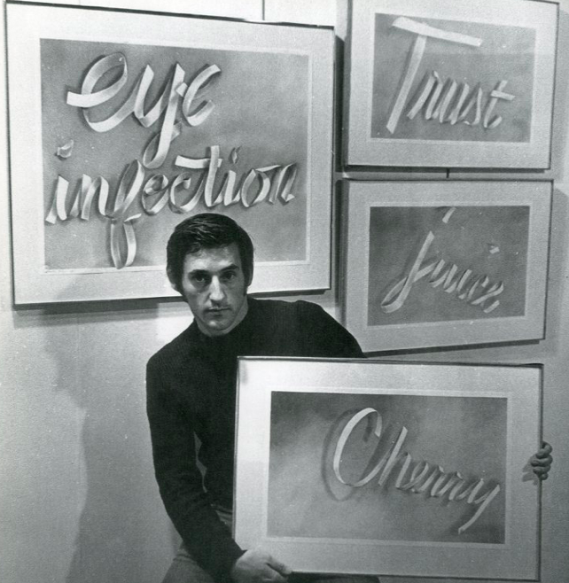
http://www.sfmoma.org/explore/multimedia/videos/189
Gunpowder as a medium
https://www.youtube.com/watch?v=h_jwq9BLVW0
I can draw from observation a word-sculpture and make it appear 3D by using value.
Notes:
Ed Ruscha, 1960’s

Slide 8
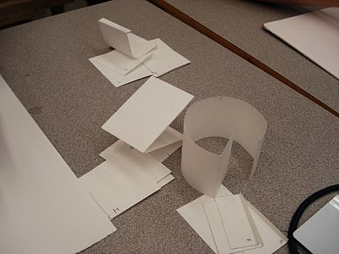
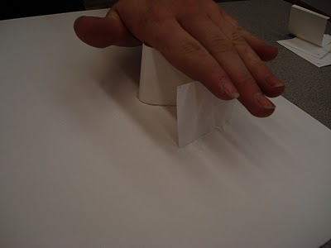
I can draw from observation a word-sculpture and make it appear 3D by using value.
Select a word that says something about YOU
Notes:
Use bristol paper to cut out and create letters. Hot glue letters to a base

Slide 9
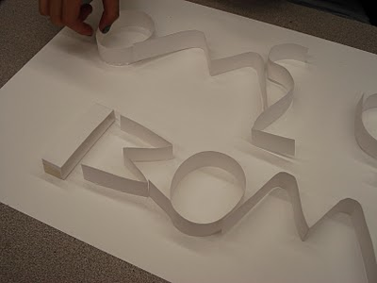
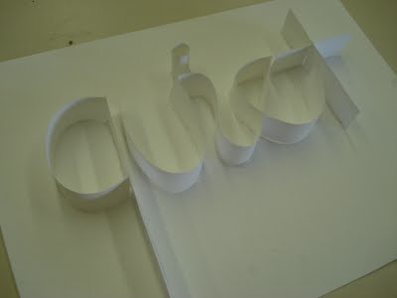
I can draw from observation a word-sculpture and make it appear 3D by using value.

Slide 10
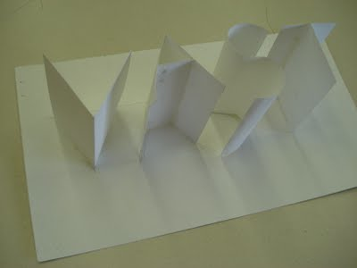
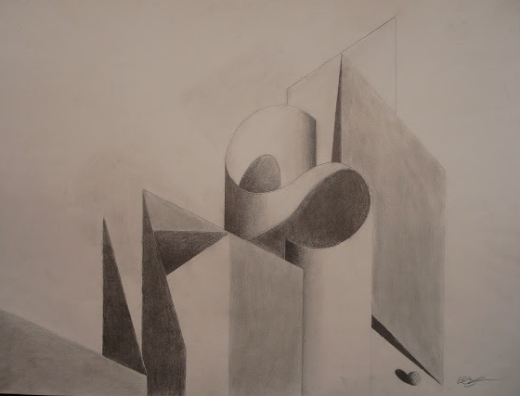
I can draw from observation a word-sculpture and make it appear 3D by using value.
Notes:
Light with a lamp to create strong shadows

Slide 11
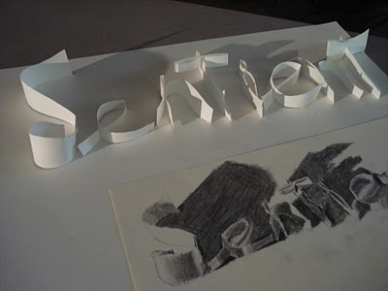
I can draw from observation a word-sculpture and make it appear 3D by using value.

Slide 12
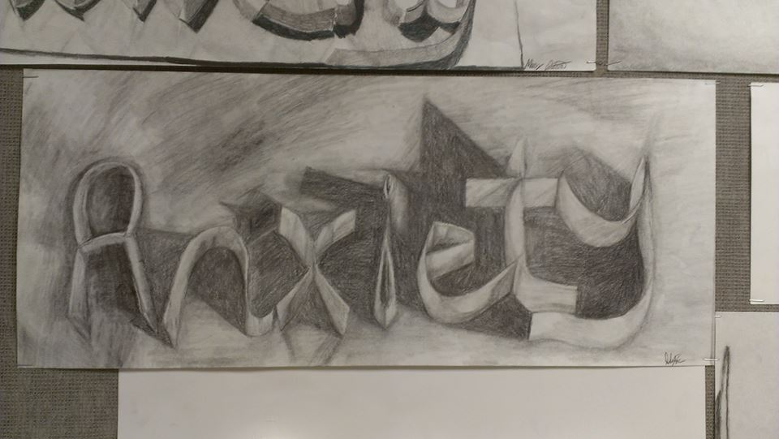
I can draw from observation a word-sculpture and make it appear 3D by using value.

Slide 13
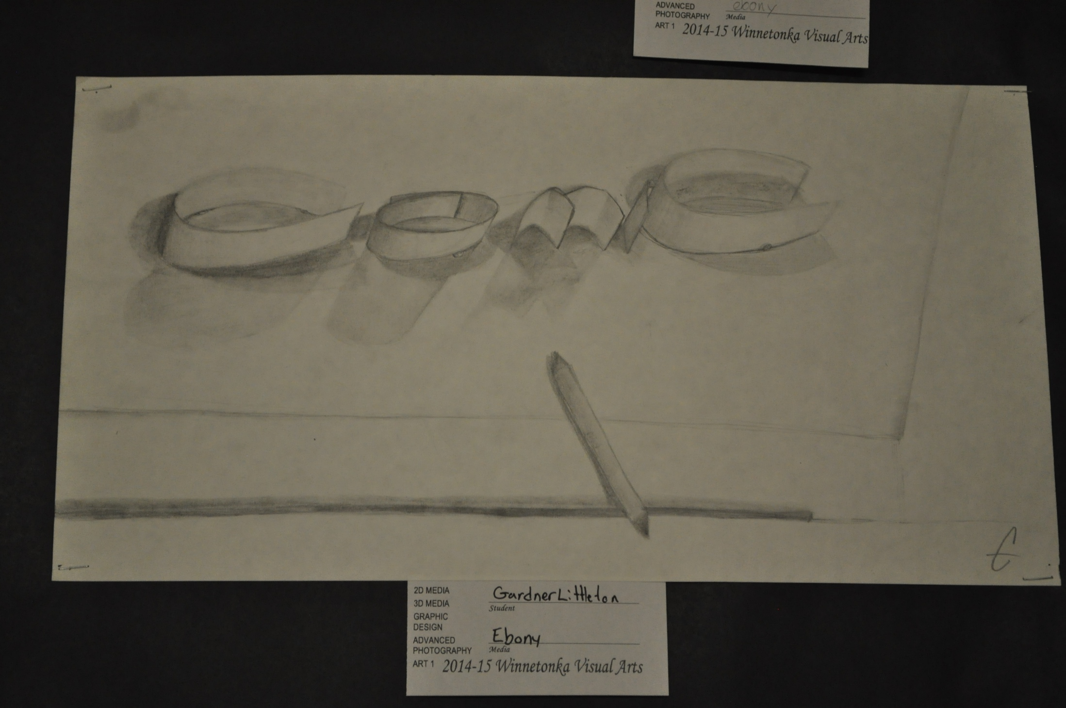
I can draw from observation a word-sculpture and make it appear 3D by using value.

Slide 14
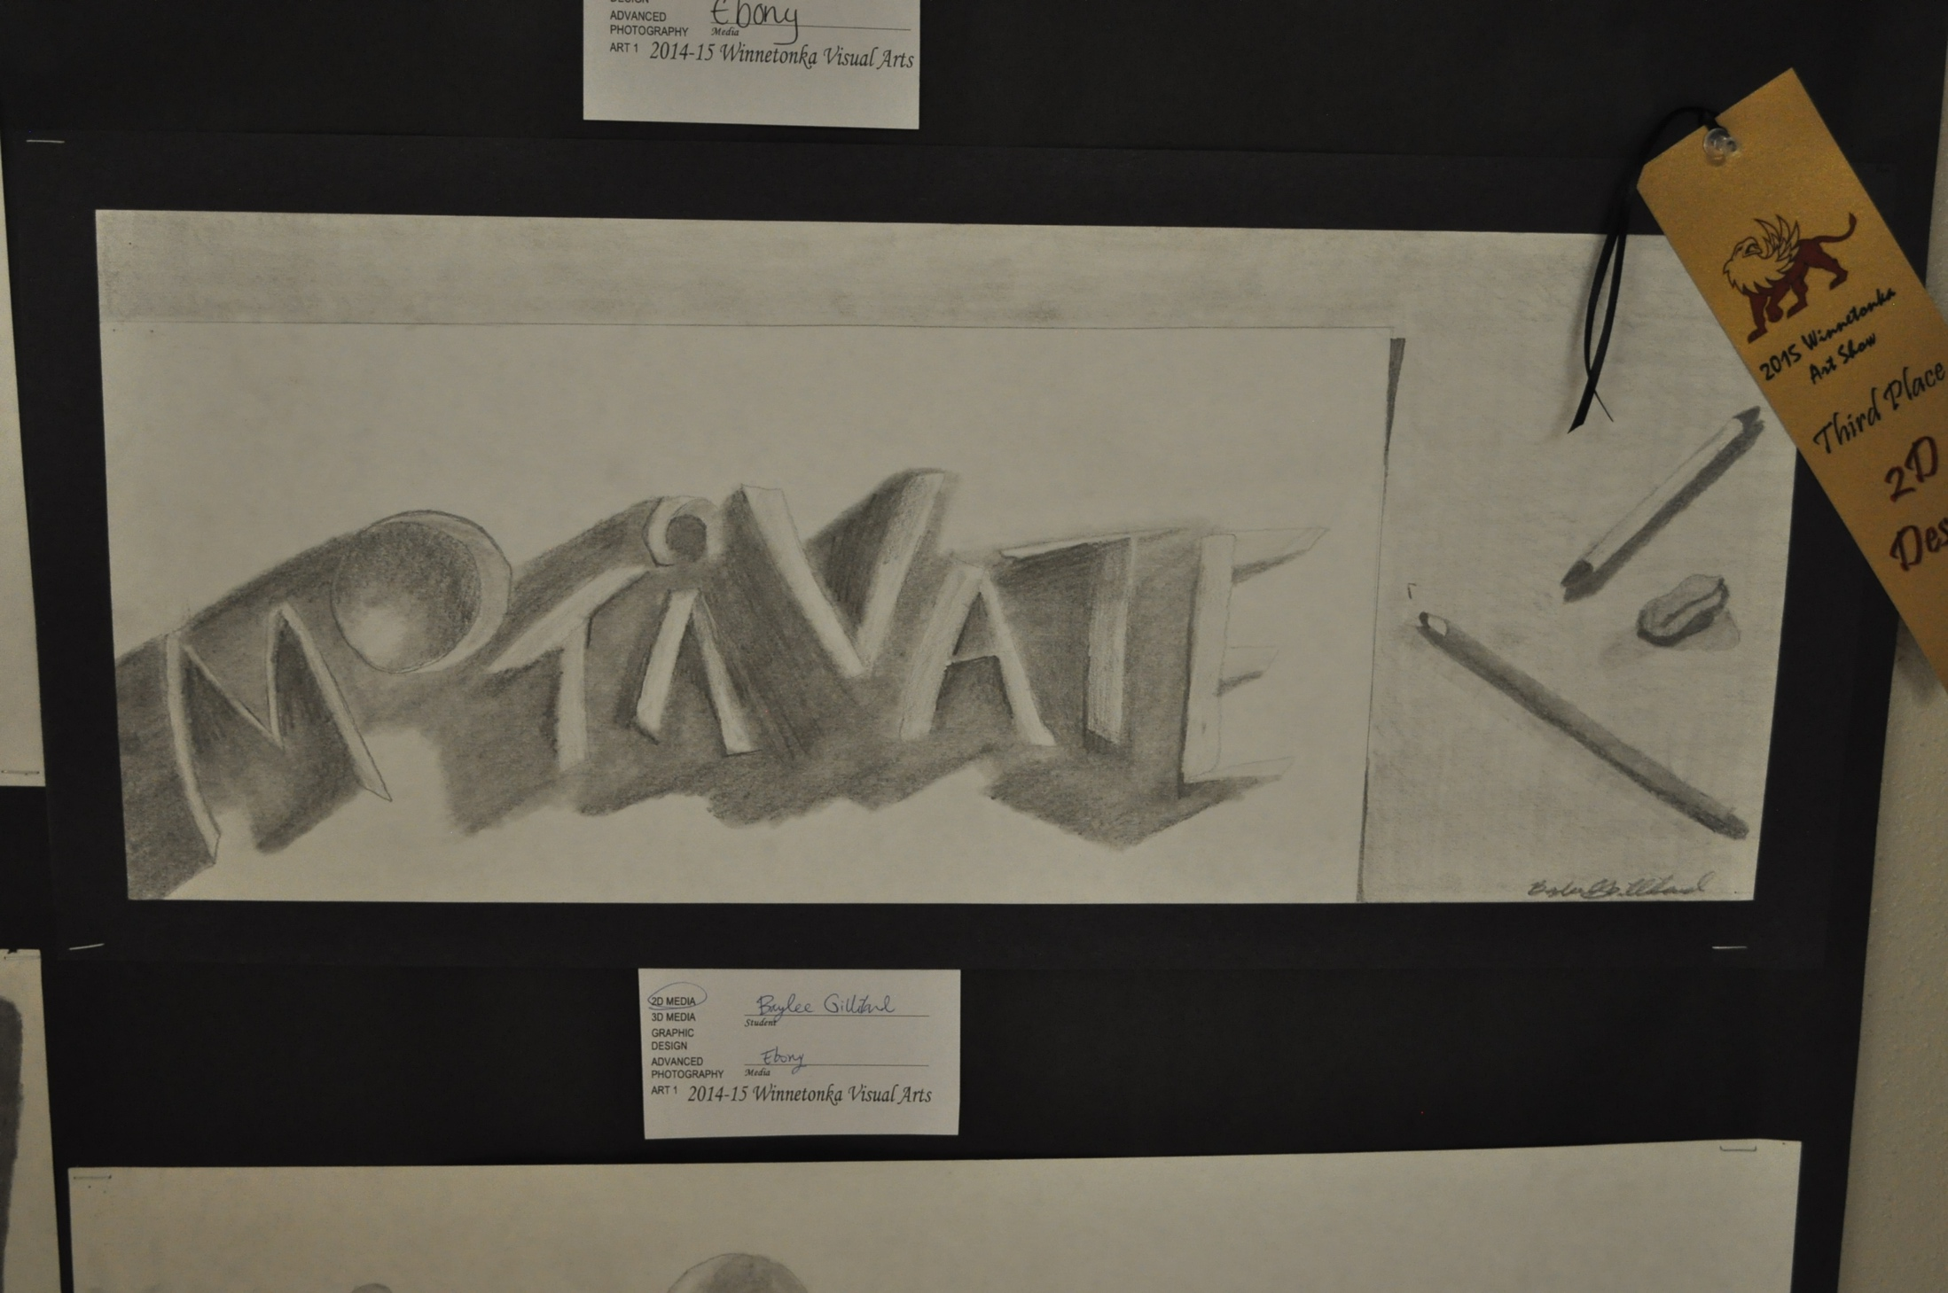
I can draw from observation a word-sculpture and make it appear 3D by using value.

Slide 15
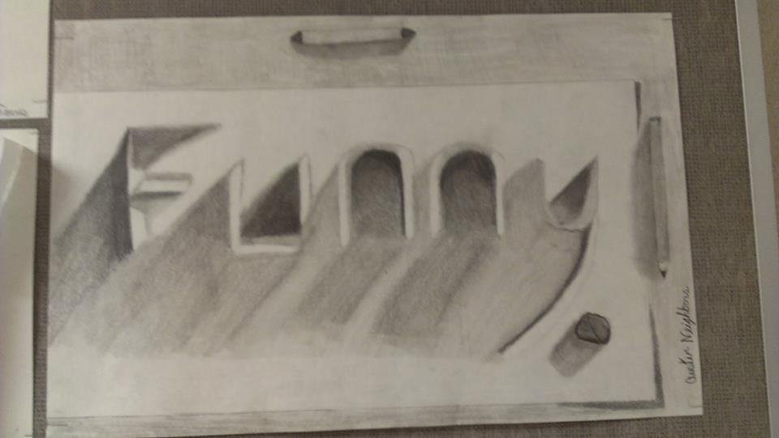
I can draw from observation a word-sculpture and make it appear 3D by using value.

Slide 16
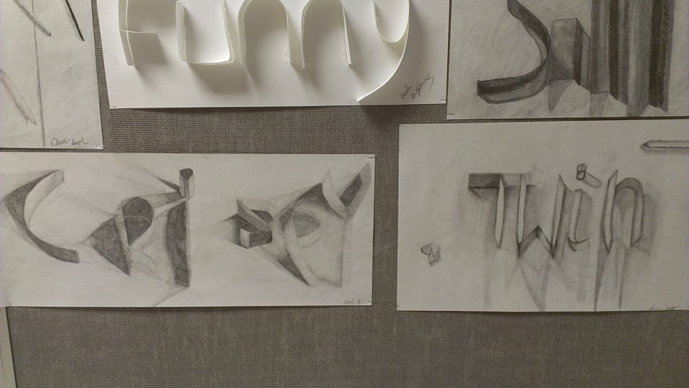
I can draw from observation a word-sculpture and make it appear 3D by using value.

Slide 17
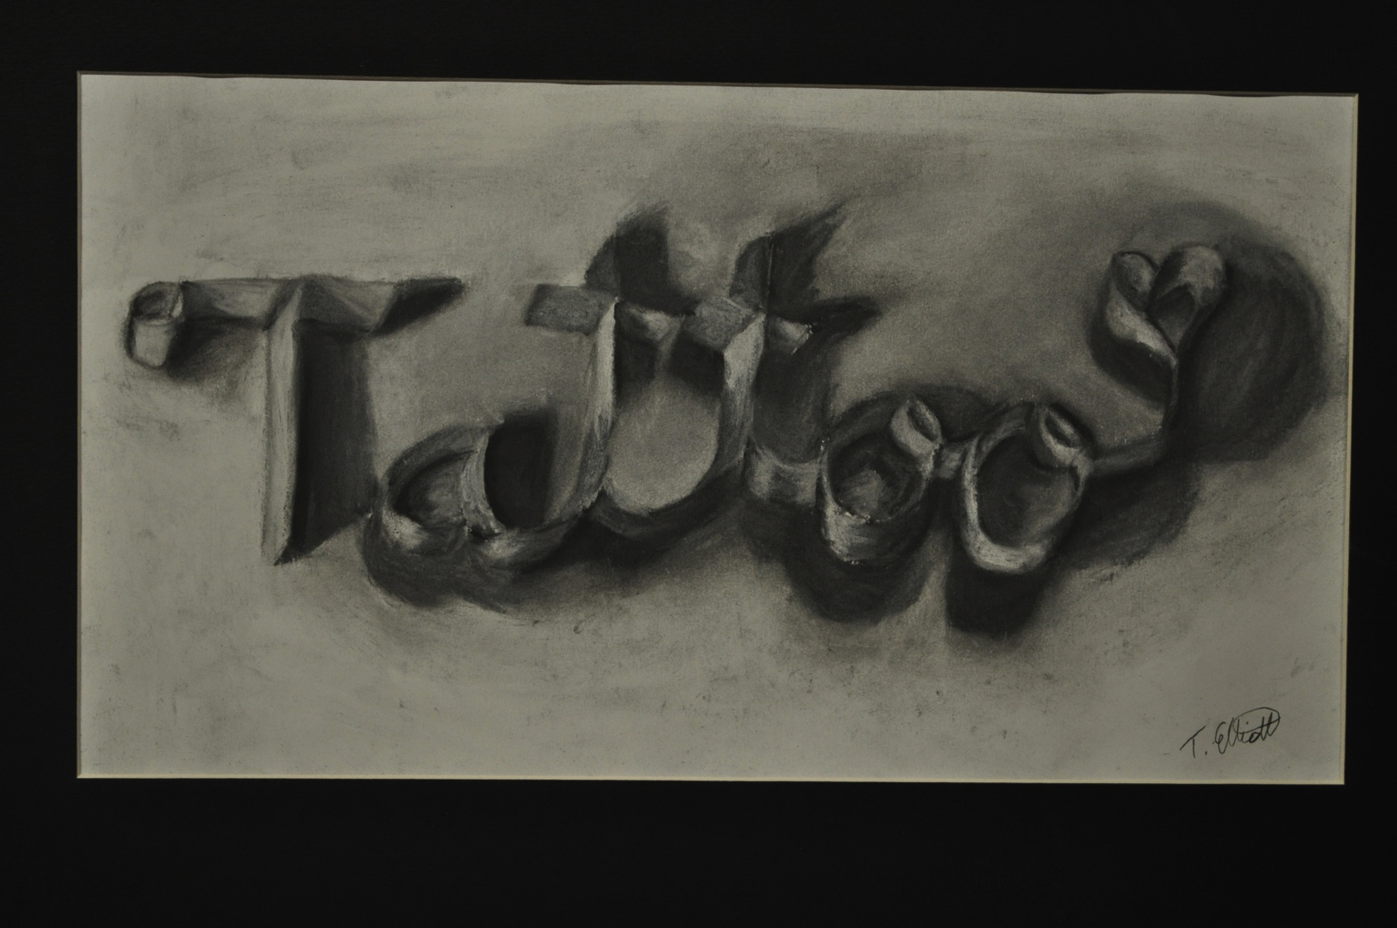
Notes:
Tanna Elliott, 2014

Slide 18
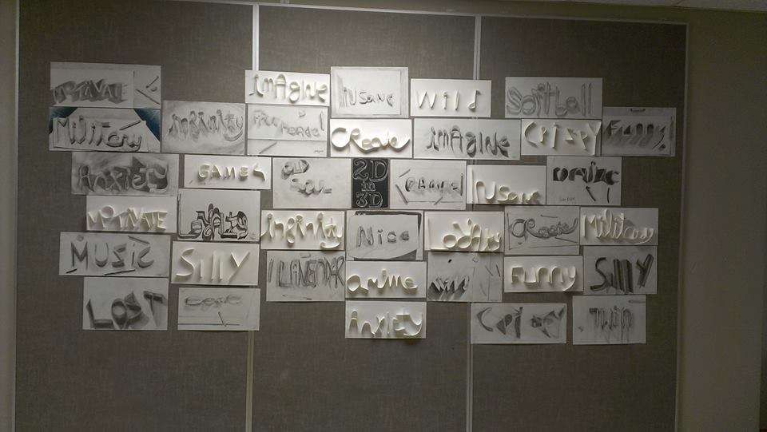
I can draw from observation a word-sculpture and make it appear 3D by using value.

Slide 19
What art movement(s)is he associated with?
I can draw from observation a word-sculpture and make it appear 3D by using value.
Notes:
Ed Ruscha, 1960’s
REVIEW/ second day… who is this guy?

Slide 20
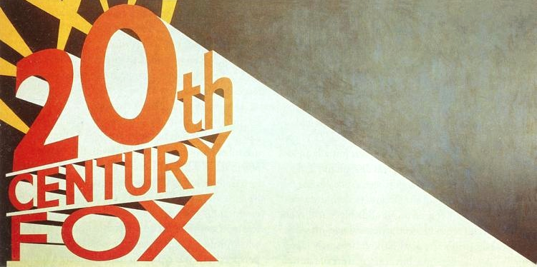
Pop Art
Surrealism
Conceptual Art

Slide 21
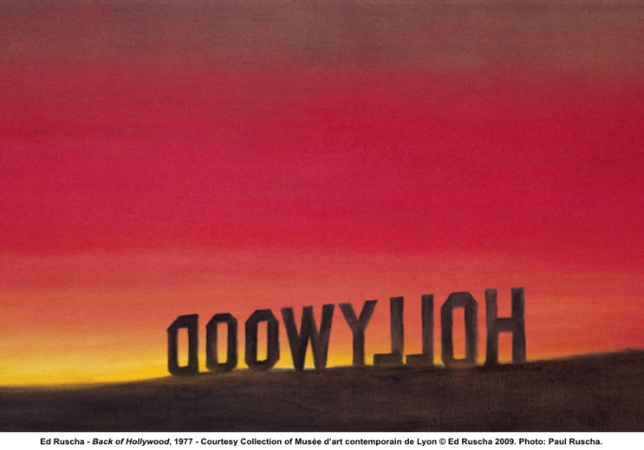

Slide 22
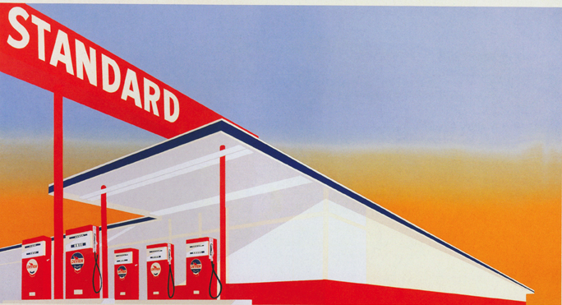

Slide 23
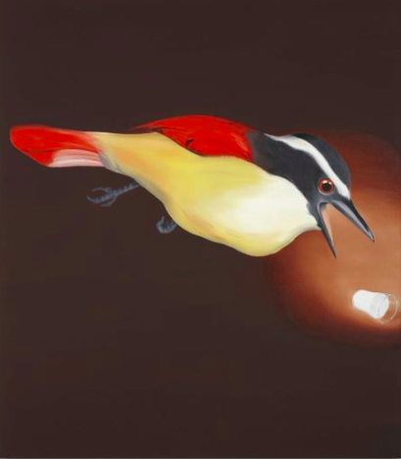
Surrealism
Angry Because it’s Plaster Not Milk, 1965
SOLD FOR $3,218,500

Slide 24
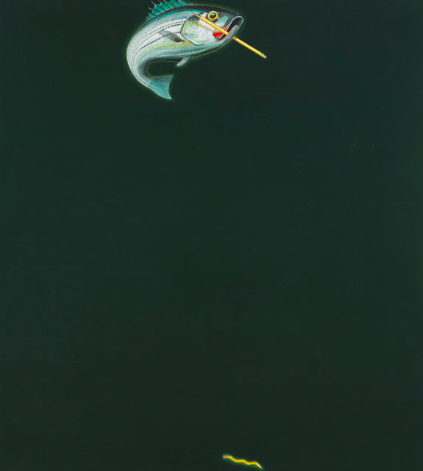
Surrealism
Strange Water for a Fresh Water Fish, 1965
Est: $3,000,000-4,000,000.

Slide 25
Notes:
Ed Ruscha, 1960’s, gunpowder and colored pencil on paper

Slide 26
Surrealism
throughout the 1970s, Ruscha experimented with a range of materials including gunpowder, vinyl, blood, red wine, fruit and vegetable juices, axle grease, chocolate syrup, tomato paste, bolognese sauce, cherry pie, coffee, caviar, daffodils, tulips, raw eggs and grass stains
Strange water for a fresh water fish, 1965
Est: $3,000,000-4,000,000.

Slide 27
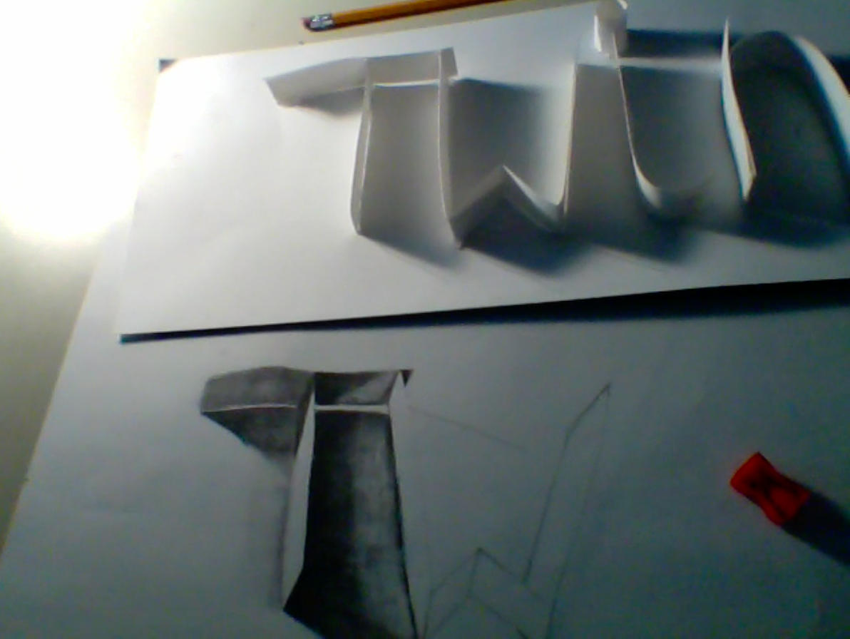
I can draw and shade from observation

Slide 28
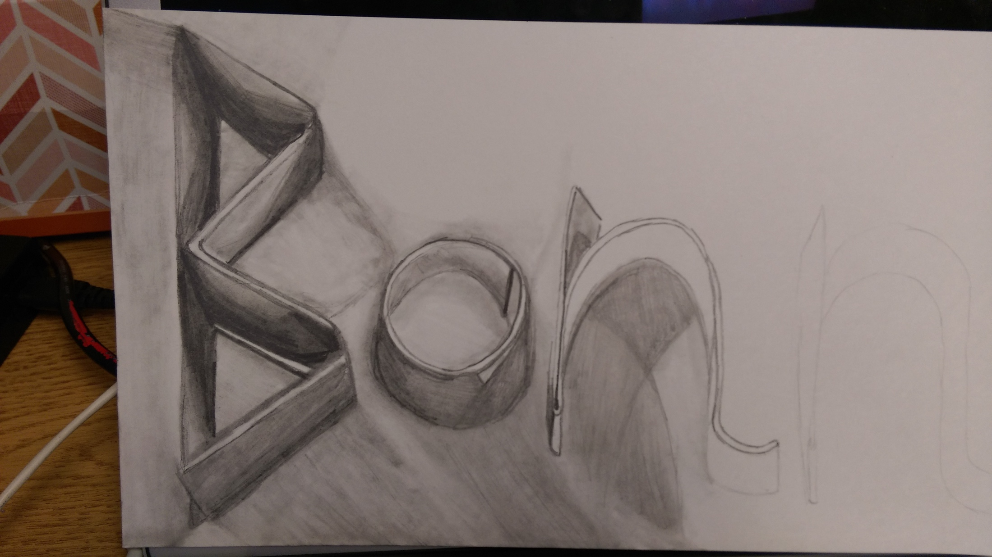
I can use value to hide the outlines of my drawing

Slide 29
Ed Ruscha-Written Reflection
Minimum of 3 sentences in your SB
Talk about the artist (what did he do, what materials did he work with, what art movements was he involved with?)
Talk about your own working process (easy, hard, what materials did you work with, what about it was easy or hard, if you could do it again, what would you do differently?)
Notes:
Last day, write on the back of grade sheet

Slide 30
Notes:
Examples of complete compositions
Destiny Thomas
Makayla Henderson

Slide 31
Notes:
Examples of complete compositions
Brittani Schneiter
Sydney Pope

Slide 32
Practice Assessment

Slide 33
Practice Assessment

Slide 34
Practice Assessment

Slide 35
2D/ Ed Ruscha WORD
Name Block
Proportions
4- The artwork is successfully drawn from observation giving it the illusion of a paper sculpture popping up off the page. All angles are correct, curves work out and lines are parallel when they should be.
3- The word could use some help in achieving the illusion on popping up off the page. Not all angles are correct, not all of the curves work out and not all lines are parallel when they should be.
2- Most angles are drawn incorrectly, most of the curves do not give the illusion of curving and most of the lines are not parallel
1- There was no or little attempt made to make to create the illusion of the word popping up on the paper.
Contrast
4- Values were used to depict the letters (not outlines) and the values range from light to dark. The values are both on the drawn-paper letters AND the cast shadows. The cast shadows have a harsh line when needed and fades out into a softer line as it gets farther away from the letter.
3-A few outlines are visible. The values are mostly dark or mostly too light.
2- Most of the outlines are visible
1- Value was not used to depict the form, all outlines are still visible
Composition
4- The entire composition is taken into consideration (with using values or drawing the table and space with tools), creating a unified, balanced work of art.
3- There is some empty space making the artwork feel unbalanced.
2- The tools drawn or the values used in the surrounding space is not done at the same level as the rest of the drawing
1- There is too much empty space, the composition was not taken into consideration,
Craftsmanship
4- The pencil marks are clean, neat and smooth. The lines have been properly smoothed out by the angle and pressure of the pencil and through the use of the tortillion (aka blending stump). The paper is not bent, ripped or creased.
3- There are a few crease marks on the sheet of paper. Some lines are still showing through in the chunks of values
2- The shading looks messy in areas but nice in some. There are a lot of crease marks on the paper.
1- The shading looks sloppy or messy throughout the whole piece. The paper looks like it’s been crumpled up, too many creases.
Final Grade:

Slide 36
Reflection in SB
Ed Ruscha-Written Reflection
Minimum of 3 sentences in your SB
Talk about the artist (what did he do, what materials did he work with, what art movements was he involved with? What do you think about his work?)
Talk about your own working process (easy, hard, what materials did you work with, what about it was easy or hard, if you could do it again, what would you do differently?)
In your sketchbook (sb), you should have your notes on the artist, a shaded square and this reflection. Your SB, you will be graded with this rubric…
Notes OR shaded square | Minimum of 3 sentence reflection
2 points | 3 points
/5=

